Slide 1
Advanced Integration Level Meeting
Office of Medical Student Education
Medical Student Services Team

Slide 2
Content Objectives
Overview of the Vermont Integrated Curriculum Schedule
Advanced Integration Level Requirements
  Graduation Requirements
  General vs. Surgery Major
  Teaching or Scholarly Project
  Electives (Clinical vs. Non-Clinical Electives)
  Away Rotations
Advising
Scheduling – OASIS
  Lotteries
  Add/Drop
  Vacation
General Residency Application Timeline
Student Panel

Slide 3
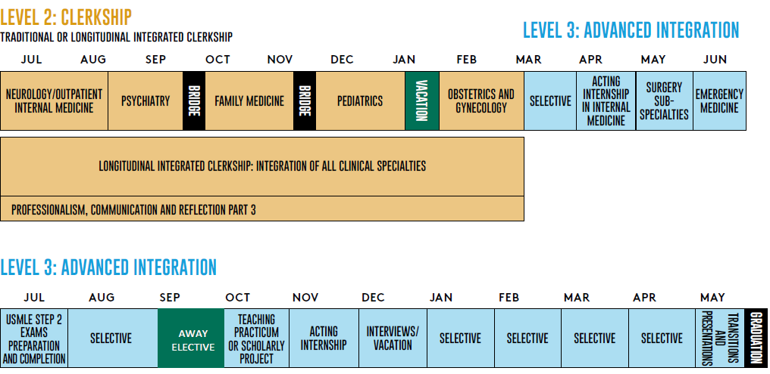
Vermont Integrated Curriculum Schedule
http://med.uvm.edu/docs/vic/medical-education-documents/vic.pdf

Slide 4
Advanced Integration Level
Requirements

Slide 5
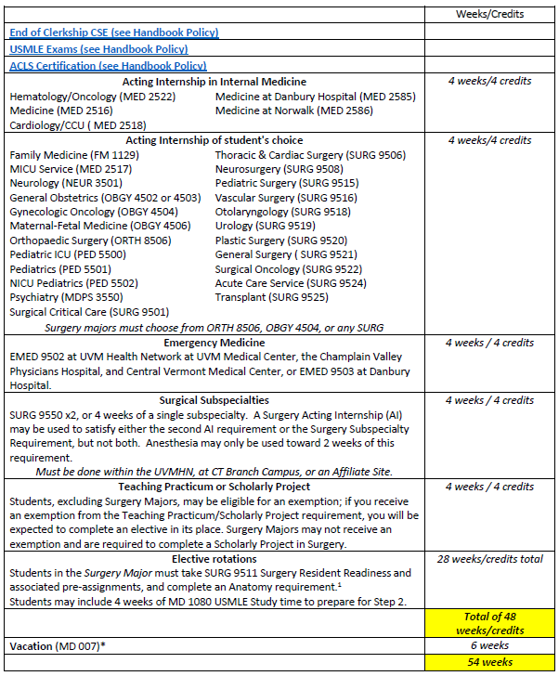
Advanced Integration Level Graduation Requirements
MICU Service (MED 2517) does not satisfy this requirement
http://contentmanager.med.uvm.edu/docs/graduationrequirements/medical-education-documents/graduationrequirements.pdf?sfvrsn=73c8b53_18
The Anatomy requirement for Surgery Majors may be satisfied by ANAT 1005 Clinical Anatomy, RAD 7501 Diagnostic Radiology, RAD 7509 General Radiology, PATH 1052 Autopsy/Neuropathology, PATH 1054 Pathology for the Clinical Physician.
Notes:
SURG 9550, Surgical Subspecialty rotation, is set up in 2-week blocks. If a student wishes to do 4 weeks of a subspecialty, but not the AI rotation, they can sign up for 2 2-week sections of the same thing, however Debbie can modify it to a 4-week block in OASIS.
Advanced Integration grading: H/P/F for 4-week clinical rotations and P/F for all 2-week courses, reading electives, research/TA, other non-clinical electives (like Medical Spanish).
If you receive an exemption from the Teaching Practicum/Scholarly Project requirement you will be expected to complete an elective in its place.
No double dipping
MICU Service (MED 2517) does NOT fulfill the IM Acting Internship requirement. It is a “choice” acting internship.

Slide 6
General vs. Surgery Major
General Major | Surgery Major
Surgical Subspecialties SURG 9550 (x2, or 4 weeks of a single subspecialty). A Surgery Acting Internship (AI) may be used to satisfy this requirement. Anesthesia may only be used toward 2 weeks of this requirement. Must be done within the UVMHN or at CT Campus | Additional 4 weeks of Surgery (may be a second Surgery AI)
4 weeks total | 4 weeks total
Teaching Practicum or Scholarly Project | Scholarly Project in Surgery
TA - 4 weeks; A 4-week rotation block may be dedicated to Scholarly Project work | A 4-week rotation block may be dedicated to Scholarly Project work
 | Surgery Resident Readiness course SURG 9511
 | 4 weeks
 | Anatomy Requirement a. Clinical Anatomy - ANAT 1005 b. Autopsy/Neuropathology – PATH 1052 c. Pathology for the Clinical Physician – PATH 1054 d. General Radiology – RAD 7509 e. Radiology Subspecialty – RAD 7501
 | 4 weeks
Emergency Medicine: EMED 9502 at UVM Health Network at UVM Medical Center, the Champlain Valley Physicians Hospital and Central Vermont Medical Center, or EMED 9503 in Danbury.
Notes:
ACLS certification will be required and will be offered through the Sim Lab.

Slide 7
Selecting the Surgery Major
Senior Student Director – Dr. Katelynn Ferranti
Student Coordinator – Debbie McDonald
Surgery Senior Major -
Students planning to do the Senior Surgery Major should identify themselves to Lisa Washburn and Emma Faustner by February 1, 2023. Please email them with the following information:
  the subspecialty you are interested in
  your contact information
  the name of your advisor.

Slide 8
Surgery Major Requirements
(in addition to the COM requirements)
Students wishing to sign-up for the Surgery Major, are requested to do so by 2/1/2023.
If a student wants to drop the surgery major, this must be done by the end of the workday on 8/31/2023.
Anatomy Requirement – students must complete one of the following by 3/1/2024
  Clinical Anatomy – ANAT 1005
  Autopsy/Neuropathology – PATH 1052
  Pathology for the Clinical Physician – PATH 1054
  General Radiology – RAD 7509
  Radiology Subspecialty – RAD 7501
Surgery Residency Readiness Course (SURG 9511)
  March 2024
  Attend all teaching and skills sessions
Participation in a surgery scholarly project

Slide 9
Surgery Subspecialty Requirement
SURG 9550
Requirements:
Four weeks of a subspecialty; this can be done in two two-week rotations of two different subspecialties or a full month of a single subspecialty (except Anesthesiology) between March 2023 and March 2024.
If you are doing two two-week subspecialties, these can be done in two different months.
Each two-week rotation must be for ten *full* weekdays.
Email Debbie McDonald to schedule your specific subspecialty at The University of Vermont Medical Center – except Anesthesia as indicated below.

Slide 10
Surgical Subspecialties
These rotations can be done in the same subspecialty or two different subspecialties including:
Anesthesia* (ANES 9550)
Cardiothoracic Surgery Pediatric Surgery
Gynecologic Oncology – contact Sara Tourville Plastic Surgery
Interventional Radiology (RAD7520) SICU
Neurosurgery Surgical Oncology
Ophthalmology Trauma Surgery
Orthopedics Urogynecology (OBGY4526)
Otolaryngology Vascular Surgery
Other subspecialties may be considered but the criteria include pre-operative assessment, intra-operative assessment, and post-operative management.
*Anesthesia may only be used toward 2 weeks of this requirement.
For more information, please visit our course on VIC Portal “Surgery Advanced Integration Course”

Slide 11
Teaching / Scholarly Project
Options:
  Teaching in a VIC Foundations Course
  Research and communication
Exemptions: Deadline – January 15, 2023
  PhD or Master’s Degree in a scientific discipline
  Significant laboratory experience and first authorship
  Masters or doctorate in education with scientific focus
  Teaching certificate and one year’s experience teaching in a scientific field.
  Contact Dr. Eileen CichoskiKelly with questions or to request an exemption.
Notes:
Current course director: Dr. Eileen CichoskiKelly (Eileen.CichoskiKelly@uvm.edu).

Slide 12
Electives
Elective rotations to total 28 weeks
May include 4 weeks of USMLE Study Period MD-1080 to prepare for Step 2
No limit on clinical versus non-clinical electives

Slide 13
Intramurals vs. Extramurals
Course Number 1095
A rotation that does not currently exist in the official catalog but will be supervised and assessed by a member of the LCOM faculty
Includes rotations done at the CT campus (Danbury/Norwalk) which are not yet in the catalog.
May need to be approved by the Medical Education Leadership Team (MELT)
Course Number 1090
Any rotation done outside of the UVM LCOM system under the supervision of non-faculty
Must be approved by the Medical Education Leadership Team (MELT) if it is not on the List of Approved Extramurals posted on the Preparing for Advanced Integration web page.

Slide 14
Extramurals
  All extramurals must be approved in advance. Credit cannot be granted for unapproved extramurals. A list of pre-approved extramurals is available on the Advanced Integration section of the website.
  Extramural information will be entered into OASIS and approval will be granted via OASIS when the rotation is added to the student’s schedule.
  Preparation for Extramurals can begin in advance. Most LCME accredited medical schools use the AAMC’s Visiting Student Learning Opportunities (VSLO) to process applications.
    To get started, send an email request for a VSLO invitation to Emma.Faustner@med.uvm.edu.
    You will receive an email from VSLO with instructions on logging in and starting the application process.

Slide 15
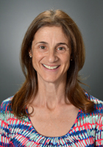
Dr. Nathalie Feldman
Director of the Learning Environment
Contact Info:
89 Beaumont Ave.
Given D-103
Burlington, VT 05405
Phone: (802) 656-5466 (office)
(802) 316-7715 (cell)
Email: nathalie.feldman@med.uvm.edu
Sign-Up for a Drop-in Meeting...

Slide 16
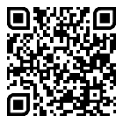
Learning Environment Reporting-Written
Clerkship and Advanced Integration Level Evaluation Form:
  Please identify one or more individuals who demonstrated exemplary professionalism and respectful behavior during the clerkship.
  Did you experience or observe any disrespectful or unprofessional behavior(s) during this clerkship?”
Confidential Web Based Learning Environment Reporting form:
  http://www.med.uvm.edu/mededucation/learningoverview
  You can access this form directly by scanning the QR code found on your new “Health Care During Clinical Rotations” and “Our Culture of Respect” card, which was distributed with your new badge earlier this year.
Password located on your badge
Notes:
This person could be an attending, resident, nurse, staff member or allied health care professional. In the space below, please tell us why you chose to recognize this/these individual(s).
If so, in an effort to enhance our learning environment, we strongly encourage you to share your experience(s) and/or concern(s) with us. In order for the COM to make improvements based on your feedback, it is important that you provide us with as many details as possible, including the specific circumstances and individuals involved. Please note that no action will be taken until 42 days have expired and final grades are submitted. To ensure anonymity if desired, please submit your comments by clicking on the confidential web-based link below, using the password “climate1802

Slide 17
Advising

Slide 18
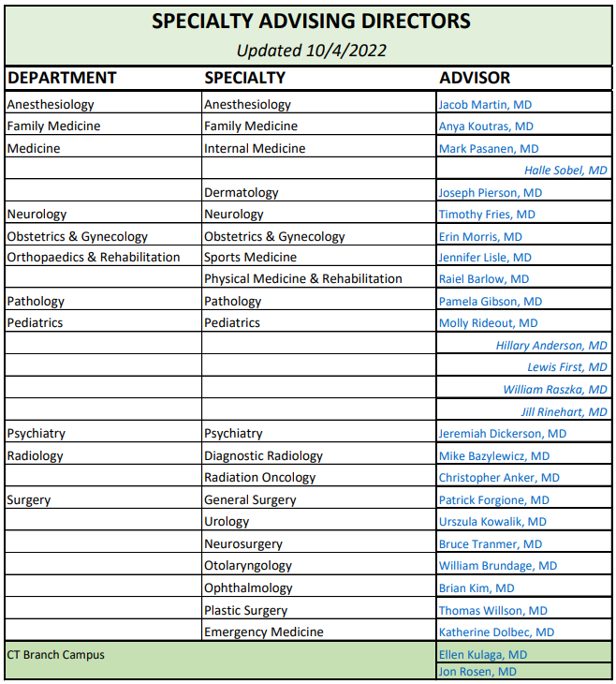
Specialty Advising Directors
http://med.uvm.edu/docs/lcom_specialtyadvising/medical-education-documents/student-affairs/lcom_specialtyadvisors.pdf

Slide 19
Identifying an Advisor in OASIS
All students are required to have an approved subspecialty advisor identified in the OASIS year labeled Advanced Integration Level prior to the fourth-year lotteries. Students may ask their PCR Mentor to serve as their Subspecialty Advisor. Students may change advisors at any time; however, this type of advisor is required.
Choose ADVISING>click on REQUEST ADVISOR next to “My Subspecialty Advisor” to initiate an email to your advisor of choice. [Detailed instructions are located in the Student User Guide.]
The deadline for identifying your subspecialty advisor is 12/2/22. It is very important that you enter OASIS via the 2023-2024 Advanced Integration Level Year when requesting an advisor; otherwise, your request will not appear in the correct year and will not satisfy the fourth-year requirement. Do NOT enter via 2022-2023 Clerkship Level Year to select an advisor!

Slide 20
Scheduling Rotations
& the Lotteries

Slide 21
Scheduling
Elective time periods:
2023 | March 20 - 31
 | April 3 - 28
 | May 1 – 26*
 | June 5 - 30
 | July 3 - 28
 | July 31 -25*
 | September 4 - 29
 | October 2 - 27
 | October 30 - November 24
 | November 27– December 22*
2024 | January 1 -26
 | January 29 – February 23
 | February 26 – March 22*
 | April 1-26
  Rotations must be either 2 or 4 weeks long. We cannot accommodate 1- or 3-week rotations.
  The general rotation blocks will likely be scheduled as follows:
  http://contentmanager.med.uvm.edu/docs/2024academiccalendar/medical-education-documents/2024academiccalendar.pdf
  All enrollment blocks must be scheduled (not during lotteries)
*denotes gap weeks

Slide 22
Lottery Schedule
Lottery I: Top Choice
Selection Period Opens: Monday, 1/9, noon
Selection Period Closes: Tuesday, 1/10, noon
Results Posted: Wednesday, 1/11
Lottery II: Second Choice
Selection Period Opens: Thursday, 1/12, noon
Selection Period Closes: Friday, 1/13, noon
Results Posted: Tuesday, 1/17
Lottery III: CT Campus IM Acting Internship/Emergency Medicine
Selection Period Opens: Wednesday, 1/18, noon
Selection Period Closes: Thursday, 1/19, noon
Results Posted: Wednesday, 1/25 (with VT Campus results)
Lottery IV: VT Campus IM Acting Internship/Emergency Medicine
Selection Period Opens: Monday, 1/23, noon
Selection Period Closes: Tuesday, 1/24, noon
Results Posted: Wednesday, 1/25
Lottery IV: Electives
Selection Period Opens: Thursday, 1/26, noon
Selection Period Closes: Monday, 1/30, noon
Results Posted: Tuesday, 1/31
Add/Drop
Opens: Tuesday, 1/31, 4:00 p.m.
Two “top choice” lottery stages: max 1 placement per round (2 total possible)
Campus-specific IM/EM stages: max 2 placements, all will have both IM and EM placements following this round, limited to 1 of each max
An Electives lottery: many placements possible, participation is optional
And Add/Drop

Slide 23
Before the Lotteries
October - December
Test your log-in to OASIS.
Browse 2023-2024 Advanced Integration Level offerings.
Identify a Subspecialty Advisor relationship in OASIS.
  This is due by December 2, 2022
  Please communicate with your selected advisor before contacting them in OASIS
You may find the worksheet included in the User Guide helpful for planning your lottery selections. (This is not required, only a resource.)
Notes:
OASIS User Guide url: http://med.uvm.edu/docs/advint_studentuserguide/medical-education-documents/student-affairs/advint_studentuserguide.pdf

Slide 24
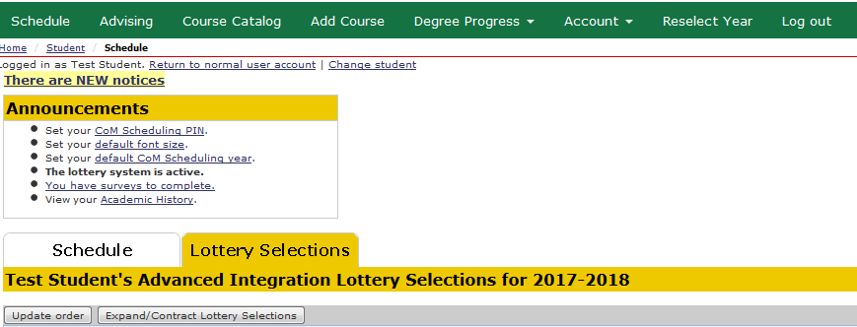
During the Lotteries
Choose “Add Course” to make your selections.
Choose “Lottery Selections” tab to review and re-order your selections
Once your selections appear in the Lottery Selections tab, you may log-out any time

Slide 25
After the Lotteries:
Add/Drop Period
Choose “Schedule” to view your placements
Make any necessary changes to your schedule by:
A) Choosing “Add Course” to add, or
B) Choosing “Schedule” to drop a course

Slide 26
Helpful Lottery Tips
Limiting your number of lottery selections will NOT improve your chances of being placed!
There is no limit to how many selections you can make. It is a good idea to make more selections for the best chances of being placed in one of your preferences. Said differently, do not overly limit your selections in the first lottery. If not placed in your top choice, your back-up choices may not be available in the next lottery if other students included them in their selections.
There is NO advantage to logging in to a lottery first.
Lottery participants are chosen at random by the software and then placed according to ranked preferences, not log-in time. In fact, server speed will be slow during the first hours of a lottery because so many users try to access the software simultaneously.
Change your COMIS password before the lotteries open if it is due to expire soon. If your log-in does expire, there is a link to reset the password on the VIC Portal log-in page.

Slide 27
Helpful Lottery Tips (continued)
Selections in subsequent lotteries may not have a time conflict with offerings confirmed to your schedule through a previous lottery.
  You may NOT drop administratively assigned clerkships.
  You may drop placements from previous lotteries to make new selections. However once dropped, the spot is immediately available to others to add to their selections. You may re-add it to your selections, but there is no guarantee that the current lottery will place you in the spot again.
  Regarding the ability to drop: The lotteries override many add/drop course restrictions. Once the lotteries close and the add/drop period opens, you will not be able to drop restricted courses without contacting the course coordinator for departmental approval.

Slide 28
Helpful Lottery Tips (continued)
You may not schedule any departmental offering until after the prerequisite clerkship has been completed. SURG-615 is a prerequisite for Emergency Medicine, Anesthesiology and Orthopedics offerings. Both Medicine clerkships, MED-618 and MED-619, are prerequisites for Medicine, Pathology, Radiology and Anesthesiology.
Requests for extra days off may not be accommodated during acting internship months. Please plan residency interview schedule accordingly in November, December, and January. An ample number of acting internship slots are available with the addition of new locations.

Slide 29
Additional Info
The initial lottery stages will include all Medicine Acting Internships, all Specialty Acting Internships, and the required Emergency Medicine course. Students may decide in which of these stages to select their requirements. However, any student who emerges from the lottery without a Medicine AI and/or Emergency Medicine course will be randomly assigned these rotations by the software prior to opening of the final Electives lottery.
Students must enroll in the required IM AI and EM course at their assigned campus. Connecticut Campus students who wish to enroll in an internal medicine acting internship and/or a required emergency medicine course at the Vermont Campus, or vice-versa, must request this exemption via OASIS no later than December 2 for Associate/Assistant Dean for Students consideration.
Students who do not participate in lotteries will not be assigned a second AI prior to the Electives lottery.
The electives lottery stage will include most subspecialty AI rotations with open spots. Extra spots in Pediatrics acting internships will be available in the Electives lottery; however, students may not schedule more than one Pediatrics acting internship through the lotteries. If space remains when the lotteries close, students should contact the departmental coordinator to add a second AI.
At the discretion of the department, some courses are view-only during the lottery stages. Students must wait to add these courses to their schedule during Add/Drop. Examples include away rotations, teaching requirements, vacations and other courses that require the student to enter individualized information for their enrollment to be approved by the department (i.e., reading and research months, as well as 2-week surgery subspecialty rotations).

Slide 30
Additional Info (continued)
It is your responsibility to maintain an up-to-date schedule in OASIS. All enrollment blocks must be scheduled by graduation; use vacation for weeks when you are not enrolled in courses. No enrollment is required for gap weeks (per the class academic calendar).
Until you are approved by the course coordinator from a waitlist, you are not officially enrolled in a course.
You may not add a course, or be added to a course from a waitlist, until you drop any conflicting courses on your schedule.
When in doubt about your enrollment status in a course or you are unable to add/drop a course from your schedule, contact the course coordinator.

Slide 31
Additional Info (continued)
Delayed USMLE Step 1 Exam
The USMLE Step 1 Exam is a prerequisite for all Advanced Integration Level clinical rotations. If the student has not taken the exam prior to the lotteries, they are required to secure an exam date through the NBME prior to the lotteries. This exam date will be reflected on their fourth-year schedule as a locked enrollment. The student will be permitted to participate in the lotteries so long as they have an exam date; however, their ability to schedule clinical rotations will be limited to dates after their Step Exam date.
If at any time the student later changes their exam date, they are required to inform the Director of Academic Achievement and LCOM Registrar so that the exam date in OASIS can be adjusted, and to drop all clinical rotations scheduled to begin before the exam is taken. In many instances the student will need to work with the course coordinator to drop the course(s).
If a USMLE Exam date is not secured prior to the lotteries, the student will not be permitted to participate in the lottery process. They will need to work with the internal medicine acting internship and required emergency medicine course coordinators to schedule these required courses after the lottery process once they have scheduled their exam.

Slide 32
Applying for Residency

Slide 33
General Residency Application Timeline
January – March: Finalize senior schedule in consultation with your faculty advisor and Dean for Students
March: MSPE information is distributed to the class
Mid – late spring: ERAS opens for students to begin their applications
April – September: MSPE meetings scheduled with the Dean for Students. MSPE information due 1 week prior to your meeting. Take USMLE Step 2 CK. Review information about residency programs via their Internet web site. Meet with your advisor to discuss preliminary list of programs. Prepare Curriculum Vitae (CV) and Personal Statement. Enter information into the ERAS system.
Late September: NRMP Registration opens. Recommended deadline for receiving Letters of Recommendation. ERAS applications can be transmitted to programs. Students review MSPE for factual accuracy.
Late September: MSPEs are released.
October – January: Interviews with residency programs.
November 30: NRMP early registration deadline: 11:59pm EST.
Mid-January: Rank Order List entry begins: noon EST
Mid-February: Finalize rank list in consultation with your faculty advisor. ROL certification deadline: 9pm EST. Late NRMP registration deadline
Mid-March: Match Week. Match Day is March 15, 2024!

Slide 34
The Medical Student Performance Evaluation
Formerly known as the Dean’s Letter
An MSPE will be written for each student.
  You will provide information for your MSPE
    Identifying Information
    Noteworthy Characteristics
MSPEs DO NOT count as Letters of Recommendation
All MSPEs will be released together in late September, 2023.
You can and are expected to review this letter. Make sure you do this as soon as your letter is ready for review!
A Residency Advising Meeting is required before end of August to discuss your residency application and draft your MSPE
The MSPE is a summary letter of evaluation, not a letter of recommendation.
View an example online at:
https://www.aamc.org/download/463314/data/mockmspesummary-april2016.pdf

Slide 35
Grade Appeal Process
  A student who disagrees with a final grade may appeal it via discussion of the matter with the course or rotation director.
  The initial appeal must be initiated within fourteen calendar days of the receipt of the grade or evaluation
  If you consider appealing a grade, please review the Medical Student Handbook Policy 540.60 – Grade and Narrative Assessment Appeals carefully prior to moving forward to ensure you are aligning to our institutional policies and procedures

Slide 36
Student Financial Services: Away Electives and Residency Interviews
Use caution with private "Residency Relocation Loans" and contact SFS before using
Away rotation costs can sometimes be covered by extra loans, only if UVMMC and surrounding areas do not offer the equivalent here (requires appeal - contact SFS)
You may complete appeal form for extra federal loan funds (above and beyond regular financial aid budget) to cover ERAS, interview travel, etc- administratively easier to wait until interviews are over and do one reimbursement. Document expenses!!
Always contact SFS for forms, instructions, etc. (MedSFS@uvm.edu)

Slide 37
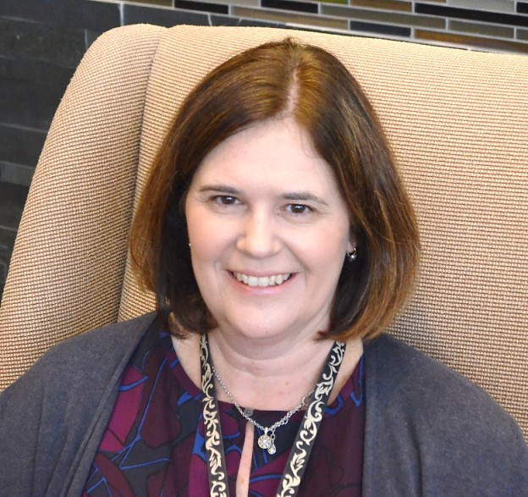
Connecticut Campus
  Students rotating in Connecticut during their Advanced Integration Year
  CONTACT:
  Dr. Ellen Kulaga, Assistant Dean for Students, Connecticut Campus
  ellen.kulaga@med.uvm.edu

Slide 38
Any Additional Questions?
Frequently Asked Questions page
The memo from the Deans, providing overview information
OASIS User Guide
The Advanced Integration Coordinator
Drop-in Meeting Sign-Ups:
  With Dr. Rosen, Director of Student Wellbeing
  With Dr. Karen George, Associate Dean for Students, or Dr. DeAngelis, Dr. McNamara, Dr. Kulaga, Assistant Deans for Students
  With Dr. Nathalie Feldman, Director of the Learning Environment

