Slide 1
Preparing for Advanced Integration Level
Office of Medical Education Medical Student Services Team
Karen George, MD, MPH, associate dean for students
Ellen kulaga MD, Assistant dean for students, ct
Katie DolBec, MD Assistant dean for students, Vt
Melissa long, Lcom registrar
Emma Faustner, Ai and residency placement coordinator

Slide 2
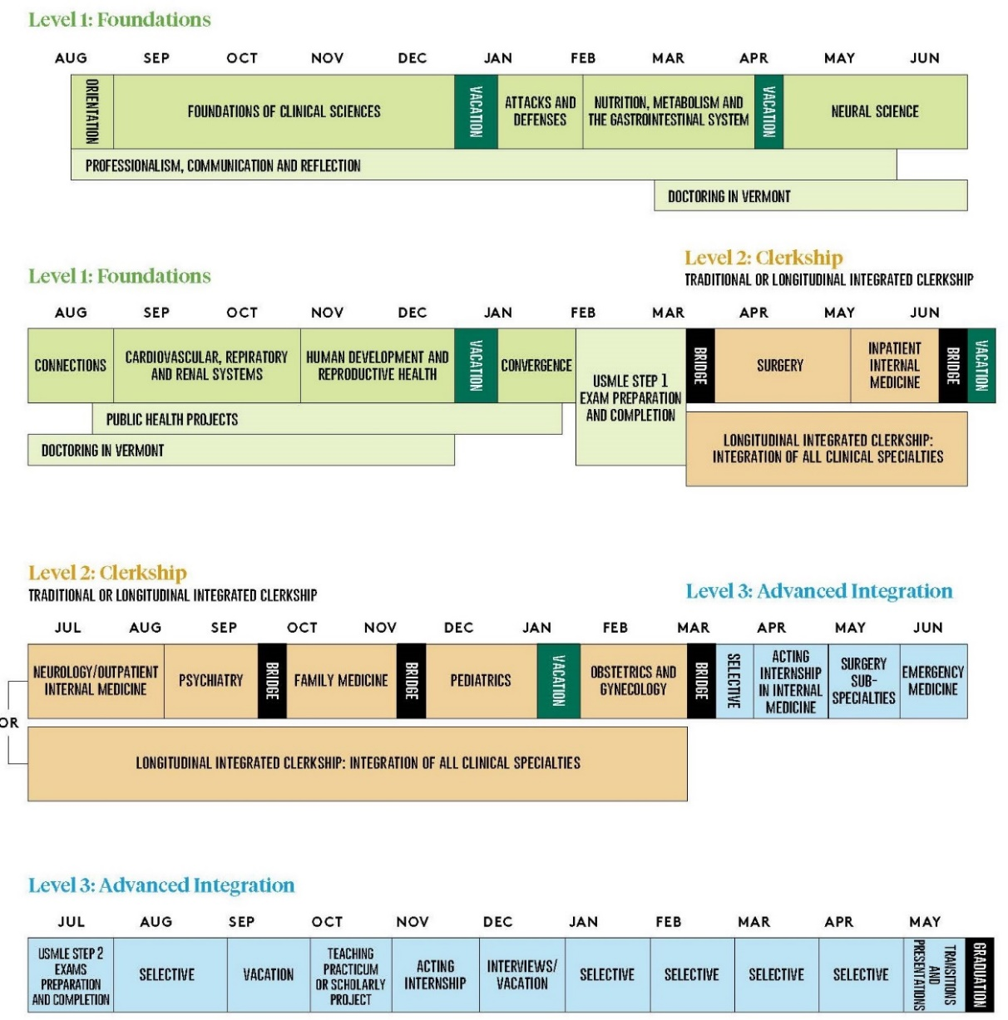
Vermont Integrated Curriculum Schedule
http://med.uvm.edu/docs/vic/medical-education-documents/vic.pdf

Slide 3
Content Objectives
Overview of the Vermont Integrated Curriculum Schedule
Advanced Integration Level Requirements
Graduation Requirements
General vs. Surgery Major
Teaching or Scholarly Project
Electives (Clinical vs. Non-Clinical Electives)
Away Rotations
Advising
Scheduling – OASIS
Lotteries
Add/Drop
Vacation
General Residency Application Timeline

Slide 4
Advanced Integration Level Requirements

Slide 5
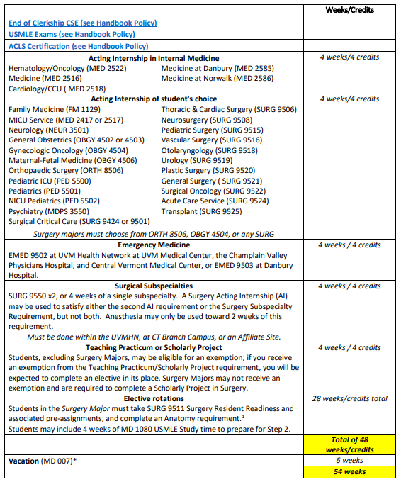
Advanced Integration Level Graduation Requirements
The Anatomy requirement for Surgery Majors may be satisfied by ANAT 1005 Clinical Anatomy, RAD 7501 Diagnostic Radiology, RAD 7509 General Radiology, PATH 1052 Medical/Surgical Autopsy, PATH 1054 Pathology for the Clinical Physician. * In addition to 4 weeks of vacation, the Advanced Integration Year calendar for the Class of 2023 includes 4 gap weeks between rotation blocks which do not need to be designated as vacation.
Notes:
SURG 9550, Surgical Subspecialty rotation, is set up in 2-week blocks. If a student wishes to do 4 weeks of a subspecialty, but not the AI rotation, they can sign up for 2 2-week sections of the same thing, however Debbie can modify it to a 4-week block in OASIS.
Advanced Integration grading: H/P/F for 4-week clinical rotations and P/F for all 2-week courses, reading electives, research/TA, other non-clinical electives (like Medical Spanish).
If you receive an exemption from the Teaching Practicum/Scholarly Project requirement you will be expected to complete an elective in its place.
No double dipping
MICU Service (MED 2517) does NOT fulfill the IM Acting Internship requirement. It is a “choice” acting internship.

Slide 6
What is an Acting Internship?
An Acting Internship (AI) consolidates and refines the student’s medical knowledge and clinical skills at a level of competency necessary to deliver comprehensive care to inpatients through increased responsibility in the evaluation and management of patients and through closely supervised direct patient care experiences on an inpatient service. Students are expected to perform as part of the resident team in order to attain a level of competence and self-confidence sufficient to be prepared for entering their first year of residency.
➔ Acting Internships are identified by “AI:” in the course title (i.e., AI: Neurology).

Slide 7
Step 2
Passing is a graduation requirement
4 weeks dedicated time for study if desired
For most specialties, this should be completed in time for residency application submission (by early September)
Must be completed by January 1, 2025.

Slide 8
General vs. Surgery Major
General Major | Surgery Major
Surgical Subspecialties SURG 9550 (x2, or 4 weeks of a single subspecialty. A Surgery Acting Internship (AI) may be used to satisfy this requirement. Anesthesia may only be used toward 2 weeks of this requirement. Must be done within the UVMHN or at CT Campus | Additional 4 weeks of Surgery (may be a second Surgery AI) May be done elsewhere
4 weeks total | 4 weeks total
Teaching Practicum or Scholarly Project | Scholarly Project in Surgery
TA - 4 weeks; 4-week rotation blocks may be dedicated to Scholarly Project work | 4-week rotation blocks may be dedicated to Scholarly Project work
 | Surgery Resident Readiness course SURG 9511
 | 4 weeks
 | Anatomy Requirement a. Clinical Anatomy - ANAT 1005 b. Medical/Surgical Autopsy – PATH 1052 c. Pathology for the Clinical Physician – PATH 1054 d. General Radiology – RAD 7509 e. Radiology Subspecialty – RAD 7501
Emergency Medicine: EMED 9502 at UVM Health Network at UVM Medical Center, the Champlain Valley Physicians Hospital and Central Vermont Medical Center, or EMED 9503 in Danbury.
Notes:
ACLS certification will be required and will be offered through the Sim Lab.

Slide 9
Selecting the Surgery Major
Senior Student Director – Dr. Patrick Forgione
Student Coordinator – Lisa Washburn
Surgery Senior Major -
Students planning to do the Senior Surgery Major should identify themselves to Lisa Washburn and Emma Faustner by February 1, 2024. Please email them with the following information:
the subspecialty you are interested in
your contact information
the name of your advisor.

Slide 10
Surgery Major Requirements (in addition to the COM requirements)
Students wishing to sign-up for the Surgery Major, are requested to do so by 2/1/2024.
If a student wants to drop the surgery major, this must be done by the end of the workday on 8/31/2024.
Anatomy Requirement – students must complete one of the following by 3/1/2025
Clinical Anatomy – ANAT 1005
Medical/Surgical Autopsy – PATH 1052
Pathology for the Clinical Physician – PATH 1054
General Radiology – RAD 7509
Radiology Subspecialty – RAD 7501
Surgery Residency Readiness Course (SURG 9511)
March 2025
Attend all teaching and skills sessions
Participation in a surgery scholarly project

Slide 11
Surgery Subspecialty Requirement SURG 9550
Requirements: Four weeks of a subspecialty; this can be done in two two-week rotations of two different subspecialties or a full month of a single subspecialty (except Anesthesiology) between March 2024 and March 2025.
If you are doing two two-week subspecialties, these can be done in two different months.
Each two-week rotation must be for ten *full* weekdays.
Email Lisa Washburn to schedule your specific subspecialty at the University of Vermont Medical Center – except Anesthesia, Interventional Radiology, Gyn/Onc, and Urogyn, as indicated below.
Email Moira Barber to schedule your specific subspecialty at the Connecticut Campus (CT campus students).

Slide 12
Surgical Subspecialties
These rotations can be done in the same subspecialty or two different subspecialties including:
Anesthesia* (ANES 9550) Pediatric Surgery
Cardiothoracic Surgery Plastic Surgery
Gynecologic Oncology – contact Sara Tourville SICU
Interventional Radiology (RAD7520) Surgical Oncology Neurosurgery Trauma Surgery
Ophthalmology Urogynecology (OBGY4526)
Orthopedics Urology
Otolaryngology Vascular Surgery
Other subspecialties may be considered but the criteria include pre-operative assessment, intra-operative assessment, and post-operative management.
*Anesthesia may only be used toward 2 weeks of this requirement.
For more information, please visit our course on VIC Portal “Surgery Advanced Integration Course”

Slide 13
Surgical Subspecialties CT campus
These rotations can be done in the same subspecialty or two different subspecialties including:
Anesthesia
SICU
Neurosurgery
Trauma Surgery
Vascular Surgery
Cardiovascular Surgery
Breast Surgery
Ophthalmology
Other subspecialties may be considered but the criteria include pre-operative assessment, intra-operative assessment, and post-operative management.
*Anesthesia may only be used toward 2 weeks of this requirement.
For more information, email Moira Barber

Slide 14
Teaching / Scholarly Project
Options:
Teaching in a VIC Foundations Course
Research and communication
Exemptions: Deadline – January 15, 2024
PhD or Master’s Degree in a scientific discipline
Significant laboratory experience and first authorship
Masters or doctorate in education with scientific focus
Teaching certificate and one year’s experience teaching in a scientific field.
Contact Dr. Eileen CichoskiKelly with questions or to request an exemption.
Notes:
Current course director: Dr. Eileen CichoskiKelly (Eileen.CichoskiKelly@uvm.edu).

Slide 15
Electives
Elective rotations to total 28 weeks
May include 4 weeks of USMLE Study Period MD-1080 to prepare for Step 2
No limit on clinical versus non-clinical electives

Slide 16
Intramurals vs. Extramurals
Course Number 1095
A rotation that does not currently exist in the official catalog but will be supervised and assessed by a member of the LCOM faculty.
Includes rotations done at the CT campus (Danbury/Norwalk) which are not yet in the catalog.
May need to be approved by the Medical Education Leadership Team (MELT).
Course Number 1090
Any rotation done outside of the UVM LCOM system under the supervision of non-faculty.
May need to be approved by the Medical Education Leadership Team (MELT) if it is not taking place at an LCME or ACGME accredited program, or on the List of Approved Extramurals posted on the Preparing for Advanced Integration web page.

Slide 17
Extramurals
All extramurals must be approved to your schedule in OASIS in advance of the start date. Credit cannot be granted for unapproved extramurals.
Extramural information will be entered into OASIS and approval will be granted via OASIS when the rotation is added to the student’s schedule.
Preparation for Extramurals can begin in advance. Most LCME-accredited medical schools use the AAMC’s Visiting Student Application Service (VSLO) to process applications.
To get started, send an email request for a VSLO invitation to Emma.Faustner@med.uvm.edu.
You will receive an email from VSLO with instructions on logging in and starting the application process.
➔ See the Extramural Guide on the Preparing for Advanced Integration webpage for more information.

Slide 18
Why would I do Extramurals (Away electives)?
Opportunity to get experience not available at home institution
Opportunity to get Letters of Recommendation/SLOE from another institution
Certain specialties put significant value in aways: Emergency Medicine, Dermatology, Surgical Subspecialties (Ophthalmology, Orthopedics, ENT, Urology, Plastic surgery)
Opportunity to get to know a program well
Opportunity to showcase your skills (Audition elective)
**keep in mind an away elective does not necessarily guarantee an interview or match
Talk to your specialty advisor to understand pros, cons, number, and timing for your specialty

Slide 19
When do I need to prepare for Extramurals
Request a VSLO account from Emma Faustner by January
Start looking at offerings
Start preparing background materials: CV, Statement of Interest, Immunizations, PPD etc.
Consider when you would ideally do away electives as you enter the lottery (leave space open)
Plan home rotation in specialty prior to away elective
Most applications are open in March-May. Average time from application to start of elective is 135 days
Average number of electives applied to is 8 electives (2 dates per elective i.e. June and July with hopes to secure one date)

Slide 20
Advising

Slide 21
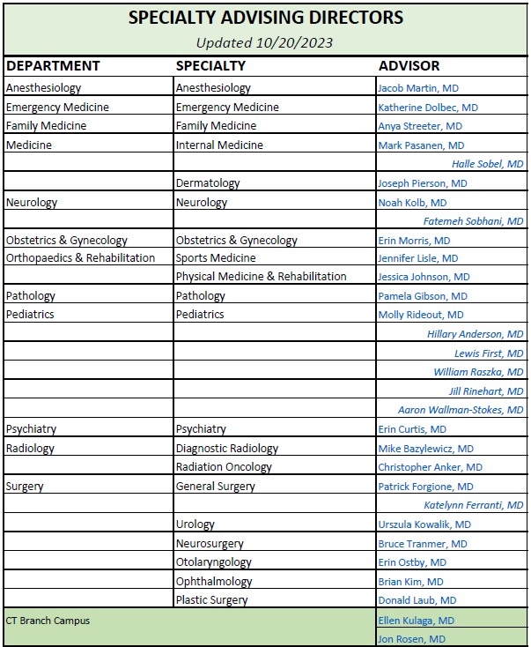
Specialty Advising Directors
http://med.uvm.edu/docs/lcom_specialtyadvising/medical-education-documents/student-affairs/lcom_specialtyadvisors.pdf

Slide 22
Identifying an Advisor in OASIS
All students are required to have requested a subspecialty advisor in the OASIS year labeled Advanced Integration Level prior to the M4 lotteries. Students may ask their PCR Mentor to serve as their Subspecialty Advisor. Students may change advisors at any time; however, this type of advisor is required.
Detailed instructions are in the Student User Guide.
Deadline 12/1/23. Enter OASIS via the 2024-2025 Advanced Integration Level Year when requesting an advisor; otherwise, your request will not appear in the correct year and will not satisfy the fourth-year requirement. Do NOT enter via 2023-2024 Clerkship Level Year to select an advisor!

Slide 23
Scheduling Rotations & the Lotteries

Slide 24
Scheduling
Elective time periods:
2024 | March 18 - 29
 | April 1 – 26*
 | May 6– 31
 | June 3 - 28
 | July 1 – 26*
 | August 5 -30
 | September 2 - 27
 | September 30 – October 25
 | October 28 - November 22
 | November 25– December 20**
2025 | January 6 -31
 | February 3 - 28
 | March 3 - 28*
 | April 7 – May 2
Rotations must be either 2 or 4 weeks long. We cannot accommodate 1- or 3-week rotations.
The general rotation blocks will likely be scheduled as follows:
academic_calendar_class_of_2025.pdf (uvm.edu)
All enrollment blocks must be scheduled (not during lotteries)
*denotes gap weeks

Slide 25
Lottery Schedule
Lottery I: Top Choice
Selection Period Opens: Monday, 1/8, noon
Selection Period Closes: Tuesday, 1/9, noon
Results Posted: Wednesday, 1/10
Lottery II: Second Choice
Selection Period Opens: Thursday, 1/11, noon
Selection Period Closes: Friday, 1/12, noon
Results Posted: Tuesday, 1/16
Lottery III: CT Campus IM AI/Emergency Medicine
Selection Period Opens: Wednesday, 1/17, noon
Selection Period Closes: Thursday, 1/18, noon
Results Posted: Wednesday, 1/24 (with the VT Campus results)
Lottery IV: VT Campus IM AI/Emergency Medicine
Selection Period Opens: Monday, 1/22, noon
Selection Period Closes: Tuesday, 1/23, noon
Results Posted: Wednesday, 1/24
Lottery V: Electives
Selection Period Opens: Friday, 1/26, noon
Selection Period Closes: Tuesday, 1/30, noon
Results Posted: Monday, 2/5
Add/Drop Period
Opens: Monday, 2/5, 4:00 p.m.
Two “top choice” lottery stages: max 1 placement per round (2 total possible)
Campus-specific IM/EM stages: max 2 placements, all will have both IM and EM placements following this round, limited to 1 of each max
An Electives lottery: many placements possible, participation is optional
And Add/Drop

Slide 26
Before the Lotteries
October - December
Test your log-in to OASIS.
Browse 2024-2025 Advanced Integration Level offerings.
Identify a Subspecialty Advisor relationship in OASIS.
Deadline December 1, 2023
Please communicate with your selected advisor before contacting them in OASIS
You may find the worksheet included in the User Guide helpful for planning your lottery selections. (This is not required, only a helpful resource.)
Notes:
OASIS User Guide url: http://med.uvm.edu/docs/advint_studentuserguide/medical-education-documents/student-affairs/advint_studentuserguide.pdf

Slide 27
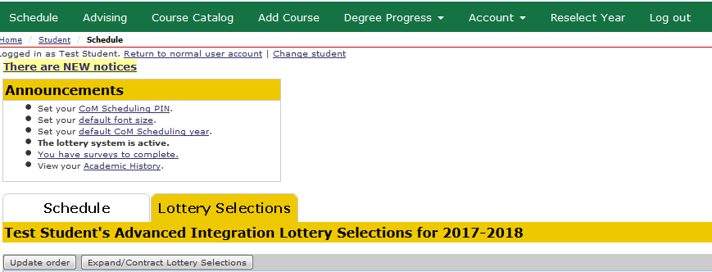
During the Lotteries
Choose “Add Course” to make your selections.
Choose “Lottery Selections” tab to review and re-order your selections
Once your selections appear in the Lottery Selections tab, you may log-out any time

Slide 28
After the Lotteries: Add/Drop
Choose “Schedule” to view your placements
Make any necessary changes to your schedule by:
A) Choosing “Add Course” to add, or
B) Choosing “Schedule” to drop a course

Slide 29
Helpful Lottery Tips
Limiting your number of lottery selections will NOT improve your chances of being placed!
There is no limit to how many selections you can make. It is a good idea to make more selections for the best chances of being placed in one of your preferences. Said differently, do not overly limit your selections in the first lottery. If not placed in your top choice, your back-up choices may not be available in the next lottery if other students included them in their selections.
There is NO advantage to logging in to a lottery first.
Lottery participants are chosen at random by the software and then placed according to ranked preferences, not log-in time. In fact, server speed will be slow during the first hour of a lottery because so many users try to access the software simultaneously.
Change your COMIS password before the lotteries open if it is due to expire soon. If your log-in does expire, there is a link to reset the password on the VIC Portal log-in page.

Slide 30
Helpful Lottery Tips (continued)
Selections in subsequent lotteries may not have a time conflict with offerings confirmed to your schedule through a previous lottery.
You may NOT drop administratively assigned clerkships.
You may drop placements from previous lotteries to make new selections. However once dropped, the spot is immediately available to others to add to their selections. You may re-add it to your selections, but there is no guarantee that the current lottery will place you in the spot again.
Regarding the ability to drop: The lotteries override many add/drop course restrictions. Once the lotteries close and the add/drop period opens, you will not be able to drop restricted courses without contacting the course coordinator for departmental approval.

Slide 31
Prerequisites for AI courses
You may not schedule any departmental offering until after the prerequisite clerkship has been completed.
SURG-615 is a prerequisite for Emergency Medicine, Anesthesiology and Orthopedics offerings.
Both Medicine clerkships, MED-618 and MED-619, are prerequisites for Medicine, Pathology, Radiology and Anesthesiology.
Requests for extra days off may not be accommodated during acting internship months. Please plan residency interview schedule accordingly in November, December, and January.

Slide 32
Medicine AI and Emergency Med
The initial lottery stages will include all Medicine Acting Internships, all Specialty Acting Internships, and the required Emergency Medicine course. Students may decide in which of these stages to select their requirements. However, any lottery-eligible student who emerges from the lottery without a Medicine AI and/or Emergency Medicine course will be randomly assigned these rotations by the software prior to opening of the final Electives lottery.
Students must enroll in the required IM AI and EM course at their assigned campus. CT students who wish to enroll in an internal medicine acting internship and/or a required emergency medicine course at the VT Campus, or vice-versa, must request this exemption via OASIS no later than December 1
Students who do not participate in lotteries will not be assigned a second AI prior to the Electives lottery.

Slide 33
Electives stage Lottery
Include most subspecialty AI rotations with open spots. Extra spots in Pediatrics acting internships will be available in the Electives lottery; however, students may not schedule more than one Pediatrics acting internship through the lotteries. If space remains when the lotteries close, students should contact the departmental coordinator to add a second AI.
Some courses are ‘view-only’ during the lottery stages. Students must wait to add these courses to their schedule during Add/Drop.
eg. away rotations, teaching requirements, vacations and other courses that require the student to enter individualized information for their enrollment to be approved by the department (i.e., reading and research months, as well as 2-week surgery subspecialty rotations).

Slide 34
Additional Info (continued)
It is your responsibility to maintain an up-to-date schedule in OASIS. All enrollment blocks must be scheduled by graduation; use vacation for weeks when you are not enrolled in courses. No enrollment is required for gap weeks (per the class academic calendar).
Until you are approved by the course coordinator from a waitlist, you are not officially enrolled in a course.
You may not add a course, or be added to a course from a waitlist, until you drop any conflicting courses on your schedule.
When in doubt about your enrollment status in a course or you are unable to add/drop a course from your schedule, contact the course coordinator.

Slide 35
Delayed USMLE Step 1?
Step 1 is a prerequisite for all M4 clinical rotations. If a student has not taken the exam, they should secure an exam date through the NBME prior to the lotteries. This exam date will be reflected on their M4 schedule as a locked enrollment. The student will be permitted to participate in the lotteries; however, their ability to schedule clinical rotations will be limited to dates after the Exam date. If an exam date is not scheduled, please refer to the chart in the scheduling user guide regarding exam placeholders.
If at any time the student changes their exam date, they must inform the Director of Academic Achievement and LCOM Registrar so that the exam date in OASIS can be adjusted, and they must drop all clinical rotations scheduled to begin before the exam is taken. In most instances the student will need to work with the course coordinator to drop the course(s).
If Step 1 Exam is not taken and passed by June 30 of their fourth year, all upcoming clinical rotations will be administratively dropped from their schedule.
Once the student has taken the exam, they should work with course coordinators to populate their schedules with clinical rotations.

Slide 36
Prep for Practice (MD 1000) 3/20-31
Objectives: 1. Provide new 4th-year medical students with information and support for the residency application process. 2. Provide medical students with information that will be valuable for their acting internships and residencies (teaching in medicine, note writing, giving feedback) 3. Provide students with information that will be useful to them as a practicing physicians (medical business course, ethics in medicine, finance, medical licensure)

Slide 37
Timeline for Residency Application
April-Sept
Jan-March
Mar 14
April-May
Oct-Jan
Interviews
Match
Day !!
Residency
Application
Post-match
Transition to residency
Rank & Wait :/

Slide 38
The Medical Student Performance Evaluation
Formerly known as the Dean’s Letter
An MSPE will be written for each student.
You will provide information for your MSPE
Identifying Information
Noteworthy Characteristics
A Residency Advising Discussion (RAD) Meeting is required before the end of August to discuss your residency application and draft your MSPE
Stay tuned for more information in March

Slide 39
Grade Appeal Process
A student who disagrees with a final grade may appeal it via discussion of the matter with the course or rotation director.
The initial appeal must be initiated within fourteen calendar days of the receipt of the grade or evaluation
If you consider appealing a grade, please review the Medical Student Handbook Policy 540.60 – Grade and Narrative Assessment Appeals carefully prior to moving forward to ensure you are aligning to our institutional policies and procedures

Slide 40
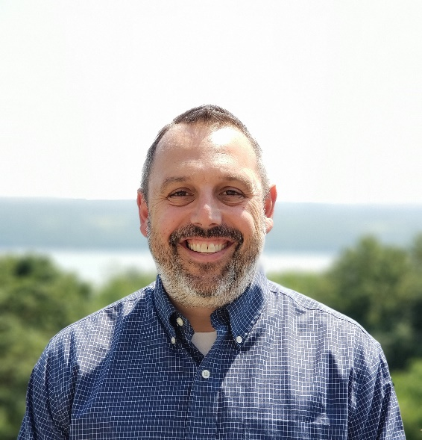
Student Financial Services: Away Electives and Residency Interviews
Use caution with private "Residency Relocation Loans" and contact SFS before using
Away rotation costs can sometimes be covered by extra loans, only if UVMMC and surrounding areas do not offer the equivalent here (requires appeal - contact SFS)
You may complete appeal form for extra federal loan funds (above and beyond regular financial aid budget) to cover application costs, interview travel, etc-
administratively easier to wait until interviews are over and do one reimbursement. Document expenses!!
Always contact SFS for forms, instructions, etc. (MedSFS@uvm.edu)

Slide 41
Dr. Nathalie Feldman
Director of the Learning Environment
Contact Info:
89 Beaumont Ave. Given D-103 Burlington, VT 05405 Phone: (802) 656-5466 (office)
(802) 316-7715 (cell) Email: nathalie.feldman@med.uvm.edu
Sign-Up for a Drop-in Meeting...

Slide 42
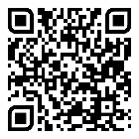
Learning Environment Reporting-Written
Clerkship and Advanced Integration Level Evaluation Form:
Please identify one or more individuals who demonstrated exemplary professionalism and respectful behavior during the clerkship.
Did you experience or observe any disrespectful or unprofessional behavior(s) during this clerkship?”
Confidential Web Based Learning Environment Reporting form:
http://www.med.uvm.edu/mededucation/learningoverview
You can access this form directly by scanning the QR code found on your new “Health Care During Clinical Rotations” and “Our Culture of Respect” card, which was distributed with your new badge earlier this year.
Password located on your badge
Notes:
This person could be an attending, resident, nurse, staff member or allied health care professional. In the space below, please tell us why you chose to recognize this/these individual(s).
If so, in an effort to enhance our learning environment, we strongly encourage you to share your experience(s) and/or concern(s) with us. In order for the COM to make improvements based on your feedback, it is important that you provide us with as many details as possible, including the specific circumstances and individuals involved. Please note that no action will be taken until 42 days have expired and final grades are submitted. To ensure anonymity if desired, please submit your comments by clicking on the confidential web-based link below, using the password “climate1802

Slide 43
Medical Student Research Opportunities
It’s never too late to get involved in research!
Larner Dean's Medical Research Fellowship
FESO (Funds for Educational and Scholarly Opportunities) are available again
Renee Stapleton, MD, PhD
Director of Medical Student Research

Slide 44
Upcoming small group sessions with Dean Dolbec
Are you trying to decide between 3 or more specialties? 11/30 @5:15 PM
Do you have it narrowed down to 2 specialties? 12/7 @5 PM
Are you certain of your specialty but want to hear more? 12/14 @5 PM
Look for Reminders and zoom links in Weekly Wire

Slide 45
Any Additional Questions?
Frequently Asked Questions page
The memo from the Deans, providing overview information
OASIS User Guide
The Advanced Integration Coordinator
Drop-in Meeting Sign-Ups:
Dr. Karen George, Associate Dean for Students
Dr. Katie Dolbec (VT)/Dr. Ellen Kulaga (CT) Asst. Deans for Students
Dr. Nathalie Feldman, Director of the Learning Environment

