Slide 1
COVID Vaccine updates and Perinatal Quality
Marjorie Meyer MD
Professor
Larner College of Medicine
University of Vermont

Slide 2
COVID-19 Vaccine in Pregnancy

Slide 3
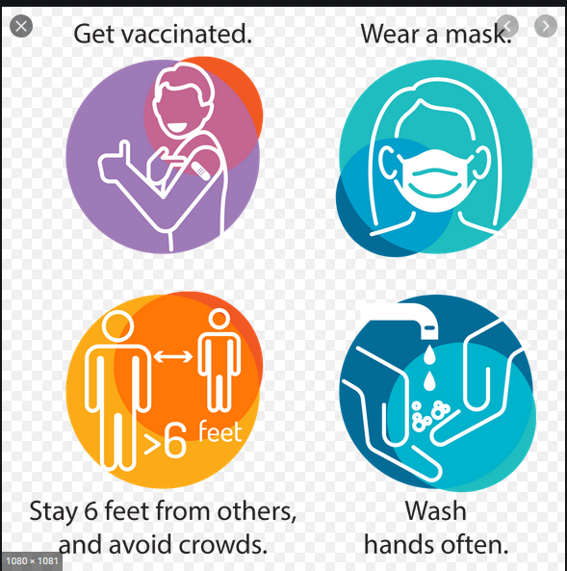
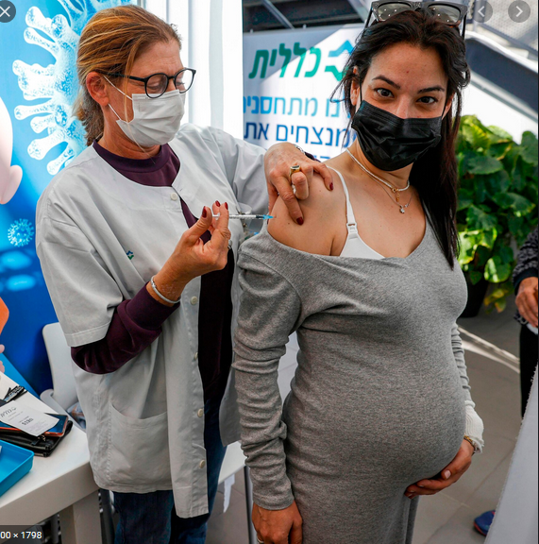
Short Story

Slide 4
Longer story
Vaccines available
Data available
Recommendations for pregnancy and breastfeeding
Recommendations for planning pregnancy

Slide 5
Vaccines
mRNA vaccines-2 shots
Pfizer-3 weeks
Moderna-4 weeks
Adenoviral vector vaccines-one shot
Janssen Biotech: Johnson and Johnson
AstraZeneca
Not in US

Slide 6
Vaccines
ACOG recommends that COVID-19 vaccines should not be withheld from pregnant individuals.
COVID-19 vaccines should be offered to lactating individuals similar to non-lactating individuals
mRNA vaccines-2 shots
Pfizer-3 weeks; 95% effective against illness
Moderna-4 weeks; 94% effective against illness
Adenovirus vector vaccines-one shot
Johnson and Johnson; 67% effective against moderate illness, 77% against critical illness, 93% against hospitalizations
(not live virus, no preservatives, does not replicate)
AstraZeneca
Not in US
“SMFM applauds ACIP’s recent discussion, which will allow pregnant and lactating people access to the Janssen COVID vaccine”-SMFM March 1, 2021

Slide 7
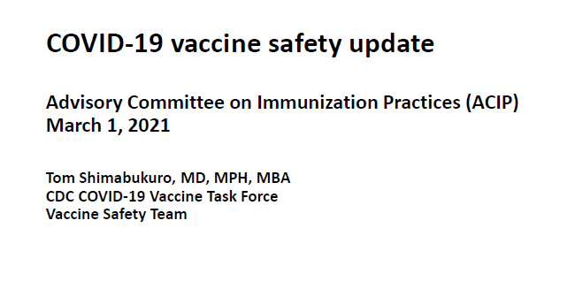
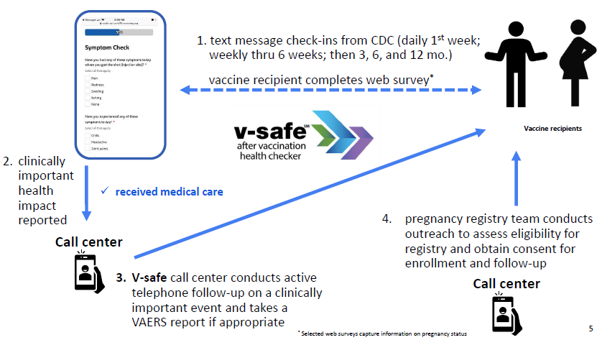

Slide 8
We have a LOT of real life data about the vaccine

Slide 9
The safety profile of vaccine is excellent

Slide 11
Anaphylaxis is RARE

Slide 12
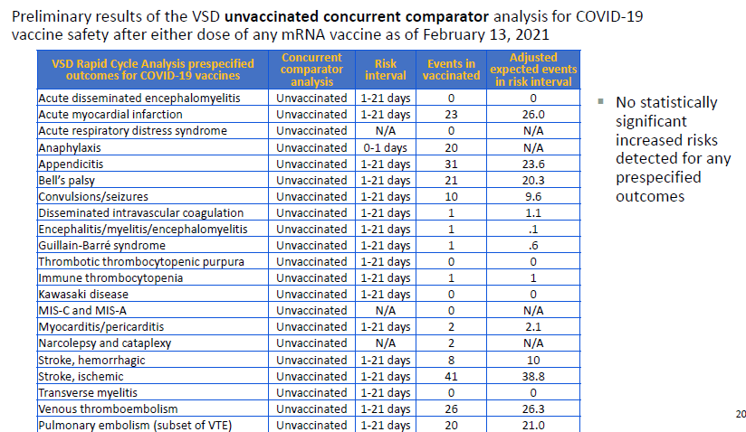
Vaccine Safety Datalink (CDC):
Comparative data of adverse health events in unvaccinated vs vaccinated people

Slide 13
What about pregnancy data?

Slide 14
Similar side effects: pregnant vs not pregnant

Slide 16
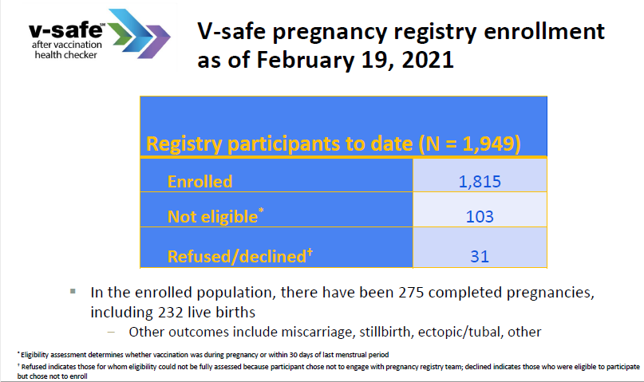

Slide 17
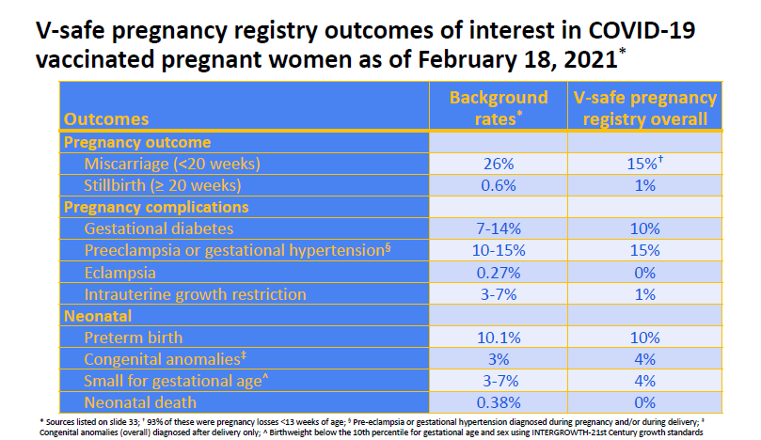
In these 2000 women, no change in pregnancy outcome compared to background rates:

Slide 20
Janssen data: all participants
…..based on data from ongoing and completed clinical trials of Ad26-vectored vaccines including COVID-19, HIV, and Ebola administered to pregnant individuals, overall, the Ad26-based vaccines have an acceptable safety and reactogenicity profile, without significant safety issues identified to date. In addition, the review of the available pregnancy data is not suggestive of a pregnancy-related safety concern (FDA 2021).

Slide 21
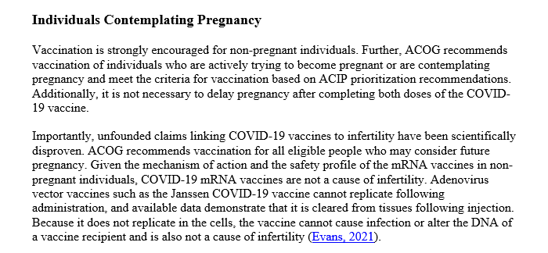
No change from
prior recs
No change from
prior recs

Slide 22
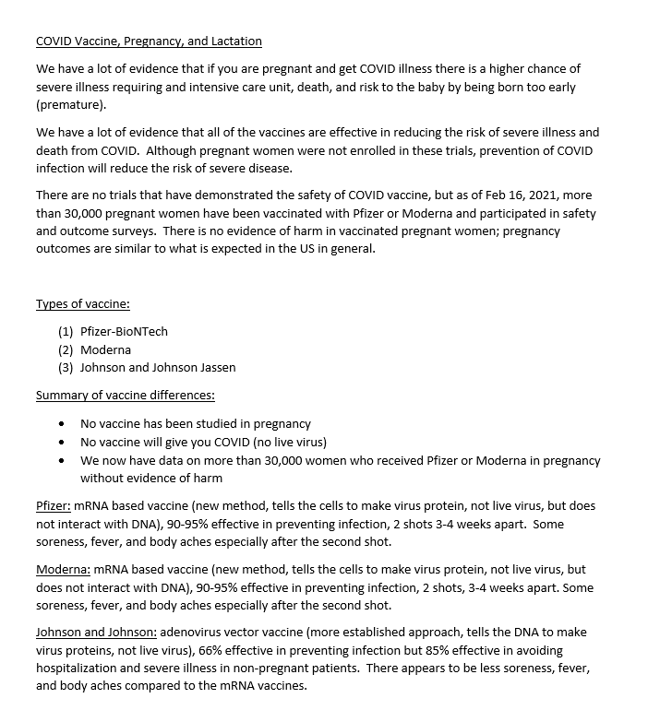
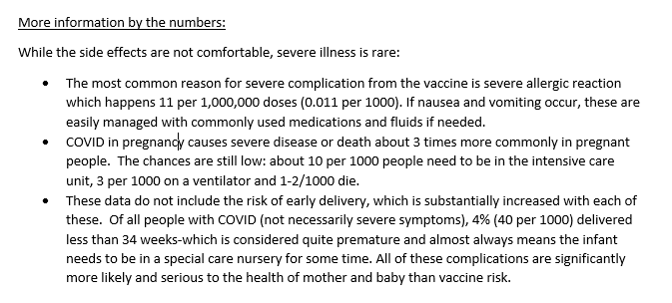

Slide 23
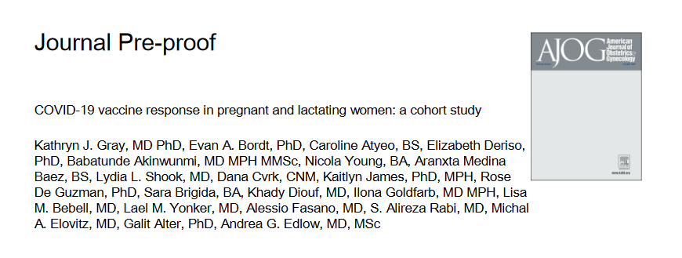
JAMA, 2021
March, 2021

Slide 24
Short Story
Excellent safety profile in pregnancy
Excellent immune response
COVID Antibodies cross placenta

Slide 25
Statewide Collaboration

Slide 26
Multiple intersecting projects all with one priority:
Perinatal Health and Quality Improvement
Vermont Childrens Health Improvement Project (VCHIP)
Vermont Department
of Health (VDH)
Alliance for Innovation on Maternal Health (AIM)

Slide 28
Coordinate efforts (and reduce duplication of efforts) re: perinatal quality and childhood health
NNEPQIN is excellent for wide dissemination of data among rural hospitals
PQC-VT will loop in state-specific issues and state (and hospital) level data

Slide 29
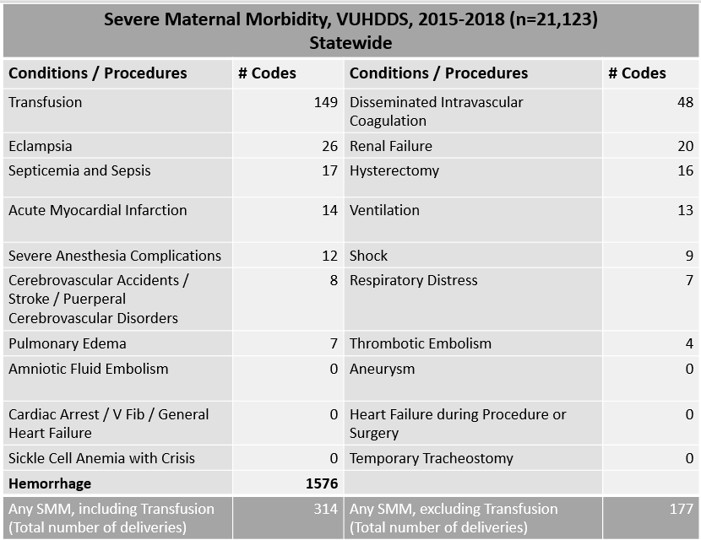
Integrated data are the backbone of
QAI efforts
Statistics Conferences
AIM: Severe Maternal Morbidity
Focus 1: PPH
Focus 2: HTN

Slide 30
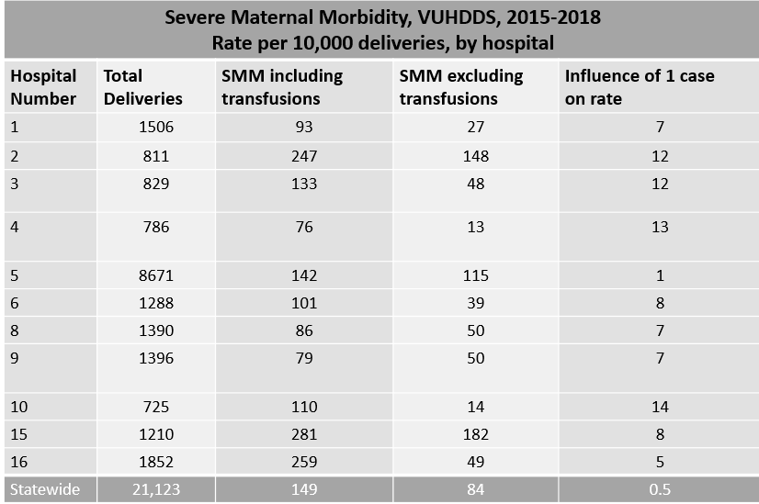
You will hopefully see hospital based statistics related to Severe Maternal Morbidity more frequently
Coding is an issue nationally: the only way to get at that is to look at the coding data and work backwards
We will continue to work on this together with the AIM initiative

Slide 32
Thank you

