Slide 1




VCHIP / CHAMP / VDH COVID-19 UPDATES
Wendy Davis, MD FAAP - Senior Faculty, Vermont Child Health Improvement Program, UVM
Breena Holmes, MD FAAP – VCHIP Senior Faculty & Physician Advisor, MCH Division, VDH
May 18, 2022

Slide 2

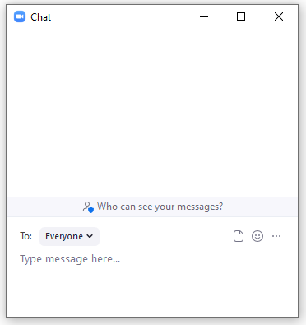

Please bear with us…
Technology Notes – “Welcome to Zoom!”
All participants will be muted upon joining the call.
Presenters: Please avoid the use of speakerphone and make sure your computer speaker is muted if you
dialed in via phone.
To ask or respond to a question using the Chat box, click on your toolbar, type your
question and press the Enter key on your keyboard to send.
We will monitor Chat and review/address questions after content presentation
If you wish to verbally ask a question, click the microphone on your toolbar or press ALT-A to Unmute/Mute.
If you have technology questions, please directly message Kelli Joyce, Allison Koneczny, or Angela Zinno.
Calls are RECORDED and posted on VCHIP web site for asynchronous review.

Slide 3

Overview
National EMS for Children Day (EMS Week 2022)
  Please consider signing on to VCHIP’s EMSC project: facilitating collaboration among community EMS (pre-hospital) providers, emergency department health care professionals, medical homes
Reminder – weekly event schedule:
  VCHIP-VDH call calendar (next slide) Governor’s Media Briefings generally Tuesdays only; VMS calls with Dr. Levine 1st and 3rd Thursdays
Practice Issues: Caring for Patients with Suicidality in Primary Care – Greta Spottswood, MD MPH
Q & A/Discussion
  [Please note: the COVID-19 situation continues to evolve – so the information we’re providing today may change]

Slide 4

VCHIP-VDH COVID-19 Call Schedule
May / June / Summer 2022:
May: calls on 5/4, 5/11, 5/18 (no call 5/25) – some specialized content (preventive care catchup; mental health care treatment/access; equity/diversity/inclusion)
June: two calls only – 6/1 and 6/8
July: one call only 7/20
August: one call only 8/24
Fall, 2022: we REALLY need your input/feedback!
Schedule subject to change if circumstances warrant!
Please continue to send your feedback re: schedule/topics to vchip.champ@med.uvm.edu
2 years strong!

Slide 5
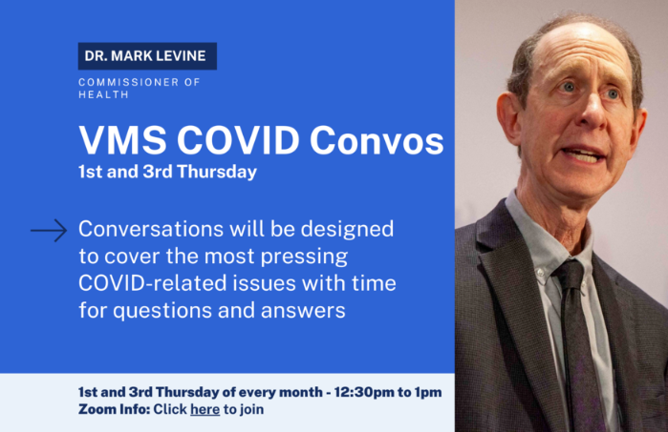
VMS COVID Convos with Health Commissioner Levine
2022 Schedule
Calls with VDH Commissioner Levine now 1st and 3rd Thursdays
Next VMS COVID Convo with VDH Commissioner Levine is 5/19/22
Summary: VMS calls are held the first and third Thursdays of the month from 12:30 to 1:00 p.m.
  Join Zoom Meeting: https://us02web.zoom.us/j/86726253105?pwd=VkVuNTJ1ZFQ2R3diSVdqdlJ2ZG4yQT09
  Meeting ID: 867 2625 3105 Password: 540684 Dial In: 1-646-876-9923

Slide 6
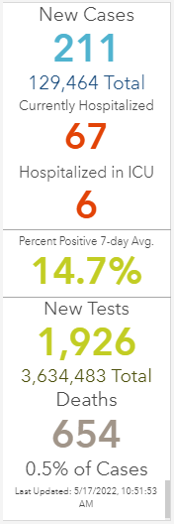
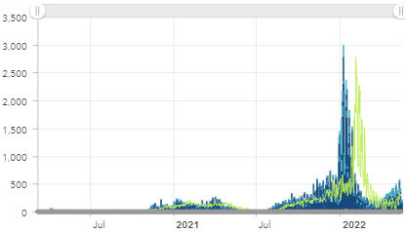
Situation update
One year ago: 23,945 VT total cases; 35 new/9 hosp.
U.S. 82.7 million+ cases; 999,027 deaths
  https://www.nytimes.com/interactive/2021/us/covid-cases.html (updated 5/18//22)
  Past week: av. 100,732 cases/day (14d. change +61%)
  6.267 million+ deaths worldwide; 522.7 million+ cases (-26% & -4% 14-day change respectively)
VDH Data Summary now q.o.week. 5/13/22:
  Table of Contents: Overview of COVID-19 in Vermont; Clinical Course; Vaccine Breakthrough.
  Vaccine breakthrough cases = 52,649 since Jan. 2021 (~10.8% of fully vaccinated). Find previous summaries at: https://www.healthvermont.gov/covid-19/current-activity/data-summary
NOTE: The COVID-19 Surveillance Report focuses on data/indicators most useful to help monitor & determine risk of COVID-19 in VT. It will be updated every Wednesday & will replace the COVID-19 Case Dashboard. The final dashboard update will be May 18.
COVID-19 data sets will still be accessible through the Vermont Open Geodata Portal, including case counts, hospitalizations, deaths, PCR testing and more.
https://www.healthvermont.gov/covid-19/current-activity/case-dashboard

Slide 7
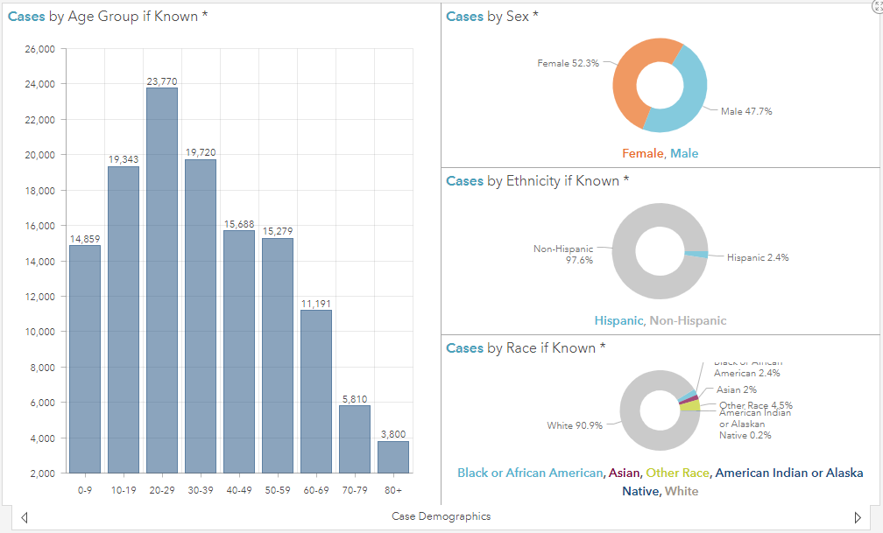
Situation update
https://www.healthvermont.gov/covid-19/current-activity/vermont-dashboard

Slide 8
NEW from VDH
COVID-19 Surveillance Report
NEW: VDH COVID-19 Surveillance Report focuses on data/indicators most useful to help monitor & determine risk of COVID-19 in Vermont.
  Will be updated every Wednesday & replace COVID-19 Case Dashboard (final 5/18/22)
  COVID-19 data sets will still be accessible through the Vermont Open Geodata Portal, including case counts, hospitalizations, deaths, PCR testing & more.
Topics: Syndromic Surveillance; Proportion of Circulating Variants; Wastewater Monitoring; Reported and Confirmed Outbreaks Active as of May 10, 2022; Vaccination Rates; Identified Cases
Report from 5/1 – 5/7/22: statewide community levels = High. Daily rate of new COVID cases/100K is >200. New COVID admissions >10/100K/day; percent hospital beds occupied by COVID-19 is <10%.
Find report at: https://www.healthvermont.gov/sites/default/files/documents/pdf/COVID-19-Surveillance-Report-20220511.pdf

Slide 9
Vermont Educational COVID-19 Data
NOTE: VT AOE has ceased data collection for “COVID-19 Cases in VT K-12 Learning Communities While Infectious”
  Find previous files at: https://www.healthvermont.gov/sites/default/files/documents/pdf/COVID19-Transmission-Schools.pdf
VT College & University dashboards:
  UVM update (week of 5/9-5/15/22): 28 pos. tests off campus; 25 on campus; 4 faculty; 9 staff.
  Bennington College (as of 5/12/22): 13 total active/3 new active cases.
  Middlebury College (as of 5/13/22): 4 new cases; 5 total active (active cases: 4 students / 1 employee)

Slide 10
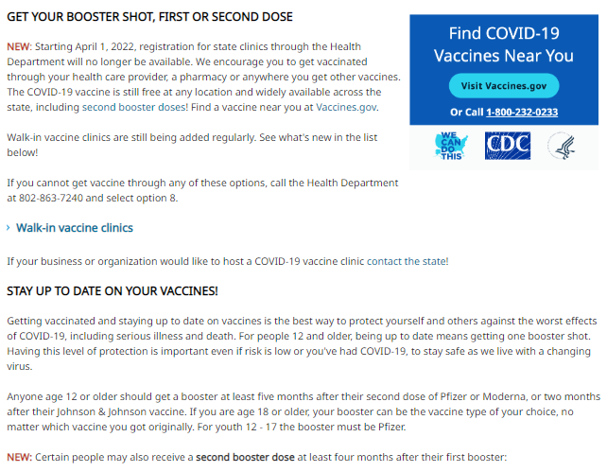
VDH COVID-19 Vaccine Web Page
https://www.healthvermont.gov/covid-19/vaccine/getting-covid-19-vaccine

Slide 11
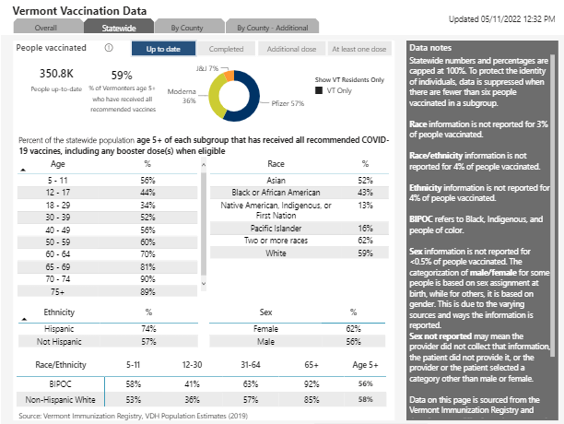
VDH COVID-19 Vaccine Dashboard (“Statewide” view, 5/11/22)
Dashboard now updated weekly on Wednesday; “UTD”= % 5+ yo w/all recommended vaccine doses)
https://www.healthvermont.gov/covid-19/ vaccine/ covid-19-vaccine-dashboard
By Age – Statewide:
  5-11 = 56%
  12-17 = 44%
  18-29 = 34%
  VT Age 5+ = 59%

Slide 12
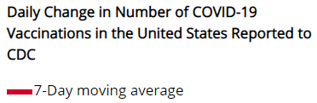
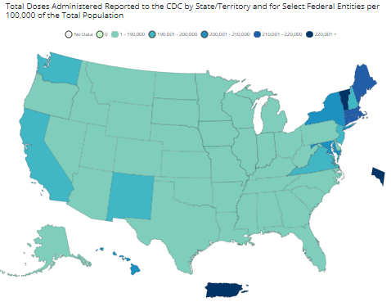
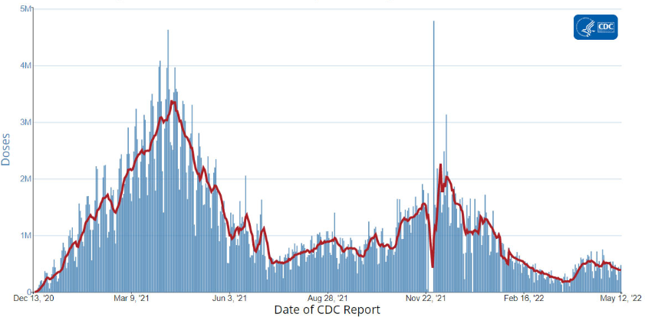
From the CDC Vaccine Tracker
https://www.cdc.gov/coronavirus/2019-ncov/covid-data/covidview/index.html
https://covid.cdc.gov/covid-data-tracker/#vaccinations

Slide 13
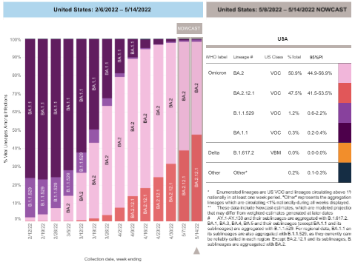
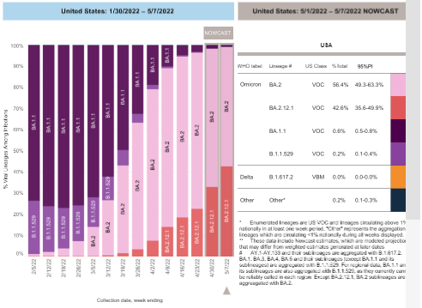
From the CDC: SARS-CoV-2 Variants in the U.S.
Note: week-to-week comparison in Omicron variant proportion (purple): far right bar in graph on left is week ending 5/14/22. LIGHTEST PURPLE is Omicron subvariant BA.2. RED is BA.2.12.1.
https://covid.cdc.gov/covid-data-tracker/#variant-proportions

Slide 14
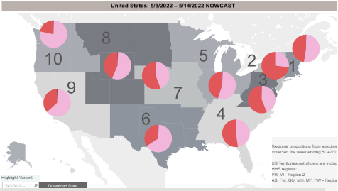
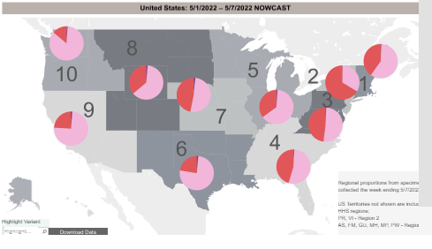
From the CDC: SARS-CoV-2 Variants in the U.S.
Note: week-to-week comparison in Omicron variant proportion (purple). Map on left is week ending 5/14/22. LIGHT PURPLE is Omicron subvariant BA.2. RED is BA.2.12.1.
https://covid.cdc.gov/covid-data-tracker/#variant-proportions
Notes:
CDC’s national genomic surveillance program identifies new and emerging SARS-CoV-2 variants to determine implications for COVID-19 diagnostics, treatments, or vaccines authorized for use in the United States. Monitoring the spread of emerging variants in the United States relies on widespread, rapid sequencing. To accelerate sequencing in the United States, CDC has contracted with commercial diagnostic laboratories and, in partnership with the Association of Public Health Laboratories (APHL), has implemented the National SARS-CoV-2 Strain Surveillance (NS3) program to provide a comprehensive and population-based U.S. surveillance system.
Based on these data, sequences with similar genetic changes associated with important epidemiological and biological events are grouped into lineages* and the proportion of lineages circulating in the United Stated are tracked and characterized to determine if they are considered variants of interest (VOI), variants of concern (VOC), or variants of high consequence (VOHC). These data, along with data from many other sources, are used to inform national and state public health actions related to variants. Most of the lineages identified through genomic surveillance are neither VOI nor VOC, and there are currently none that rise to the level of high consequence.
*A viral lineage is a group of viruses defined by a founding variant and its descendants. Names are assigned to SARS-CoV-2 lineages using manual and automated methods. Lineage designations are based on the identification of shared mutations, followed by a phylogenetic analysis, which determines genetic or evolutionary relatedness.

Slide 15
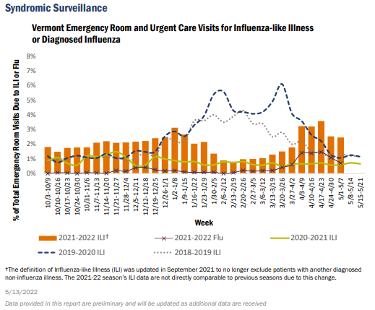
Don’t Forget Influenza!
The CDC-calculated influenza-like illness (ILI) activity level in Vermont this reporting period remains minimal.
From the CDC (week ending 5/7): Seasonal influenza viruses continue to circulate and activity is increasing in parts of the country.
Now 24 pediatric flu deaths this season
Link to VDH weekly surveillance:
https://www.healthvermont.gov/sites/default/files/documents/pdf/2021-2022-Flu-WeeklyReport-Week-18.pdf

Slide 16
AAP (National) Updates
Slides 17 – 21 courtesy of the American Academy of Pediatrics

Slide 17
Next AAP COVID-19 Town Hall
Town Hall Thursday, May 26 – 8 pm Eastern
Session will address the latest related to the COVID-19 pandemic and its impact on children, adolescents, and families – hear from leading experts and connect with your peers
Summer Schedule: monthly from May 26
Find previous recordingNexts on AAP COVID-19 Town Hall webpage:
https://www.aap.org/en/pages/2019-novel-coronavirus-covid-19-infections/connecting-with-the-experts/

Slide 18
Potential Upcoming FDA VRBPAC Meetings
June 7: Plan to discuss EUA request for the Novavax COVID-19 vaccine for individuals >18 years of age
June 8, 21, and 22: Held dates to discuss updates to the Moderna and Pfizer-BioNTech EUAs for COVID-19 vaccines to include younger populations
June 28: Plan to discuss whether the SARS-CoV-2 strain composition of COVID-19 vaccines should be modified, and if so, which strain(s) should be selected for Fall 2022
  https://www.fda.gov/news-events/press-announcements/coronavirus-covid-19-update-fda-announces-tentative-advisory-committee-meeting-schedule-regarding

Slide 19
COVID-19 Vaccine Updates
ACIP Meeting on May 19 from 11-4 pm ET
Agenda reportedly to include COVID-19

Slide 20
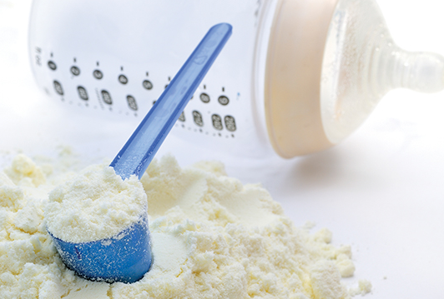
Formula Shortage
AAP News Article, "Health care providers can request Abbott formula for patients in urgent need"
HealthyChildren.org article, "With the baby formula shortage, what should I do if I can't find any?"

Slide 21

MENTAL HEALTH ADVOCACY CAMPAIGN
JOIN OUR WEAR GREEN DAY ACTION
The AAP Board & Staff will participate in “Wear Green Day of Action” on Friday, May 20. Join us by posting pictures to your social media accounts along with messages supporting the advocacy campaign
TAG us @AmeriAcadPeds #MENTALMENTALHEALTHAWARNESSMONTH

Slide 22

From the CDC
Acute Hepatitis and Adenovirus
What: COCA call (Clinician Outreach and Communication Activity) Clinical Recommendations for Adenovirus Testing and Reporting of Children with Acute Hepatitis of Unknown Etiology
When: Thursday, May 19, 2022, 2:00–3:00 P.M. ET
Who: Clinical professionals, including physicians, nurses, physician’s assistants, pharmacists, paramedics, public health practitioners, and state and local health department officials.
How: access Zoom webinar link at: https://emergency.cdc.gov/coca/calls/2022/callinfo_051922.asp

Slide 23

Save the date!
Caring for Adolescents & Young Adults w/Disordered Eating

Slide 24
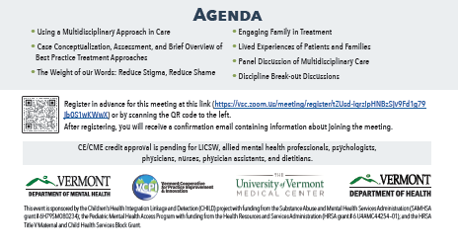
Save the date!
Caring for Adolescents & Young Adults w/Disordered Eating

Slide 25
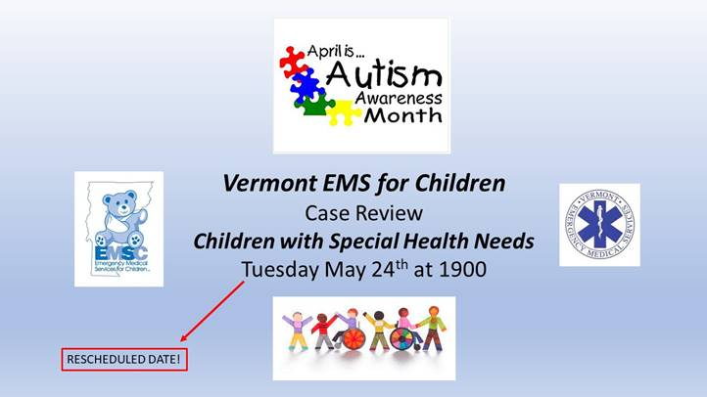
Coming soon…
Emergency Medical Services for Children Case Review
Cases involving Children with Special Health Needs
New date: May 24, 2022 – join via Zoom (see email for link)
Thank you, Dr. David Nelson, Ped EM at UVM CH

Slide 26
WIC Infant Formula - Abbott Update
All Substitutes for Similac formulas extended through August 2022
This includes substitutes for Similac Advance and Isomil, as well as substitutions for Total Comfort, Spit Up and Sensitive.

Slide 27
Abbott Update
Sturgis, MI Plant
Abbott entered into Consent Decree with FDA to re-open plant
Once finalized could re-open in 2 weeks, with 6-8 weeks before product on shelves (potentially late-July/early August seeing on shelf)
Abbott will prioritize production of Alimentum, EleCare and metabolic formulas
Other formulas to follow….. Total Comfort/Spit Up/Sensitive
CDC concluded its investigation with no findings of a link between Abbott formulas and infant illnesses

Slide 28
New Additions to Large Can Size Food Packages
Added:
Enfamil Infant & Enfamil NeuroPro Infant
Enfamil Reguline
Enfamil Enspire and Enspire Gentlease
Good Start GentlePro
Store Brands:
Hannaford = Always My Baby and Natures Promise
Price Chopper = Tippy Toes
Shaw’s = Signature Care and O Organics

Slide 29
Vermont News: Infant Formula Shortage
VPR: Baby formula shortage deals major blow to low-income Vermonters – Mikaela Lefrak (5/17/22) https://www.vpr.org/vpr-news/2022-05-17/baby-formula-shortage-deals-major-blow-to-low-income-vermonters
Seven Days: The Infant Formula Crisis Is Causing Stress for Vermont Families – Alison Novak (5/17/22) https://www.sevendaysvt.com/vermont/the-infant-formula-crisis-is-causing-stress-for-vermont-families/Content?oid=35595809
  Thank you, Meghan Gunn, MD FAAP (Chief of Pediatrics, Southwestern Vermont Medical Center)

Slide 30
From the VDH Immunization Program
UPDATE Booster for ages 5-11
FDA approved EUA for Pfizer Booster 5-11 on 5/17/2022
ACIP scheduled to meet Thursday 5/19 with CDC recommendation to follow
Approximately 18K children will be eligible at the time of the recommendation
Requests may come into provider offices once approval comes
Walk-in clinics and pharmacies continue to be available options for this age group
FDA Approval: www.fda.gov/news-events/press-announcements/coronavirus-covid-19-update-fda-expands-eligibility-pfizer-biontech-covid-19-vaccine-booster-dose
Second Booster Clinical Considerations: www.cdc.gov/vaccines/covid-19/downloads/Clinical-Considerations-Second-COVID-19-Booster-508.pdf
Notes:
FDA may plan to talk about this submission during their June 28 – COVID-19 strain selection/future boosters, we have not heard any more than this yet.

Slide 31
COVID-19 vaccine for children under 5
Moderna
  submitted data to the FDA on April 28
  6 months through 5 years
  2 dose series of 25 µg each (1/4 of adult dose)
  Different formulation and NDC
Pfizer
  data not yet submitted, hearing early June
  6 months through 4 years
  3 dose series of 3 µg each (1/10 of adult dose)
  Different formulation and NDC
VRBPAC Tentative Meeting Schedule - June 2022
The FDA VRBPAC committee released tentative dates for virtual meetings in anticipation of upcoming EUAs for COVID vaccines announced by vaccine manufacturers. See VRBPAC announcement.
June 7 - Novavax 18+ (no rollout expected now)
June 8, 21, and 22 - Pfizer/Moderna EUA under 5 or 6
June 28 – COVID-19 strain selection/future boosters
VRBPAC announcement: www.fda.gov/news-events/press-announcements/coronavirus-covid-19-update-fda-announces-tentative-advisory-committee-meeting-schedule-regarding

Slide 32
COVID Vaccine for under age 5
What VDH is doing
  Ensuring access for all families
  Hosting clinics for WIC participants
    WIC clients will be able to schedule with us or PCP offices
  Coordinating with Pharmacies that will offer vaccine to age 3+
How can we help PCP offices?
  Can make resource guide for front office staff
  Written communication to share with families
  Once vaccine(s) are approved we will provide materials and training

Slide 33
Recent Communication
Program communications available on the Health Care Professionals Page: www.healthvermont.gov/covid-19/health-care-professionals/vaccine-information-health-care-professionals
April Provider Update: mailchi.mp/635a48bb756f/vermont-vaccine-program-update-april-2022
Immunization Program 03/22/2022 Provider Call:
Slide deck: www.healthvermont.gov/sites/default/files/documents/pdf/HS-IZ-VVP-COVID19-Vaccine-Training-03.22.2022.pdf
Recording: www.youtube.com/watch?v=y9msC5c8d4s
Notes:
Pfizer offers regular trainings on all of its vaccine formulations. We highly encourage you to watch one of them.

Slide 34

Tuesday Media Briefing (5/17/22)
Governor Phil Scott [Note: announced run for 4th term today]
Reviewed legislative session: historic investments w/state & federal funding. Get us the best ROI for years to come. Our areas of disagreement get the most attention, but in the end, by working together, we really did accomplish a lot.
Commented upon the “horrific act of domestic terrorism in Buffalo over the weekend…reminder that the embers of hate & white supremacy are still flaring up. It’s on all of us to extinguish those embers when we see them & find ways to stop them…It’s important for all Vermonters to recognize there is still work to be done & also to know that many Vermonters of color could use our support and extra kindness right now.”
Legislative session/budget: five funding buckets to benefit Vermonters: housing, climate change mitigation, water/sewer/stormwater infrastructure, broadband, economic development... I look forward to shovels in the ground across the state this summer.

Slide 35

Tuesday Media Briefing (cont’d.)
VDH Commissioner Dr. Mark Levine
Acknowledge the tragic milestone US has reached – 1million people have died due to COVID-19. Staggering to contemplate that # & even higher # who bear the grief. 654 lives lost here in Vermont – each a family member, friend, neighbor who mattered & can never be replaced.
Paxlovid: VDH reached out to health care system thru HAN (5/13/22) to decrease barriers to obtaining this treatment – includes user-friendly tools for decision-making. Don’t think you need to save it for someone more needy – we currently have plentiful supply (rec’d. courses this week).
SEE VDH Health Advisory (May 13, 2022): “Increasing Paxlovid Prescribing,” Allison Lafferty, MD, Health Department Epidemiologist
  https://www.healthvermont.gov/sites/default/files/documents/pdf/HAN-Paxlovid.pdf

Slide 36
Tuesday Media Briefing (cont’d.)
VDH Commissioner Dr. Mark Levine
New surveillance report: incl. ED trends in pts. w/COVID-like illness; case trends; hospital impact; outbreaks; vaccination rates; wastewater monitoring; variant proportions over time.
Base decisions on personal risk assessment (vs. daily case #s).
Dashboard not longer updated after 5/18/22; vaccine dashboard will cont. to be updated. Will also sunset other reports. Teams will continue to collect & respond to data in real time – would not have been able to respond w/o them. Thank you, Vermonters, for paying attention to the data.
Testing: as we move out of emergency phase& incorporate this into our day-to-day public health work – will be similar to vaccines which have now moved to traditional sites with medical providers & pharmacies.

Slide 37
Tuesday Media Briefing (cont’d.)
VDH Commissioner Dr. Mark Levine
Next change: testing to move from state-run sites to health care system & pharmacies.
Demand for PCR testing slowing as at-home tests yield quicker results. Widely available as we deal w/increasingly transmissible form of virus. Pharmacies have options; providers can assess symptomatic pts. for testing. Priorities: people with symptoms or close contacts not UTD on vaccine.
Public sites will close in phased manner thru May & June. At home tests widely available – working to make them convenient & free.
May order at covid.gov or pick up at state sites through end of June.

Slide 38
Tuesday Media Briefing (cont’d.)
VDH Commissioner Dr. Mark Levine
Infant formula: USDA & FDA taking steps to address shortages. Recent news re: reopening closed manufacturing plant; hope supply will increase but will take weeks-months.
Current situation frustrating –WIC & VDH local health offices, Agency of Agriculture working on this issue.
Fam should NOT substitute goat’s milk, cow’s milk or plant-based products & do not water down formula. As a general rule, don’t make homemade formula.
Pay close attention if purchasing online – caution to use recognized options.
Ask practice offices if they have in-office samples. If expecting baby soon, consult w/HCP re: breastfeeding (VT WIC has breastfeeding resources).

Slide 39




Practice Issues
Caring for Patients with Suicidality in Primary Care
Greta Spottswood, MD MPH – Child Psychiatrist, Community Health Centers of Burlington; Medical Director, Vermont Child Psychiatry Access Program (VTCPAP)Medical Director
Notes:
Margaret (Greta) Spottswood, MD, MPH graduated from University of Vermont College of Medicine and completed her Psychiatry Residency and Child and Adolescent Psychiatry Fellowship at the Cambridge Health Alliance. She enjoys the challenge of evidence-based psychiatric care using a team approach with patient registries and care managers to provide consultation and care to large populations.

Slide 40
Caring for Patients with Suicidality in Primary Care
Prevention | Assessment | Intervention
VCHIP VDH CHAMP COVID-19 update call
Wednesday May 18, 2022
Greta Spottswood, MD, MPH, VTCPAP Medical Director
Stephanie Fosbenner, MD, MPH
Notes:
multiple suicide prevention initiatives in VT right now--doing our best to coordinate

Slide 41
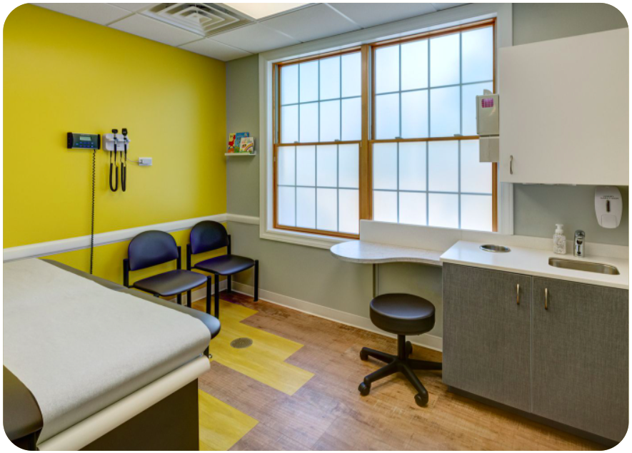
Composite case:
14 yo African American bisexual cis-female presents with her father for an annual physical exam…

Slide 42
Composite case study:
HPI | Grades have dropped: As to B-Cs since high school/pandemic Gets along well with family and peers
ROS | Sleeping more x2 months
Screening | PHQ-9 is 14, question 9 is “somewhat”
Meds | Multivitamin usually
Therapy | No

Slide 43
Composite case study:
Diet/exercise/healthy act. | Not as hungry for a few months Used to play soccer but stopped last year
Medical hx | h/o asthma when younger, not currently a problem
Family hx | H/o hypothyroid for mother alcoholism in 2 grandparents and an uncle
Social hx | Lives with parents and little sister (age 10, doing well)
Trauma | h/o “bad relationship” last year
MSE | Well groomed Eager to answer questions Looks away when asked about how she is feeling, +SI

Slide 44
Composite case: differential diagnosis

Slide 45
Composite case: next steps, treatment plan
Take homes:
Suicide prevention
  Separate on problem list
  Buys time to treat the underlying cause

Slide 46
Old approach to suicidal ideation…
Only treat the underlying cause
Non-systematic
Stop at PHQ-9

Slide 47
New evidence!
Sequence of care helps prevent fatal outcomes

Slide 48
Objectives
Definitions
Epidemiology & Context
Risk factors
Screening
Intervention
Notes:
Today’s talk is intended to give a brief overview of tips for identifying suicidality and completing a risk assessment
Will also discuss interventions you can make in the office to reduce risk and points to consider in referring for additional services

Slide 49
Suicidality As a Spectrum
Non-Suicidal Self Injury (NSSI)
Suicidal Ideation
Suicidal Method
Suicidal Planning & Preparation
Suicide Attempt
INCREASING INTENT, RISK, ACUITY
Gordon & Melvin, 2014
Notes:
Want to start to by establishing a shared language around concepts related to suicidality, as referring to a youth as “being suicidal” can mean different thigs and warrant different types of intervention
Suicidality can be thought of as existing on a spectrum with different terms being used to describe different points along this spectrum
NSSI – intentionally injuring oneself without intent to die. While there is evidence that NSSI can elevate ones risk for future suicidal behavior, it is by definition not suicidal in nature, and instead may be fulfilling a self-regulation, expression, or punishment function
Suicidal Ideation – essentially involves having thoughts about suicide. These can be passive thoughts, such as thoughts about wishing one was dead or more active thoughts about wanting to kill oneself, but in either case, the thoughts aren’t associated with acts of furtherance, in the way of planning out how one would carry out a suicide or preparing to attempt suicide
Suicidal method – like it’s name suggests, involves thinking generally about what method one would use to attempt suicide such as overdosing on a medication, cutting oneself, or hanging
Suicidal planning and preparation – relate to engaging in acts or preparation towards an imminent suicide attempt. This could involve creating a specific plan, preparing to carry out the plan, such as buying pills to overdose on, and/or preparing for the aftermath of an attempt such as giving away belongings
Suicide attempt – refers to execution of intentional self-injury pursued with intent to die

Slide 50
Objectives
Definitions
Epidemiology & Context
Risk factors
Screening
Intervention
Notes:
Today’s talk is intended to give a brief overview of tips for identifying suicidality and completing a risk assessment
Will also discuss interventions you can make in the office to reduce risk and points to consider in referring for additional services

Slide 51
Sobering Epidemiology
Second most common cause of death for youth 10+ Wyckoff, 2021
56% increase in adolescent suicide 2007-2017 Curtin et al., 2019
Mean U.S. weekly number of ED visits by youth for suspected suicide attempts relative to 2019
  22% ↑ summer 2020
  39% ↑ winter 2021 Yard et al., 2021
Rates rising more for minority youth
  Racial, sexual, gender Sheftall et al., 2021; Murray & Thomas 2021
Notes:
It has been well-documented that the incidence of suicide among youth globally has been increasing since at least 2007
Suicide is currently the 2nd leading cause of death for youth ages 10 and older after accidents --- more youth die by suicide than the top 17 leading medical causes of death combined
Evidence this concerning trend was accelerated by the COVID pandemic and more pronounced for racial, sexual, gender, and minority youth

Slide 52
Why Primary Care?
7,000 youth (16+) screened with PHQ-9 in primary care:
    26% screened positive for depression (score of > 11)
    8.6% screened positive on the suicidal risk questions
Farley et al., 2020
Notes:
We know the the busy practice environment of primary care can make managing mental health concerns and especially acute suicidal risk challenging
And yet, mental health concerns, including suicidal ideation are relatively common presentations in primary care
In one study of 7000 adolescents 16+ who were screened with the PHQ9 in primary care:
Over a quarter (26%) screened positive (> 11)
Furthermore, 8.6% screen positive on the suicidal risk questions, more than half of whom were below the score threshold of 11 for the PHQ9 to be considered positive
More youth with mental health concerns get treatment in primary care than specialty mental health care, and primary care is often on the frontlines of identifying mental health concerns and suicidality in young people

Slide 53
Objectives
Definitions
Epidemiology & Context
Risk factors
Screening
Intervention
Notes:
Today’s talk is intended to give a brief overview of tips for identifying suicidality and completing a risk assessment
Will also discuss interventions you can make in the office to reduce risk and points to consider in referring for additional services

Slide 54
Risk Factors for Adolescent Suicide
Demographic | Clinical History | Environmental | Clinical Exam
Male (completed; female attempted) Older adolescent (16+) LGBTQ identity | Past attempt Family hx of attempts + completion (5x risk) Psychiatric diagnosis Recent discharge from inpatient hospitalization Childhood trauma Childhood sexual abuse/rape Chronic illness + impairment Personality traits (neuroticism, perfectionism) Low self-esteem | Recent life stressors (school, family, peer, romantic) Bullying Social isolation Access to lethal means Parental mental illness Poor relationships with caregivers | Intrusive suicidal thoughts with planning, intent Substance intoxication Agitation/anger Severe anxiety Hopelessness Impulsivity Poor problem-solving
Suicide Prevention Resource Center, nd
Gordon & Melvin, 2014
Kivisto et al., 2020
Notes:
It is not possible to predict suicide at the individual patient level, but there are population level risk factors, some of which are modifiable
Note that this is a busy slide, but points to highlight:
Males more likely to complete suicide, females more likely to attempt
Past behavior is a strong predictor of current and future behavior --- so personal and family history of suicide is a strong risk factor, as is past and ongoing abuse
None of these environmental risk factors are surprising, but encouragingly some are modifiable, particularly access to lethal means ---
Recent study that 50% of completed adolescent suicides during the study period involved a fire arm. Found strong association between household firearm ownership and adolescent suicide, as well as association between safe storage procedures (i.e policies mandating locks and safe storage) and decreased adolescent firearm suicide (Kivisto et al, 2020)

Slide 55
Protective factors for Adolescent Suicide
Strong social support
Positive, trusting relationships with caregivers
Connection to a community
Engagement in meaningful work/activities
Ability to engage in problem solving
Restricted access to lethal means
Access to mental health and substance use treatment
Suicide Prevention Resource Center, nd
Gordon & Melvin, 2014
Kivisto et al., 2020
Notes:
There are also several factors that have been associated with reduced risk of suicide
PERCIEVED sense of connection vs felt disconnection associated with psychological pain

Slide 56
Risk Factors for Suicide: “Three-Step Theory”
Pain + Hopelessness = desire for suicide
Perceived (Dis)connection
Capability for suicide
Klonsky et al. 2021
Notes:
Disconnection—
Connection = “to people, communities, valued hobbies, roles, jobs, any sense of purpose or meaning”

Slide 57
Risk Assessment
Triage
ID by screening
Suicide Prevention
Intervention
Notes:
While a balance of risk and protective factors is a necessary component of any risk assessment which is a critical component of suicide prevention.
Comprehensive prevention efforts necessitates both screening and appropriate intervention based on risk
Primary care has a critical role in suicide prevention through screening efforts that facilitate identification and allow for appropriate triage and intervention

Slide 58
Objectives
Definitions
Epidemiology & Context
Risk factors
Screening
Intervention
Notes:
There is currently no USPSTF recommend for universal suicide screening in primary care for youth or adults
Screening higher risk groups is the current agreed upon standard of care. High risk groups include those with known mental or substance use concerns.
?A case could be made for screening adolescents, as rates of suicide increase during adolescence, as well as sexual and gender minority youth, given documented high rates of suicidal ideation and behavior in this population

Slide 59
Youth Suicide screen tools
Screening Tool | ages | Accessible
PHQ-9 Adolescent | 11-17 | https://www.aacap.org/App_Themes/AACAP/docs/member_resources/toolbox_for_clinical_practice_and_outcomes/symptoms/GLAD-PC_PHQ-9.pdf
Ask Suicide Screening Questions (ASQ) | 10-24 | https://www.nimh.nih.gov/research/research-conducted-at-nimh/asq-toolkit-materials/youth-asq-toolkit
Columbia Suicide Severity Rating Scale Screen (C-SSRS) | 12+ | http://cssrs.columbia.edu/wp-content/uploads/C-SSRS_Pediatric-SLC_11.14.16.pdf
Suicide Assessment 5-Step Evaluation and Triage (SAFE-T) | Youth | https://www.porticonetwork.ca/documents/366159/1073220/Suicide+Assessment+Five-Step+Evaluation+and+Triage+%28SAFE-T%29%20Booklet/00b209ca-3078-45db-a175-6983c6962166
Spottswood et al., 2021)
(AAP, n.d.)
Notes:
There are multiple validated tools available for screening for suicide in youth that are freely available including:
PHQ9-Adolescent which includes two questions focused on suicide that are not included on the adult PHQ9, namely a question about having had serious thoughts about end one’s life in the past month and having ever made a suicide attempt
ASQ is a 4-item suicide-screening tool that takes less than an minute to administer. Also provides guide for subsequent risk assessment and triage. Different versions for different clinical settings, including version specifically designed for use for youth in primary care. Available in multiple languages.
Columbia Suicide Severity Rating Scale Screen has two questions about passive and active suicidal ideation, with subsequent follow-up questions further characterizing the ideation if present. Provide overview of recommended triage points.
SAFE-T provides an overview of the key steps involved in doing assessment and provides general recommendations for intervention based on risk

Slide 60
 | LOW | Moderate | High
Characteristics of ideation | Death wish or wish to have never been born No planning No intent | Thoughts about method No concrete acts of furtherance in way of pursuing method (i.e. detailed planning, purchasing materials) No intent | Detailed planning Acts of furtherance Intent
History of Suicidal Behavior | None | Remote (> 1 year ago) | Recent (within the past 6 mos)
Access to Means | None or restricted | None or restricted | Yes (limited capacity to restrict)
Social support and monitoring | Multiple sources of social support Capacity for caregiver monitoring | At least one source of social support Capacity for caregiver monitoring | No/meager social support Limited/nconsistent caregiver monitoring
Mental State | Mild distress, hopeful, calm, able to problem solve | Moderate distress, moderate anxiety or mood symptoms, some belief that things can improve, some ability to problem solve | Agitated/highly anxious, hopeless, impulsive, intoxicated, isolated, can’t problem solve, feels a burden, sense of isolation
Safety Planning | Able to engage | Able to engage | Unable to engage
Protective factors | Readily able to identify | Able to identify | Unable to identify
Precipitating factors/stressors | Viewed as modifiable / solvable | Viewed as significant, potentially not immediately modifiable, but manageable | Viewed as disastrous, not modifiable, not tolerable
Notes:
Not going to go through this in detail, but these are some things to think about when doing a risk assessment
Many of these points are covered in the ASQ and other screening measures
Key points of differentiation between lower risk and higher risk are:
Presence of a specific plan and intent
Access to means
Presence of social support and monitoring

Slide 61
Safety Assessment Pearls
Ensure privacy
Normalize
Be direct
Assess planning/preparation and intent
Assess acute vs. chronic ideation
Precipitating factors, risk and protective factors
Validate
Safety trumps confidentiality--give autonomy when possible
Changes in pain
Changes in hopelessness
Are they feeling worse??
Notes:
The youth should ideally have privacy from their caregivers when filling out screens about mental health concerns. Any subsequent safety assessment should also be conducted privately with the youth
It can be helpful to normalize the experience of suicidal ideation, but at the same time, it’s important to ask directly about it. For example, many patients I see tell me they’ve experienced suicidal thoughts when upset or going through a difficult time. Have you experienced similar thoughts about wanting to kill yourself?
It can be helpful to initially be open-ended in obtaining more details about a youth’s suicidal ideation (i.e. can you tell more more about the thoughts?) however asking specific questions about any acts of furtherance the youth has made in the way of acting on their ideation, such as planning out their attempt, purchasing materials, and giving away belongings, is essential for characterizing acute risk
It is also important to get a sense of whether the youth’s suicidal thoughts are acute or chronic in nature (How long have you been having these thoughts), context for the thoughts (do you think anything has happened to bring on these thoughts), and sense of protective factors (what has prevented you from acting on the thoughts)?
Many of these points are laid out in the ASQ, as well as the C-SSRS screeners
It’s important to praise the youth’s courage in disclosing suicidality and validate their emotional experience (thank you for sharing this with me. It sounds like things have been very difficult, and I want to help you stay safe and feel better)
In cases of acute concern, it may be necessary to break confidentiality to ensure safety. When doing this, try to give the youth autonomy in how it is done. I’m concerned about you and need to let your parent know so we can all come up with a plan to keep you safe. How is it best for us to let them know? Do you want me to tell them? Do you want to let them know? Or should be do it together?

Slide 62
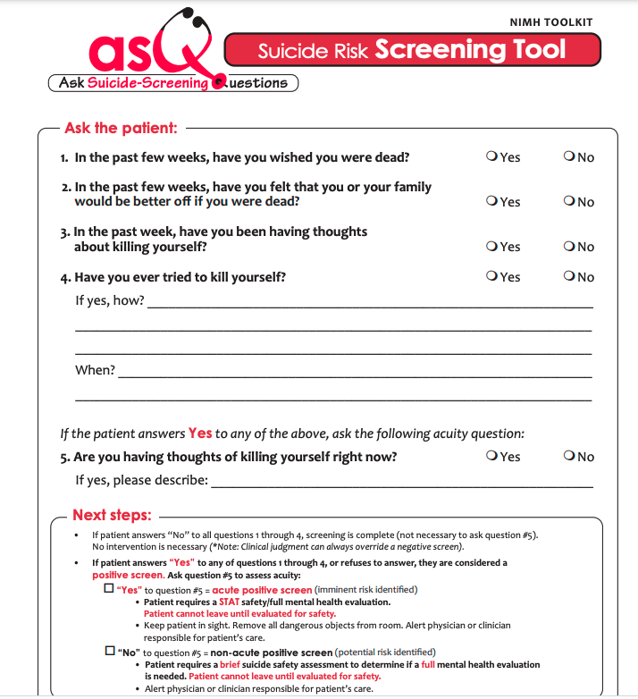
Progresses from passive to active ideation
Assessing acute risk
(Horowitz et al., 2012)
Accessible at:
https://www.nimh.nih.gov/research/research-conducted-at-nimh/asq-toolkit-materials/youth-asq-toolkit
Notes:
Given limited time, I’m only going to focus on one of the screening tools. Here is the ASQ
Here are the 4 ASQ questions --- assess for both passive and active suicidal ideation, and a 5th question about current ideation

Slide 63
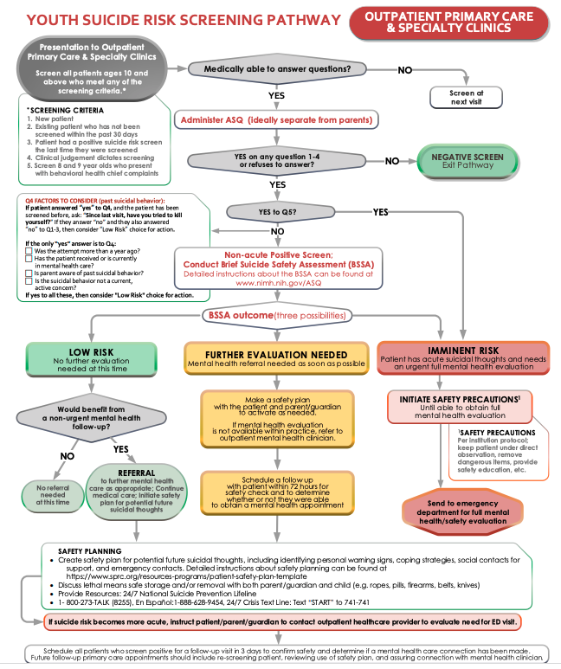
Brief Suicide Safety Assessment
  Frequency
  Planning
  Past suicidal behavioral
  Symptoms
  Social supports & stressors
Guide to triage
(Horowitz et al., 2012)
Freely accessible at:
https://www.nimh.nih.gov/research/research-conducted-at-nimh/asq-toolkit-materials/youth-asq-toolkit
Notes:
Depending on the patients responses to the initial there is guide to follow-up questions for conducting a more thorough assessment, focused on more precisely characterizing the pervasiveness and context of the patient’s current ideation, as well as risk and protective factors
From there, there is a flow chart to assist with triaging risk and intervention

Slide 64
Objectives
Definitions
Epidemiology & Context
Risk factors
Screening
Intervention

Slide 65
Reducing Risk
Safety planning
Lethal means reduction
Relationship (PCP, adults)
Notes:
Immediate intervention focuses on altering modifiable risk factors and equipping youth with problem solving and distress tolerance strategies for managing moments of heightened distress
[Maybe not important to mention] --- In the longer-term there is RCTs quality evidence that certain medications can reduce suicidality by targeting underlying mood and anxiety disorders. For example, in youth there is evidence that treatment with SSRIs can reduce suicidal ideation in youth with depression [TADS study]. In adult populations, there is evidence for the utility of Lithium and Clozapine in reducing risk of suicide in people with affective disorders and psychosis respectively.
Two of the most powerful interventions that can be most readily made in a primary care visit are:
(1) Safety planning
(2) Lethal means restriction

Slide 66
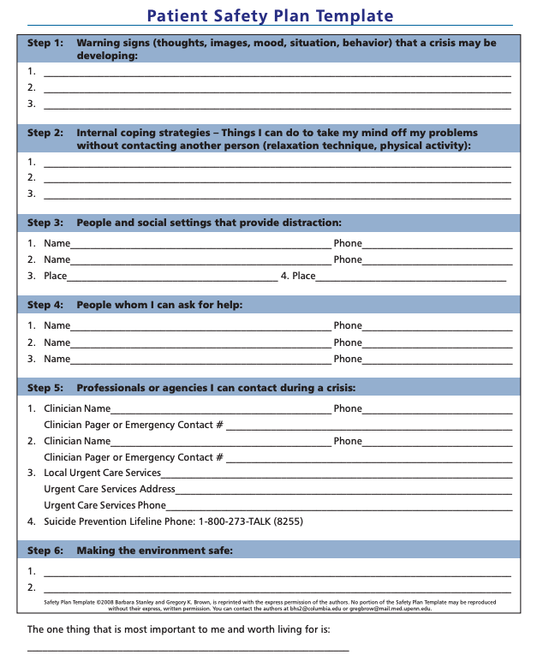
Warning Signs
Virtual HOPE Box:
Helps kids make their own hopeful pictures/reminders of safety plan
Coping Strategies
Crisis Resources
Crisis Text Line: Text “VT” to 741741
Lethal means restriction
Stanley & Brown, 2008
Free: https://suicidepreventionlifeline.org/wp-content/uploads/2016/08/Brown_StanleySafetyPlanTemplate.pdf
Protective Factors
Notes:
Safety planning helps with coping, BUYS TIME to treat other diagnoses
Reduces chances → impulsive/lethal action
A safety plan is a plan for what the youth should do in the event of significant distress or suicidal ideation to avoid managing it by engaging in suicidal or other self-harm behavior.
There are various templates available for safety planning --- this is a screenshot of the Stanley Brown safety planning template. Most plans incorporate the same core elements in terms of:
Identifying warning signs that one is reaching a point of high distress and is potentially at risk engagement in unsafe behavior. These signs can include changes and behaviors the patient notices in themselves, such as socially withdrawing, low motivation, feeling tense, crying, arguing more etc.
Can ask the youth “How do you tend to feel or what do you do before you have thoughts about or engage in harming yourself?”
Identifying coping strategies that youth can implement on their own, termed internal coping strategies, such as listening to music, taking a walk, taking a shower, and people or places the youth can turn to for support, termed external strategies
Can ask the youth “What are somethings you can do yourself when your feeling upset to help yourself calm down? If those strategies alone aren’t enough, what people could you call, or places could you go to to help you stay safe?
Safety plans typically include a section to insert crisis numbers
They also include prompts about making the environment safe and identifying protective factors.
Making the environment safe touches directly on reducing access to lethal means

Slide 67
Lethal Means Reduction
Lock box / locking cabinets
Gun trigger lock
Education about safe gun storage
Removing items from home
Notes:
Here are some potential strategies for reducing access to lethal means ….

Slide 68
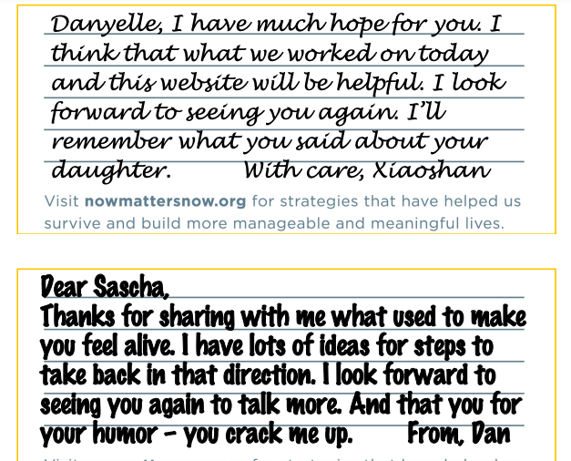
Relationships
Perceived relationships
Caring contacts:
Office can follow through
with a caring relationship
Nowmattersnow.org

Slide 69
VTCPAP: never worry alone
Use emergency resources for urgent/emergencies
(not an emergency service)
Risk assessment is not an exact science
Call for a second opinion/help with decision making
Email aquinn@chcb.org to register your practice
Opening June 13
Weekdays 9-3p

Slide 70
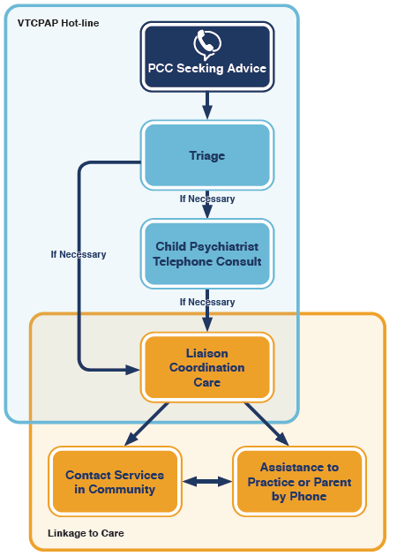

Slide 71
Summary
Youth suicide is a public health problem
Primary Care--critical role
Address underlying problems
Provide treatment now
Sequence of Care
                Screen and triage
                Safety Plan
                Lethal means reduction
Notes:
Summary
Suicide is a significant public health problem among youth that has been exacerbated by the pandemic
Comprehensive suicide prevention requires a multi-pronged approach, in which primary care plays a critical role through screening at risk populations, triaging risk, and safety planning

Slide 72
References
Curtin SC, Heron M. Death rates due to suicide and homicide among persons aged 10-24: United States, 2000-2017. NCHS Data Brief. 2019;(352):1–8
Farley AM, Gallop RJ, Brooks ES, Gerdes, M, Bush ML, Young JF. Identification and management of adolescent depression in a large pediatric care network. J Dev Behav Pediatr. 2020;41(2):85–94.
Gordon, M. & Melvin, G. “Risk Assessment and Initial Management of Suicidal Adolescents.” Australian Family Physician. 43(6). June 6, 2014. Available: https://www.racgp.org.au/afp/2014/june/suicidal-adolescents/
Horowitz, L. M., Bridge, J. A., Teach, S. J., Ballard, E., Klima, J., Rosenstein, D. L., Wharff, E. A., Ginnis, K., Cannon, E., Joshi, P., & Pao, M. (2012). Ask Suicide-Screening Questions (ASQ): A Brief Instrument for the Pediatric Emergency Department. Archives of Pediatrics & Adolescent Medicine, 166(12), 1170–1176. https://doi.org/10.1001/archpediatrics.2012.1276
Kivisto, A. J., Kivisto, K. L., Gurnell, E., Phalen, P., & Ray, B. (2021). Adolescent Suicide, Household Firearm Ownership, and the Effects of Child Access Prevention Laws. Journal of the American Academy of Child & Adolescent Psychiatry, 60(9), 1096–1104. https://doi.org/10.1016/j.jaac.2020.08.442
Klonsky DE, Pachkowski MC, Shahnaz A, May AM (2021). The three-step theory of suicide: Description, evidence, and some useful points of clarification. Preventive Medicine, 152(1), 106549.
Notes:
Intervention

Slide 73
References
Murray, P.J. & Thoma, B.C. Effective Screening and Treatment to Reduce Suicide Risk Among Sexual and Gender Minority Youth | Pediatrics | American Academy of Pediatrics. (n.d.). Retrieved April 12, 2022, from https://publications.aap.org/pediatrics/article/148/4/e2021051831/181293/Effective-Screening-and-Treatment-to-Reduce
https://zerosuicide.edc.org/sites/default/files/nowmmattersnow.pdf. Accessed May 16, 2022.
Sheftall, A. H., Vakil, F., Ruch, D. A., Boyd, R. C., Lindsey, M. A., & Bridge, J. A. (2021). Black Youth Suicide: Investigation of Current Trends and Precipitating Circumstances. Journal of the American Academy of Child & Adolescent Psychiatry, 0(0). https://doi.org/10.1016/j.jaac.2021.08.021
Wyckoff, A.S. (2021). It’s everybody’s problem: goal to end youth suicide unites experts, organizations. AAP News.
Suicide Prevention Resource Center. Available: https://www.sprc.org/
Spottswood, M., Lim, C.T., Davydow, D., & Huang, H. (2021). Improving suicide prevention in primary care for differing levels of behavioral health integration: a review. Frontiers in Medicine. Publication pending.
Stanley, B., & Brown, G. K. (2012). Safety planning intervention: A brief intervention to mitigate suicide risk. Cognitive and Behavioral Practice, 19(2), 256–264. https://doi.org/10.1016/j.cbpra.2011.01.001
Yard, E. (2021). Emergency Department Visits for Suspected Suicide Attempts Among Persons Aged 12–25 Years Before and During the COVID-19 Pandemic—United States, January 2019–May 2021. MMWR. Morbidity and Mortality Weekly Report, 70. https://doi.org/10.15585/mmwr.mm7024el

Slide 74
From the American Academy of Pediatrics
Policy Statement: Eliminating Race-Based Medicine
Addresses the elimination of race-based medicine as part of a broader commitment to dismantle the structural and systemic inequities that lead to racial health disparities.
  Race-based medicine has been pervasively interwoven into the fabric of health care delivery in the United States for more than 400 years. Race is a historically derived social construct that has no place as a biologic proxy.
  https://publications.aap.org/pediatrics/article/doi/10.1542/peds.2022-057998/186963/
AAP News article – “Equity journey: AAP calls for elimination of race-based medicine in new policy” https://publications.aap.org/aapnews/news/20159/Equity-journey-AAP-calls-for-elimination-of-race
News Release: American Academy of Pediatrics Calls for Elimination of Race-Based Medicine https://www.aap.org/en/news-room/news-releases/aap/2022/american-academy-of-pediatrics-calls-for-elimination-of-race-based-medicine/
NPR coverage: https://www.npr.org/2022/05/02/1095939915/american-academy-of- pediatrics-race-based-guidance

Slide 75

Happening now…
Vermont State Parks Prescription Program
Prescription Passes Summer 2022
Who: Collaboration between VT Governor’s Council on Physical Fitness & Sports with VT Department of Forests, Parks and Recreation
What: free day passes at Vermont State Parks
How: prescriptions distributed to medical practices; creates opportunity for child/family health professionals to discuss importance/ health benefits of outdoor exercise.
If interested, please email dbutsch@gmail.com & request desired number of presription pads (50 per pad)
Thank you, Dr. David Butsch!

Slide 76
In case you missed it 5/11/22)
Blood Lead Screening Update
Blood lead screening rates have fallen during the COVID-19 pandemic: please help increase screening rates by 10% by December 2022!
Opportunities: families are attending more well visits
LeadCare II analyzer testing kits are once again available
The Public Health Lab will send free kits and you can return to them for free for analysis – results typically within 3 days
Report regularly to VDH using Globalscape
Please contact us for more information, one-time technical assistance or ongoing practice-specific QI work:
Jill.Davis@med.uvm.edu
Matt.saia@uvmhealth.org

Slide 77
In case you missed it (5/4/22)
Vermont Child Psychiatry Access Program (CPAP)
VT-CPAP: funded by Pediatric Mental Health Care Access (PMHCA) New Area Expansion grant from the ARPA via HRSA. VT DMH & Community Health Centers of Burlington will host of the Vermont Child Psychiatry Access Program.
Intent: support VT PCPs in managing patients with behavioral health problems so they may continue to be treated within the practice. Patient group includes children, adolescents and young adults through age 21.
Support will be available to providers through telephone consultations with VT-CPAP psychiatrists who can answer questions related to diagnosis, medication management, and psychotherapy recommendations. VT-CPAP providers will eventually by available by phone M – F from 9 am to 3 pm, excluding holidays.
Liaison Coordinator will assist by triaging referral for consultation, responding to questions & forwarding cases to the psychiatrist for same/next-day phone consultation, provide linkages to community resources.

Slide 78
Green Mountain Care Board Chair and Member Vacancies
Applications Due 5/27/22
The State of Vermont has posted the description and application for the upcoming Green Mountain Care Board Chair vacancy and a member seat. The State is seeking candidates for the Chair (full time) and Board Member (32 hours per week) who serve a term of 6 years on the Board. Applications are due by May 27th. For more information see: https://humanresources.vermont.gov/GMCB-Search-2022

Slide 79
VCHIP-VDH COVID-19 Call Schedule
May / June / Summer 2022:
May: calls on 5/4, 5/11, 5/18 (no call 5/25) – some specialized content (preventive care catchup; mental health care treatment/access; equity/diversity/inclusion)
June: two calls only – 6/1 and 6/8
July: one call only 7/20
August: one call only 8/24
Fall, 2022: we REALLY need your input/feedback!
Schedule subject to change if circumstances warrant!
Please continue to send your feedback re: schedule/topics to vchip.champ@med.uvm.edu
2 years strong!

Slide 80
VCHIP-VDH COVID-19 Update Calls – now via ZOOM!
Call login information:
Topic: CHAMP VDH COVID-19 Call
Join Zoom Meeting
  https://uvmcom.zoom.us/j/94142791300?pwd=K2N4VUYrSHlMQi9XeGVnc3duNTFmZz09
  NOTE: password (CHAMP) should be imbedded in link (sharing in case needed for any reason. You will not be prompted to enter PW if using link we provided.
Meeting ID: 941 4279 1300
Passcode: CHAMP
One tap mobile
+16468769923,,94142791300# US (New York)
+13017158592,,94142791300# US (Washington DC)

Slide 81
Questions/Discussion
Q & A Goal: monitor/respond in real time; record/disseminate/revisit later as needed.
For additional questions, please e-mail: vchip.champ@med.uvm.edu
  What do you need – how can we be helpful (specific guidance)?
VCHIP CHAMP VDH COVID-19 website: https://www.med.uvm.edu/vchip/projects/vchip_champ_vdh_covid-19_updates
Next CHAMP call in 2 weeks: Wednesday, June 1, 2022 12:15 – 1:00 pm
NO CALL NEXT WEEK (May 25, 2022)
Please tune in to VMS COVID-19 call with VDH Commissioner Levine: May 19 – 12:30-1:00 p.m.
Join VMS Zoom Meeting: https://us02web.zoom.us/j/86726253105?pwd=VkVuNTJ1ZFQ2R3diSVdqdlJ2ZG4yQT09
  Meeting ID: 867 2625 3105 / Password: 540684
  One tap mobile - +1 646 876 9923,,86726253105#,,,,0#,,540684#

