Slide 1
Title of Program: Medicine Grand Rounds Title of Talk: Morbidity & Mortality Speaker/Moderator: Dr. Allen Repp Planning Committee Members: Drs. Ralph Budd, Steve Lidofsky, Marie Wood, Michael LaMantia, Allen Repp, and Heather Wright Date: 3/29/2019 Workshop #: 19-104-26 Learning Objectives 1. Use a systems-based approach to analyze drivers of adverse events 2. Identify opportunities to improve care delivery systems and your own practice of medicine 3. Model a collaborative culture of safety DISCLOSURE: Is there anything to disclose? Yes or No Please list the Potential Conflict of Interest (if applicable): N/A All Potential Conflicts of Interest have been resolved prior to the start of this program. Yes or No (If no, credit will not be awarded for this activity.) All recommendations involving clinical medicine made during this talk were based on evidence that is accepted within the profession of medicine as adequate justification for their indications and contraindications in the care of patients. Yes COMMERCIAL SUPPORT ORGANIZATIONS (if applicable):______________________________________________________________
x
x
x
The University of Vermont College of Medicine is accredited by the Accreditation Council for Continuing Medical Education (ACCME) to provide continuing medical education for physicians.
The University of Vermont designates this live activity for a maximum of 1 AMA PRA Category 1 CreditsTM. Physicians should claim only the credit commensurate with the extent of their participation in the activity.
In order to receive CME credit participants must fill out an evaluation form.
This slide was presented at the start of the program.
x

Slide 2
Want CME Credit? Use this QR Code!
(or use the link below)
http://www.highmarksce.com/uvmmed/index.cfm?do=ip.claimCreditApp&eventID=10365

Slide 3
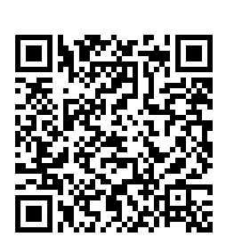
Interested in career advancement and academic promotion?
Join the Department of Medicine Faculty Development ListServ!
Receive once-weekly emails summarizing:
Relevant upcoming talks, conferences, & training opportunities here and elsewhere
Opportunities to teach, serve on committees, and other CV-worthy activities
Information and reminders related to Reappointment and Promotion
Updates from the DOM Faculty Development Committee
Email Benjamin.Suratt@uvm.edu or use this quick QR code:

Slide 4
Proud to be GIM: April 8th 2019
A collaboration between the internal medicine programs at UVMMC and Dartmouth. Contact Dr. Halle Sobel if you are interested in attending a day to encourage medical students and residents to pursue GIM.

Slide 5
AAMC Medical Education Research Certificate (MERC) Workshops
Friday, April 12, 2019
Morning and afternoon sessions with
Larry Gruppen, PhD
University of Michigan Medical School
9am-12pm
Formulating Research Questions and Designing Studies
1-4pm
Measuring Educational Outcomes with Reliability and Validity
For more information and to register:
Visit the Teaching Academy website and click Events

Slide 6
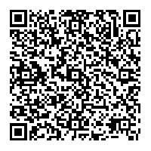
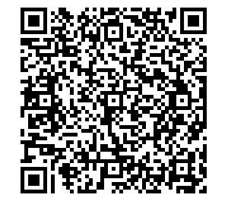
Share your QI Work!
Are you currently working on a scholarly QI initiative that you would like to share with your colleagues? Did you present QI work at a regional or national meeting this past year?
Present a poster at the…
Department of Medicine Quality Showcase
Who? Open to faculty, fellows, residents, and students who have a faculty mentor in the Department of Medicine.
When? Friday, April 19, 2019 9-10 AM, immediately following Grand Rounds
Where? Davis Concourse
How? Register by sending an e-mail to allen.repp@uvmhealth.org. Details to follow via e-mail.
Add to your calendar:
Register:

Slide 7
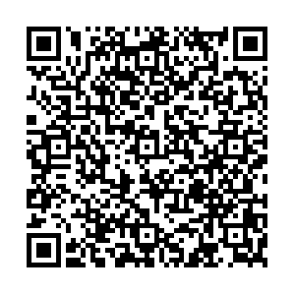
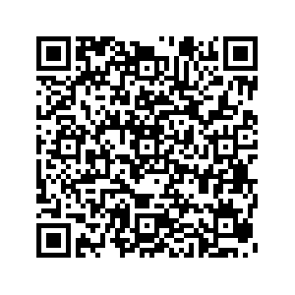
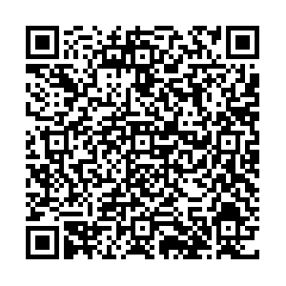
Seeking nominations…
For the annual Department of Medicine faculty awards
The Distinguished Clinician Award To recognize outstanding clinicians in the Department
The Research Mentor Awards
Clinical Resident or Fellow Mentor: To recognize Department faculty members who are outstanding mentors to Residents and/or Fellows
Graduate Student or Post-Doctoral Fellow Mentor: To recognize Department faculty members who are outstanding mentors to graduate students and/or postdoctoral fellows
The Quality Scholarship Award To recognize Department faculty members and/or faculty-led teams who have demonstrated excellence in scholarly quality improvement, patient safety, or high value care
Check your e-mail for more details and nomination forms
Submit nominations to Sue Lee (Suzanne.Lee@uvmhealth.org) by April 30

Slide 8
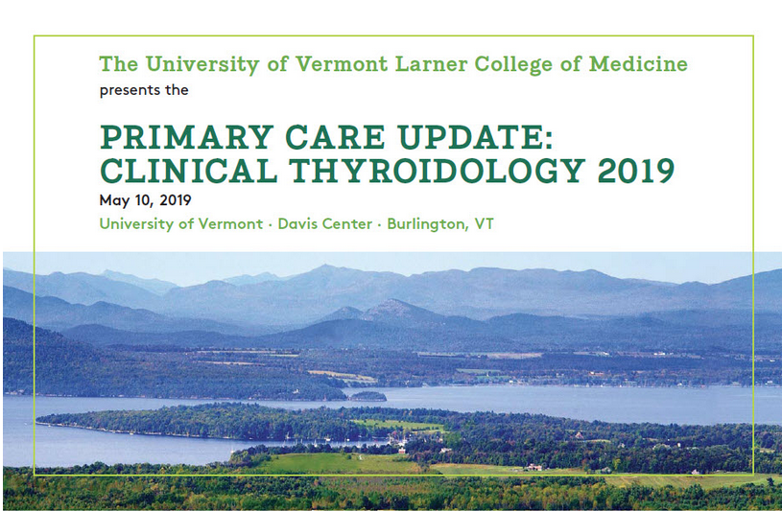
Save the Date: CME

