Slide 1
Title of Program: Medicine Grand Rounds Title of Talk: Building an Integrated Model of Care for Persons Living with Alzheimer's Disease Speaker/Moderator: Dr. Christopher Callahan Planning Committee Members: Drs. Ralph Budd, Steve Lidofsky, Marie Wood, Michael LaMantia, Allen Repp, and Heather Wright Date: 4/5/2019 Workshop #: 19-104-27 Learning Objectives 1) Understand the public health perspective of Alzheimer's disease and related dementias 2) Review the interface of medical and social care for persons living with dementia 3) Describe the next generation of models of care for persons living with dementia DISCLOSURE: Is there anything to disclose? Yes or No Please list the Potential Conflict of Interest (if applicable): N/A All Potential Conflicts of Interest have been resolved prior to the start of this program. Yes or No (If no, credit will not be awarded for this activity.) All recommendations involving clinical medicine made during this talk were based on evidence that is accepted within the profession of medicine as adequate justification for their indications and contraindications in the care of patients. Yes COMMERCIAL SUPPORT ORGANIZATIONS (if applicable):______________________________________________________________
x
x
x
The University of Vermont College of Medicine is accredited by the Accreditation Council for Continuing Medical Education (ACCME) to provide continuing medical education for physicians.
The University of Vermont designates this live activity for a maximum of 1 AMA PRA Category 1 CreditsTM. Physicians should claim only the credit commensurate with the extent of their participation in the activity.
In order to receive CME credit participants must fill out an evaluation form.
This slide was presented at the start of the program.
x

Slide 2
Want CME Credit? Use this QR Code!
(or use the link below)
http://www.highmarksce.com/uvmmed/index.cfm?do=ip.claimCreditApp&eventID=10386

Slide 3
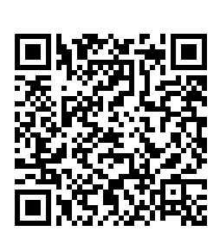
Interested in career advancement and academic promotion?
Join the Department of Medicine Faculty Development ListServ!
Receive once-weekly emails summarizing:
Relevant upcoming talks, conferences, & training opportunities here and elsewhere
Opportunities to teach, serve on committees, and other CV-worthy activities
Information and reminders related to Reappointment and Promotion
Updates from the DOM Faculty Development Committee
Email Benjamin.Suratt@uvm.edu or use this quick QR code:

Slide 4
Welcome R1s! Categorical and Primary Care Residents
Jason Browne University of Wisconsin School of Medicine and Public Health
Elizabeth Carson* Robert Larner, M.D., College of Medicine at the University of Vermont
Nathan Centybear Robert Larner, M.D., College of Medicine at the University of Vermont
Robert Hardwick University of Washington School of Medicine
Yu Ting “Christina” He Weill Cornell Medicine
Jonathan Hingre State University of New York Upstate Medical University
Arjun Janardhan Robert Larner, M.D., College of Medicine at the University of Vermont
Aurasch Moaven University of Maryland School of Medicine
Alison Kim Chicago Medical School at Rosalind Franklin University of Medicine and Science
Seth Levy Jacobs School of Medicine and Biomedical Sciences at the University of Buffalo
Jamie Rowell Medical University of South Carolina College of Medicine
David Steinmetz Perelman School of Medicine at the University of Pennsylvania
Ryan Thomas Albany Medical College
Sean Till Loyola University Chicago Stritch School of Medicine
Areg Zingiryan Robert Larner, M.D., College of Medicine at the University of Vermont
*Primary Care

Slide 5
Welcome R1s! Preliminary Residents
Taylor Abegg-Lawrence Drexel University College of Medicine
Thomas "Daniel" Crowder University of South Carolina School of Medicine
Andrew Gallagher Robert Larner, M.D., College of Medicine at the University of Vermont
Patrick Hartnett Donald and Barbra Zucker School of Medicine at Hofstra/Northwell
Parisa Heidari Tehran University of Medical Sciences School of Medicine
Margaret Johnston Robert Larner, M.D., College of Medicine at the University of Vermont
Conrad Koerper The University of Texas Southwestern Medical School
Alexander Marchese Robert Larner, M.D., College of Medicine at the University of Vermont
Joseph "Joe" Migliazzo University of Missouri Kansas City School of Medicine
Eric Newman University of Queensland School of Medicine
Tobias Robinson Oregon Health & Science University School of Medicine
Santana VanDyke University of Virginia School of Medicine Dermatology
Katherine Zerebiec Medical School: Jagiellonian University Medical College

Slide 6
Proud to be GIM: April 8th 2019
A collaboration between the internal medicine programs at UVMMC and Dartmouth. Contact Dr. Halle Sobel if you are interested in attending a day to encourage medical students and residents to pursue GIM.

Slide 7
AAMC Medical Education Research Certificate (MERC) Workshops
Friday, April 12, 2019
Morning and afternoon sessions with
Larry Gruppen, PhD
University of Michigan Medical School
9am-12pm
Formulating Research Questions and Designing Studies
1-4pm
Measuring Educational Outcomes with Reliability and Validity
For more information and to register:
Visit the Teaching Academy website and click Events

Slide 8
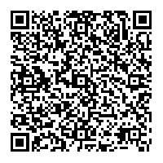
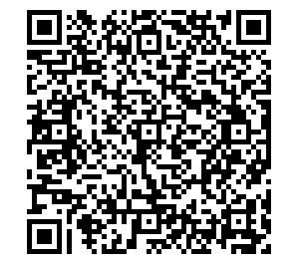
Share your QI Work!
Are you currently working on a scholarly QI initiative that you would like to share with your colleagues? Did you present QI work at a regional or national meeting this past year?
Present a poster at the…
Department of Medicine Quality Showcase
Who? Open to faculty, fellows, residents, and students who have a faculty mentor in the Department of Medicine.
When? Friday, April 19, 2019 9-10 AM, immediately following Grand Rounds
Where? Davis Concourse
How? Register by sending an e-mail to allen.repp@uvmhealth.org. Details to follow via e-mail.
Add to your calendar:
Register:

Slide 9
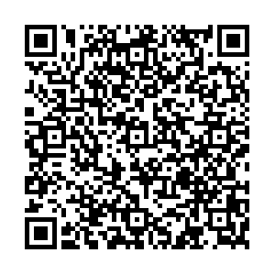
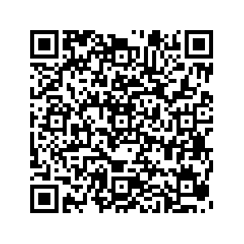
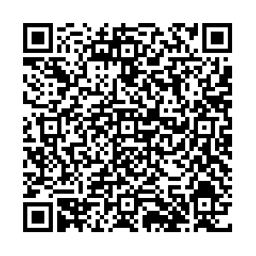
Seeking nominations…
For the annual Department of Medicine faculty awards
The Distinguished Clinician Award To recognize outstanding clinicians in the Department
The Research Mentor Awards
Clinical Resident or Fellow Mentor: To recognize Department faculty members who are outstanding mentors to Residents and/or Fellows
Graduate Student or Post-Doctoral Fellow Mentor: To recognize Department faculty members who are outstanding mentors to graduate students and/or postdoctoral fellows
The Quality Scholarship Award To recognize Department faculty members and/or faculty-led teams who have demonstrated excellence in scholarly quality improvement, patient safety, or high value care
Check your e-mail for more details and nomination forms
Submit nominations to Sue Lee (Suzanne.Lee@uvmhealth.org) by April 30

Slide 10
Tuesday, April 30th
5:30-8:30 pm
The Larner Classroom
StorySlam R_{x}
Storytelling Workshop
with Susanne Schmidt
The UVM Larner College of Medicine will be hosting a
Moth-style StorySlam for all members of the UVM Medical Center community on May 16th, 2019.
In preparation for this event, we are hosting a storytelling workshop with Moth producer and StorySlam winner, Susanne Schmidt. In this workshop, you will learn how to take your story from the page, to the stage.
The theme is resilience. We want you to tell us about a time when you understood what it meant to struggle and prevail, went the distance to strive for the impossible, or bounced back after a fall.
For more information, visit storyslamrxworkshop.eventbrite.com

Slide 11
Thursday, May 16th, 2019
StorySlam R_{x}
Join us for an evening of true stories about resilience told by members of the UVM medical community
The Hoehl Gallery
UVM Larner College of Medicine
Doors open at 6:45 pm
Cash bar
For tickets or to sign up to share a story,
visit storyslamrx.eventbrite.com

Slide 12
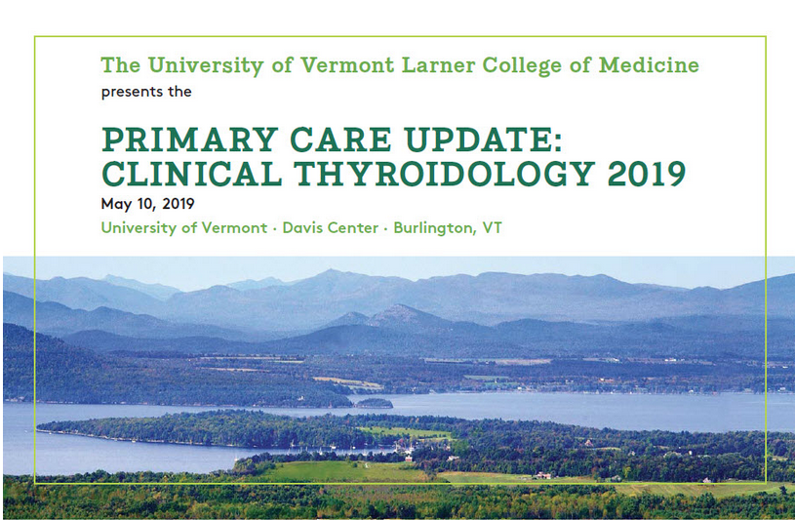
Save the Date: CME

