Slide 1
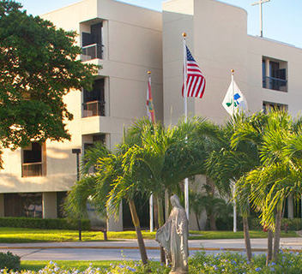
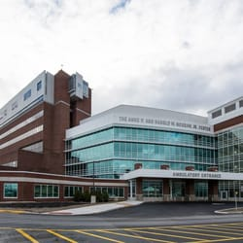
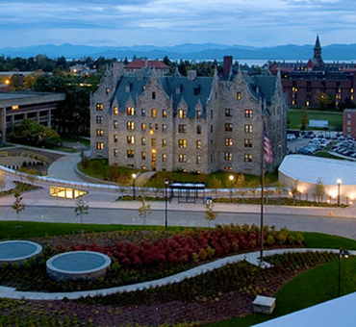
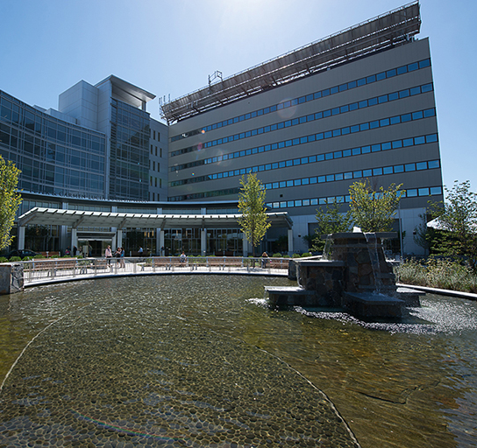
Promoting a Positive Learning Environment:
Mistreatment Prevention
Teaching Academy
Essentials of Teaching 2021
Judy Lewis, M.D.
Nathalie Feldman, M.D.
Notes:
More time for questions/discussions
Time at end to share more proactive strategies for promoting a positive learning environment from the whole group

Slide 2
Objectives
Review how medical student mistreatment is defined and measured by the AAMC and experienced by our students
Gain a greater understanding of the nuances of this complex problem and the challenges inherent in addressing it
Better understand both learner and faculty perspectives on challenges encountered in the learning environment
Develop and review tools that may help bridge generational divides and improve the learning environment
Notes:
Format:
1st ½ hour:
a few definitions
summary of data
2nd ½ hour:
Film – interactive discussion
Resources

Slide 3

What is your knowledge of the behaviors the AAMC includes in their definition of “medical student mistreatment”?
No knowledge
Slight knowledge (I could only name a few behaviors)
Moderate knowledge (I could name most behaviors)
Comprehensive knowledge (I know all the behaviors)

Slide 4
In your opinion, how significant is the issue of medical student mistreatment at the UVM College of Medicine?
Not significant
Slightly significant
Moderately Significant
Very significant
Extremely significant
I am not sure

Slide 5
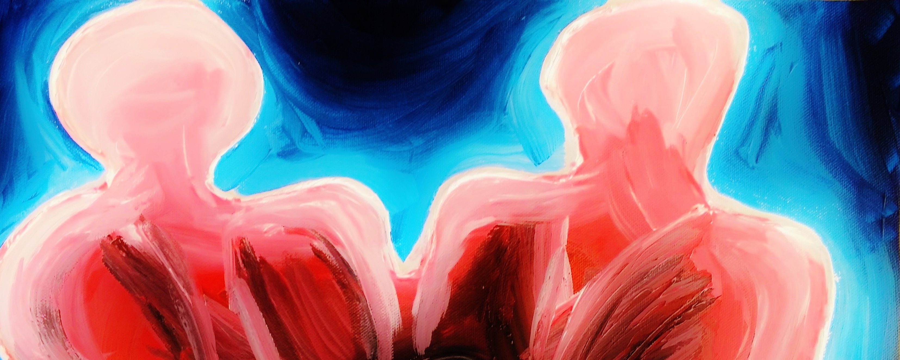
Mistreatment Defined- AAMC
  “Mistreatment, either intentional or unintentional, occurs when behavior shows disrespect for the dignity of others and unreasonably interferes with the learning process.”
Association of American Medical Colleges: Graduation Questionnaire 2001
Notes:
Good working definition- note the term “disrespect” and not “abuse”

Slide 6
Content for GQ Questionsfor GQ Mistreatment Questions
Publicly embarrassed/humiliated
Threatened with physical harm or physically harmed
Required to perform personal services
Subjected to offensive sexist, racial, ethnic, or sexual orientation remarks
Based solely on gender, race, ethnicity, or sexual orientation
  Denied opportunities for training or rewards
  Received lower evaluations or grades
Subjected to unwanted sexual advances
Asked to exchange sexual favors for grades or other rewards
Notes:
About 20 areas queried
AAMC added questions about mistreatment in 1991
Topic of student mistreatment 1st introduced in 1982 in a JAMA commentary by Henry Silver a pediatrician who drew analogy of transformation students undergo with that of the battered child.

Slide 7
Prevalence (%) of selected mistreatment reported on AAMC GQ
Notes:
UVM
2017= 48%
2018= 44.1%
2019 = 50.0%
2020= 39.8

Slide 8

Wide Implications
Notes:
A dysfunctional medical culture negatively affects all members of the learning environment by increasing work stress and burn out
Long been written about in nursing education (Bjorkqvist 2001)
Resident physicians are also affected by a hostile work environment, but there is no “GQ” equivalent for residents.
2014 meta-analysis by Fnais calculated the prevalence of harassment of residents at 63% (mostly sexual harassment & gender discrimination)
Quality of care is impacted; medical errors increase, ultimately, patients are adversely affected (Laschinger, 2014)

Slide 9
University of Vermont Initiatives
Multidisciplinary inter-professional LEAP Committee
Student honor code, authored by students
Teaching Academy supporting faculty development in creating positive LE
New Professionalism Statement – widely distributed
Director of Learning Environment position
Redefined policies and created new reporting procedures
“You Said, We Did”
Professionalism Accolades
Developed an institution wide curriculum….
Notes:
Include new course and clerkship evaluations in “reporting procedures”

Slide 10
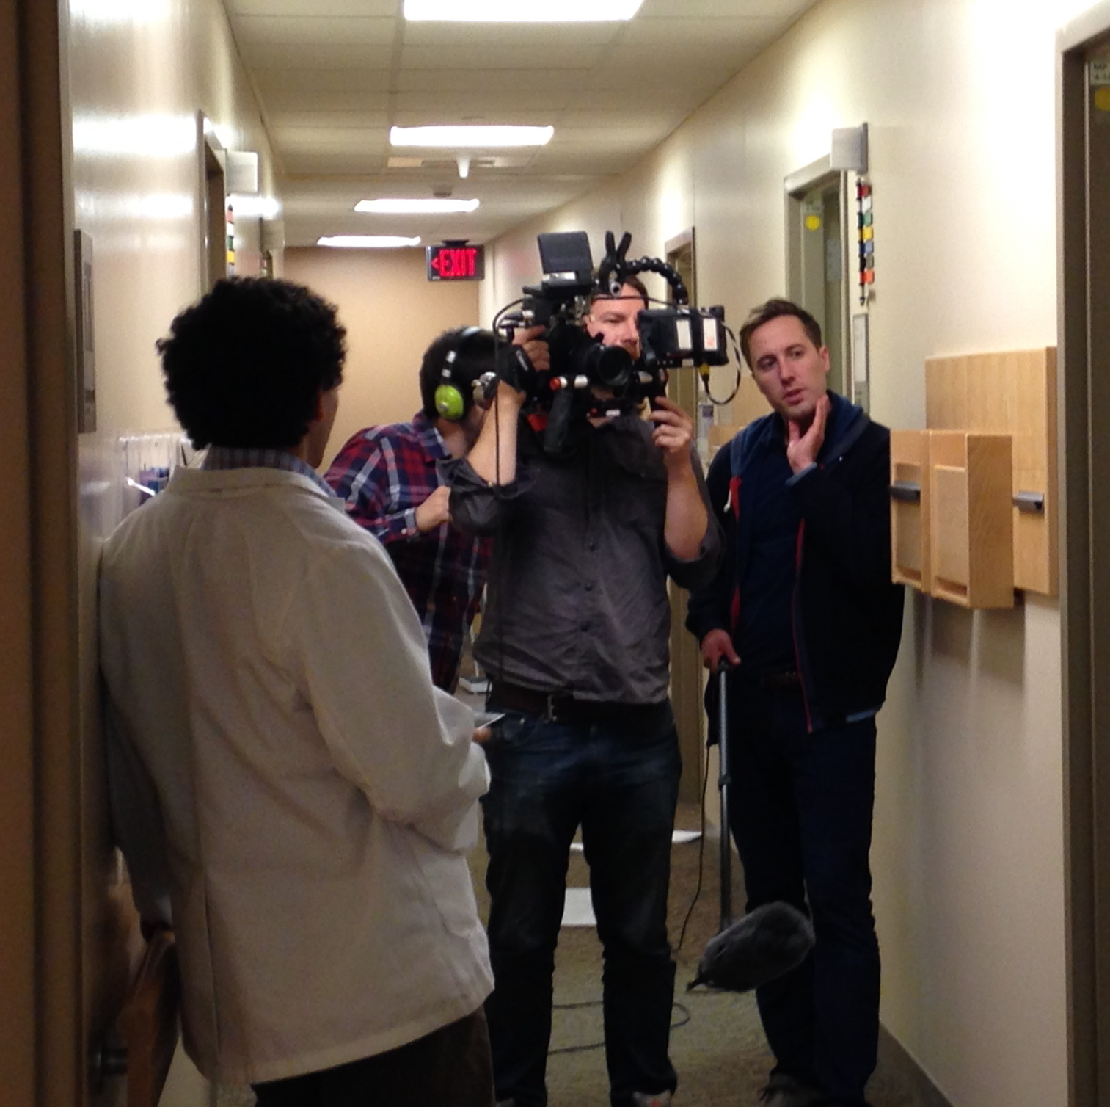
Created Film
Script created from focus groups and student reports at UVM
Themes universal
8 minutes long; contains 4 vignettes
Notes:
Created film to illustrate concepts- most salient points brought up by student focus groups
Scenarios purposely ambiguous to stimulate discussion

Slide 11
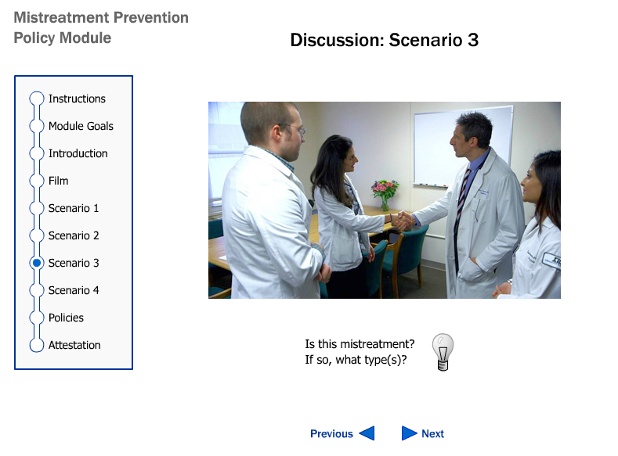
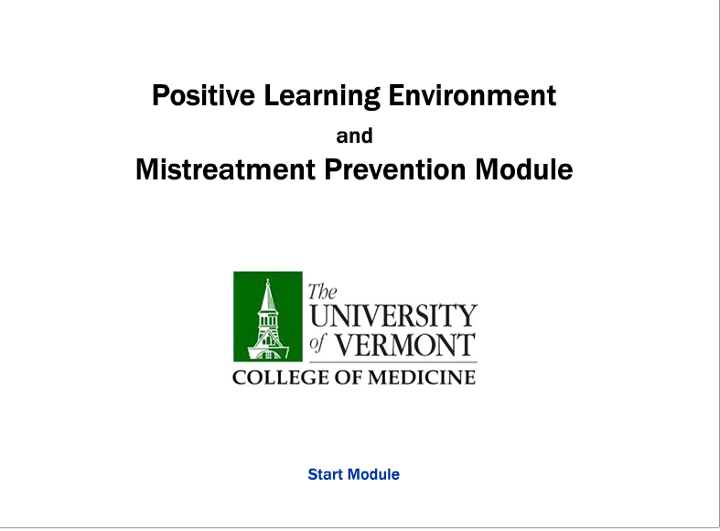
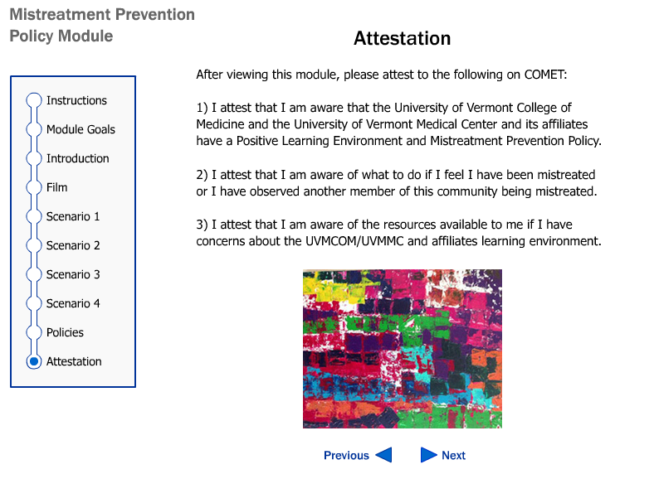
On-Line Module
Required of all 3rd year medical students and incoming housestaff
Defines mistreatment
Explores factors that contribute to and mitigate mistreatment
Links to policies and reporting routes w/ attestation function
Notes:
We were interested in educating our students about existing policies/reporting routes and also trying to get a handle on what students were experiencing and whether that was true mistreatment or whether they were possibly misinterpreting behaviours as mistreatment and if so why.

Slide 12

Film
Notes:
Film 1

Slide 13
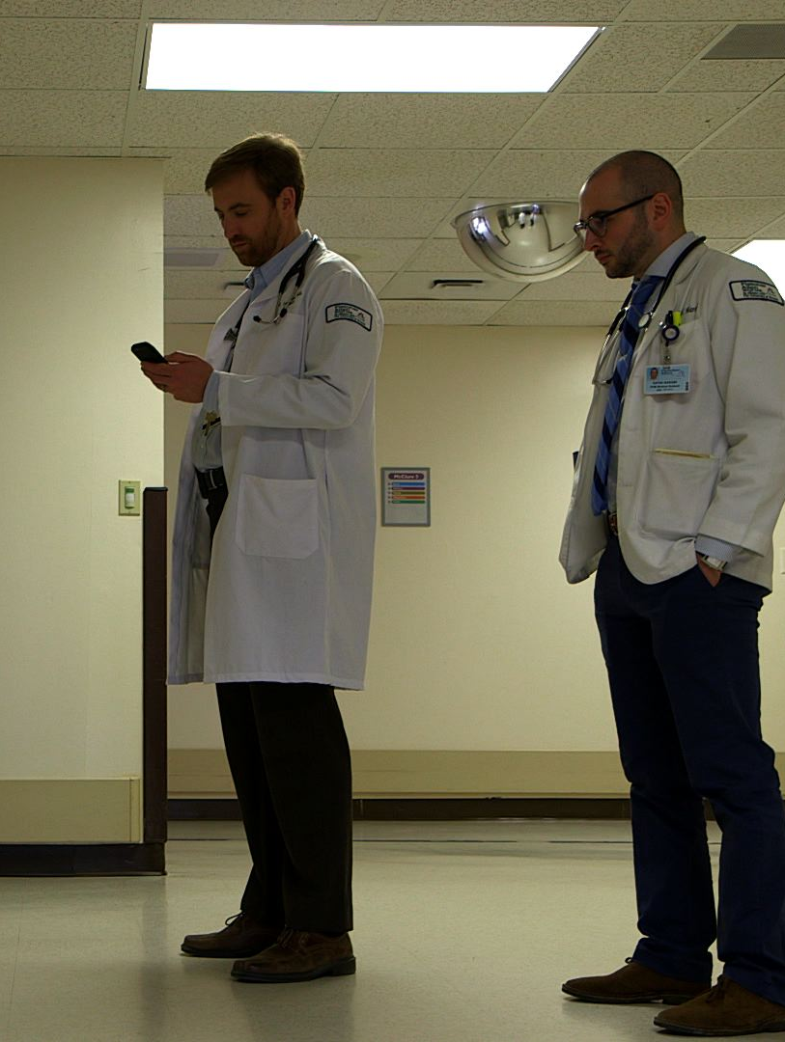
Scenario 1: Does this constitute mistreatment?
Yes
No
Not sure

Slide 14
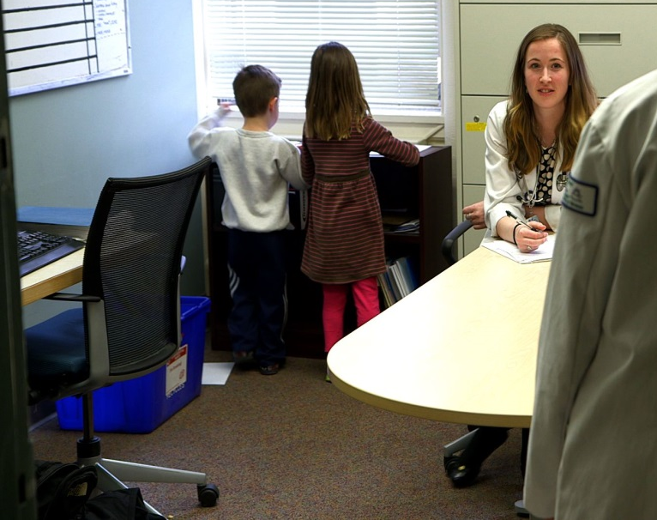
Scenario 2: Does this constitute mistreatment?
Yes
No
Not sure

Slide 15
Scenario 3:
Is there mistreatment here?ScScenario 3:
Is there Mistreatment Here?
Yes
No
Not sure

Slide 16
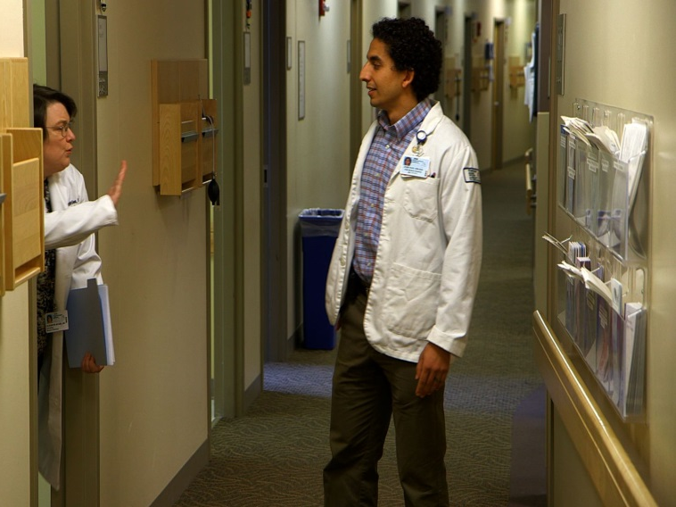
Scenario 4: Does this constitute mistreatment?
Yes
No
Not sure
Notes:
“A medical student is working with Dr. X as part of the health care team today. The student will be in shortly to help ____ (i.e., clarify your history, ask you a few questions, listen to heart and lungs, etc…).”

Slide 17
What We Learned
Feedback from film discussions led us to discover that the issue is more complicated!
Perspective of faculty, staff, residents and nurses important to consider and relay to students
System changes and generational differences are important contributors
Notes:
Qualitative analysis of discussions from grand rounds and other presentations
9 focus groups at 3 sites
4 nursing groups
3 clinical faculty groups
1 basic science faculty group
1 resident group
1 Office of Medical Student Education staff group

Slide 18
Perspectives About Students Shared By Faculty, Residents, Nurses and Staff
Disinterest
Lack of situational awareness
Lack of initiative
Overconfidence
Lack of appreciation for policies and protocols
Absorbed in technology
Disrespectful of other institution employees
Tardiness or Truancy
Self centeredness
Grievances re: grades
Inappropriate or unhelpful feedback
Inability to separate education from activism
Notes:
Shadow a nurse for a day at the beginning of clerkship. Paired with orientation video – helps increase the student’s situational awareness!

Slide 19
How We Responded
Qualitative analysis of discussion themes from Grand Rounds and other presentations
Received UVM Medical Group funding
10 focus groups at 3 sites
Reviewed the literature for communication challenges in medical education
Identified themes to create a script for a second film

Slide 20
Second Film Curriculum
Both learner and faculty perspectives on challenges encountered in the learning environment
Explore generational differences that may contribute to conflicts in the learning environment
Develop and review tools to help bridge generational divides and improve the learning environment
Notes:
We have received FB in past that most people have participated in this curriculum, so today, we hope to refresh memories and provide key points for those who haven’t seen it.
Learner: anyone in the position of student, trainee, mentee
Educator: anyone in the position of teacher, trainer, mentor
Understanding that in exemplary Learning Environments, ALL participants are teachers and learners!

Slide 21
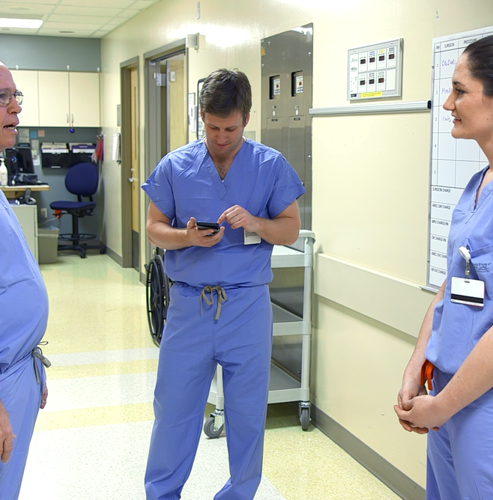
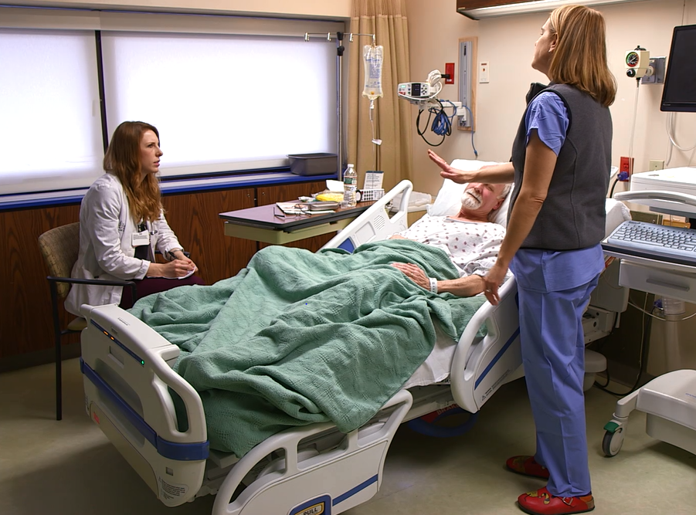
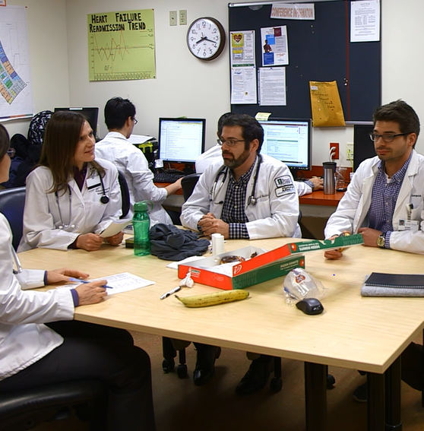
Film #2: Building Relationships Across Divides
Notes:
Brief description of film #2

Slide 22
Notes:
TRAILER WOULD GO HERE (LEF clip 4.mp4 )
48 seconds

Slide 23
Educator Teaching Points in Scenario 3
MAIN THEME
BEHAVIORS
Optimal | Suboptimal
Be curious about students | Assuming that an observed behavior is governed by sense of entitlement
Be aware of “invisible” pressures on students | Not setting clear expectations
Dialogue is good: Be prepared to learn as well as teach Preface your observations with “it seemed to me” rather than sharing an assumption as reality | Not being curious about hidden pressures on learners.
What looks like “entitled” behavior may be lack of acculturation to the clinical setting
Notes:
EXAMPLES OF CURRICULUM PAIRED WITH FILM #2

Slide 24
Learner Curriculum Scenario 3
MAIN THEMES
BEHAVIORS
Faculty and staff often unaware of pressures you are under
Older generations hold experience in high regard
In clinical settings, patient care is #1
Optimal | Suboptimal
Be curious, humble, and open to learning from nurses | Not seeking or honoring staff/nurse/PA/NP opinions
Let faculty and staff know your goals and engage them in helping you achieve them | Put own goals ahead of patient needs
Pay attention to situation and ask: “Would this be an OK time”? | Being over confident in new settings

Slide 25
Bridging the Gap Through Film
First film helps faculty/residents/staff become more aware of student concerns
Second film helps students become more aware of faculty/resident/staff perspective
Notes:
…Which can lead to many initiatives…

Slide 26
LE Initiatives Born From Dialogue
Student education on providing constructive, professional feedback to faculty (Clerkship and Foundations level)
Trainings on peer-mediated (“Cup of Coffee”) conversations supporting professionalism
Equity and justice initiatives in collaboration with ODI, OMSE, LEAP, Teaching Academy, UVM (bystander trainings, restorative justice)

Slide 27
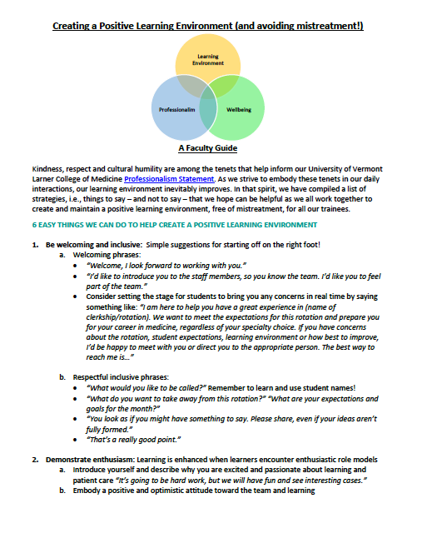
Resources
Creating a Positive Learning Environment (and avoiding mistreatment!) – Faculty Guide
Online module – interactive engagement with first film curriculum

Slide 28
Acknowledgements
Sean Ackerman, M.D
David Adams, M.D
Katie Evans, M.D.
David Harari, M.D.
Alison Howe, M.S.
Hayley McKinnon, M.D
Charmaine Patel, M.D.
Anne Rich, M.D.
Lee Rosen, PhD.

Slide 29
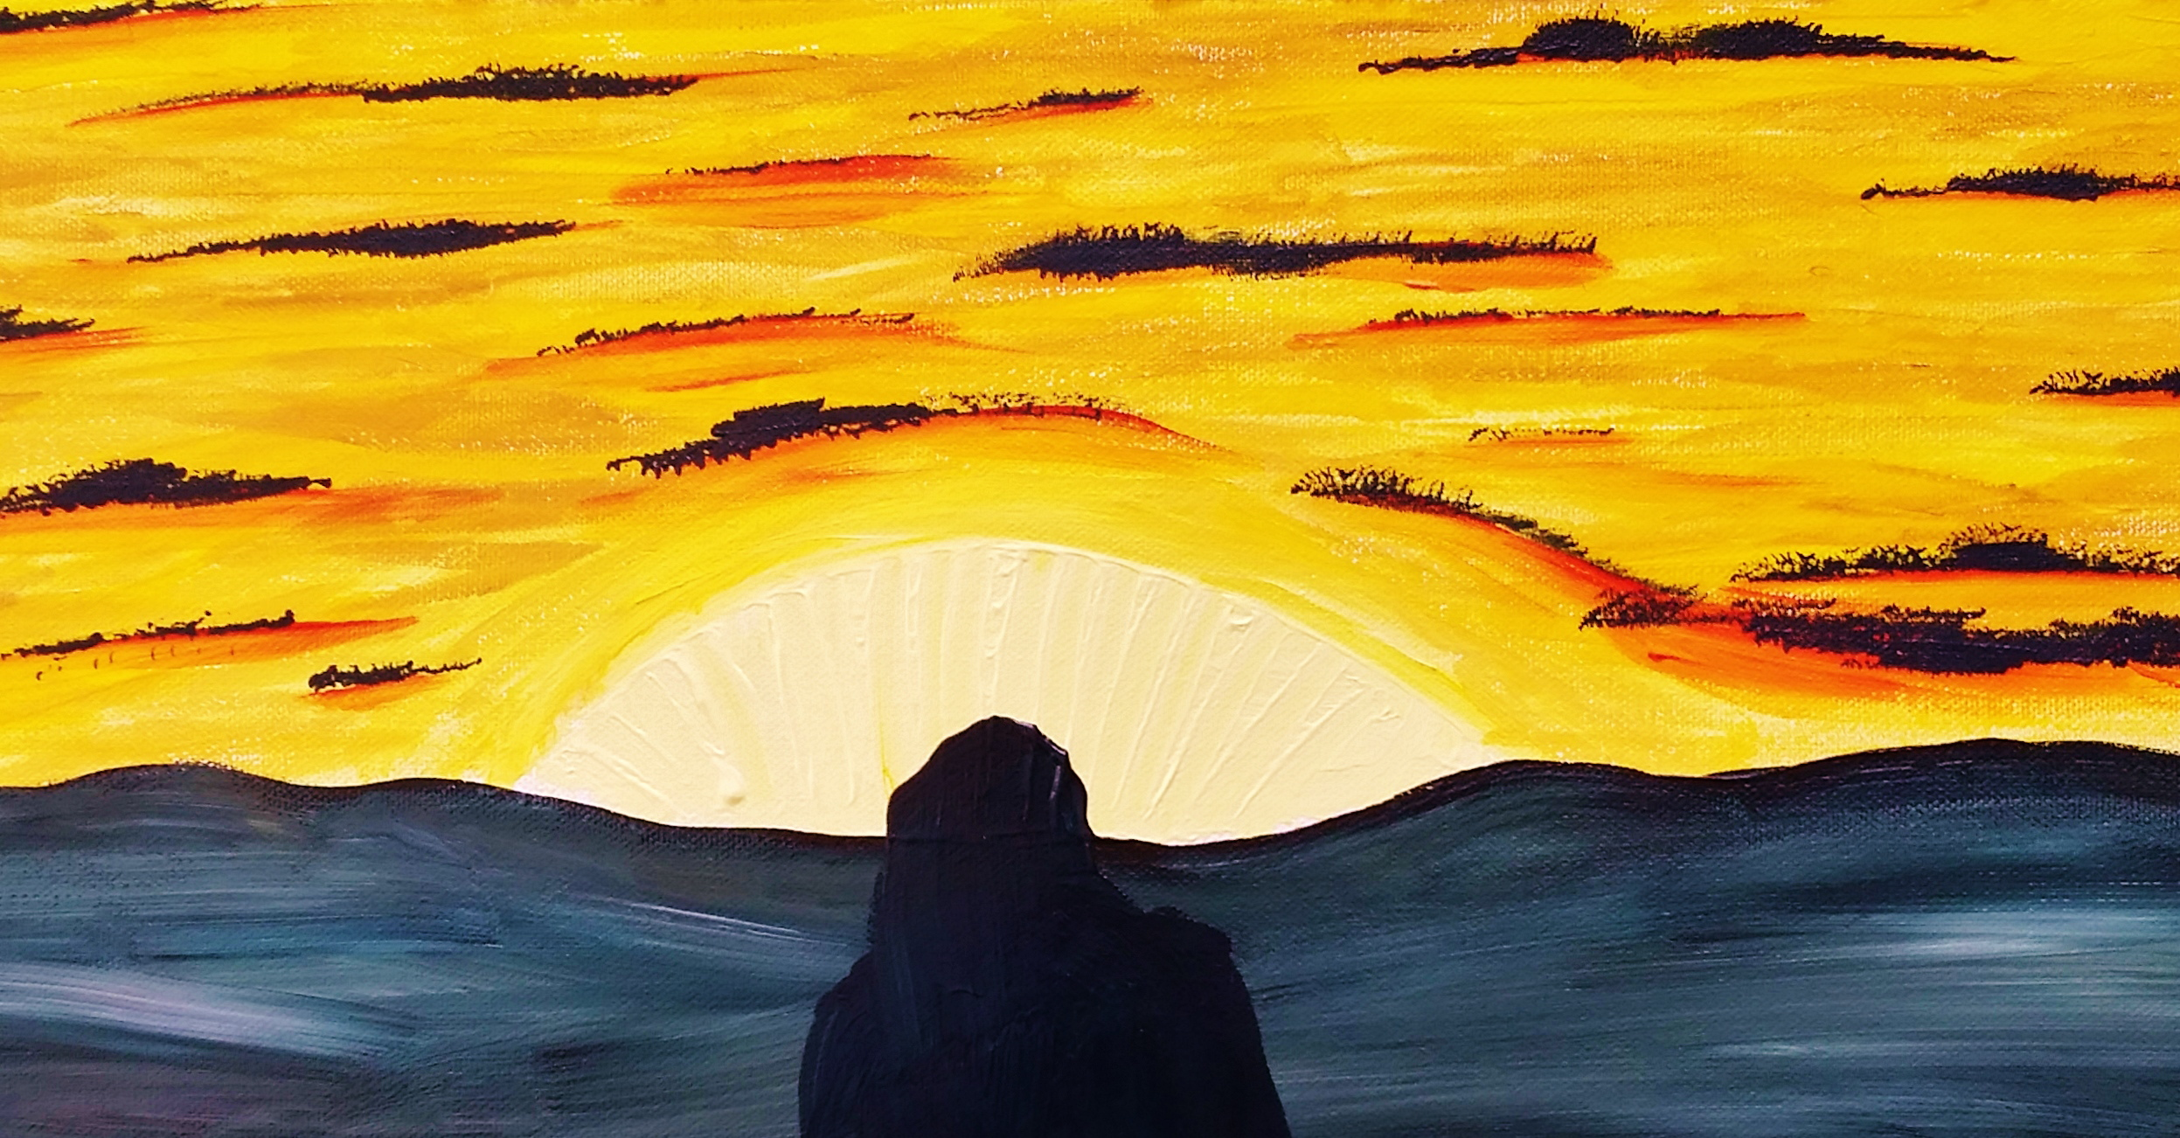
Thank you!

