Slide 1
OME Advising
The Lottery
Class of 2025

Slide 2
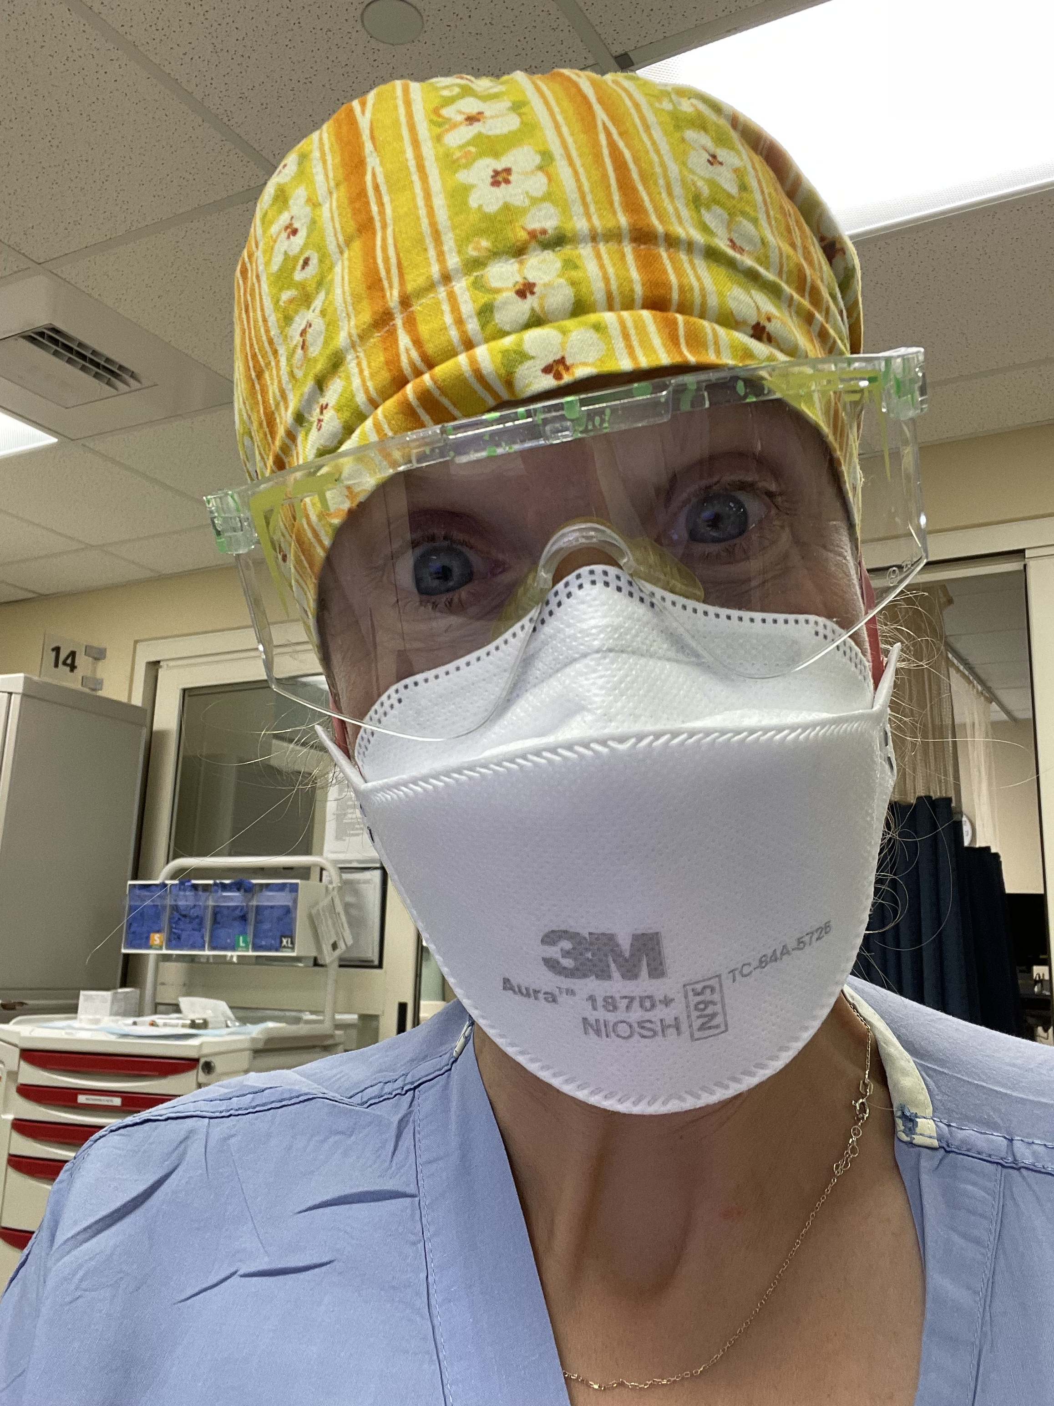
Katie Dolbec, MD
Assistant Dean for Students
Office of Medical Education
Katherine.dolbec@med.uvm.edu

Slide 3
2024-2025 Advanced Integration Level Lottery Schedule
Lottery I: Top Choice
Selection Period Opens: Monday, 1/8, noon
Selection Period Closes: Tuesday, 1/9, noon
Results Posted: Wednesday, 1/10
Lottery II: Second Choice
Selection Period Opens: Thursday, 1/11, noon
Selection Period Closes: Friday, 1/12, noon
Results Posted: Tuesday, 1/16
Lottery III: CT Campus IM Acting Internship/Emergency Medicine
Selection Period Opens: Wednesday, 1/17, noon
Selection Period Closes: Thursday, 1/18, noon
Results Posted: Wednesday, 1/24 (with the VT Campus results)
Lottery IV: VT Campus IM Acting Internship/Emergency Medicine
Selection Period Opens: Monday, 1/22, noon
Selection Period Closes: Tuesday, 1/23, noon
Results Posted: Wednesday, 1/24
Lottery V: Electives
Selection Period Opens: Friday, 1/26, noon
Selection Period Closes: Tuesday, 1/30, noon
Results Posted: Monday, 2/5
Add/Drop Period
Opens: Monday, 2/5, 4:00 p.m.

Slide 4
DECIDED
UNDECIDED
Notes:
Today’s session is focused more on the group of undecided students

Slide 5
Goals of Advanced Integration
Make a schedule that:
ensures clinical experiences to support specialty decision
optimizes your residency application
fulfills all graduation requirements
allows space and time for residency interviews
fills medical knowledge gaps
enables you to explore specific interests within medicine, whether or not they have anything to do with your intended career path
Notes:
In this order

Slide 6
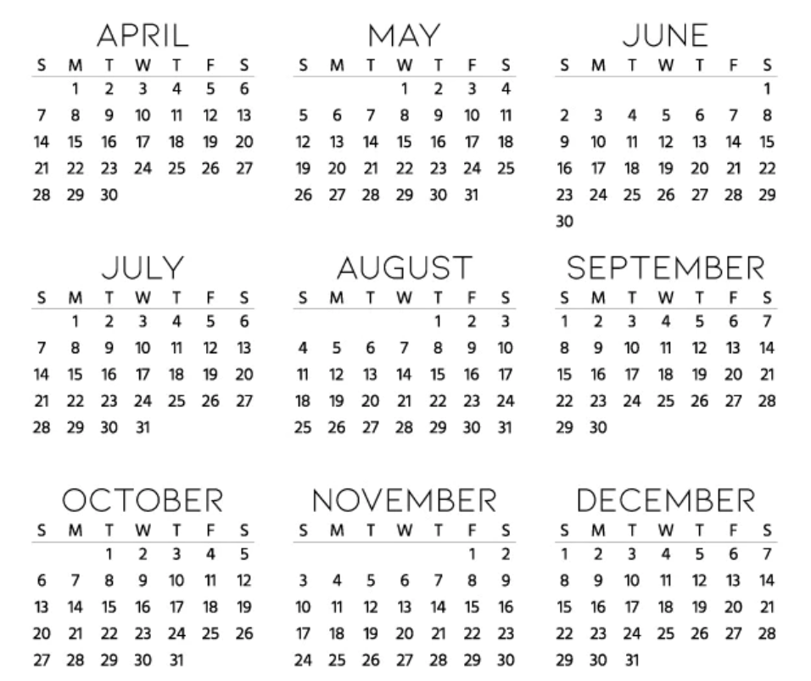
2024
2025
Notes:
Here are the 13 months you have to work with

Slide 7
Make a schedule that:
ensures clinical experiences to support specialty decision
optimizes your residency application
fulfills all graduation requirements
allows space and time for residency interviews
fills medical knowledge gaps
enables you to expand on specific interests within medicine, whether or not they have anything to do with your intended career path
DECIDED

Slide 8
Make a schedule that:
ensures clinical experiences to support specialty decision
optimizes your residency application
fulfills all graduation requirements
allows space and time for residency interviews
fills medical knowledge gaps
enables you to expand on specific interests within medicine, whether or not they have anything to do with your intended career path
UNDECIDED

Slide 9
Deciding on a Specialty
Notes:
These are the months you have to play with. If you are between 2-3 specialties, you need to fit in rotations, or, even better, AIs, during these first few months in order to have time to choose, get LORs, and get your application materials in time. This is your priority!
You are going to want to prioritize these rotations in the first few months so as to make a final decision by the end of June. If you have Step or any clerkships to make up, you may run out of time this application cycle if you are undecided.

Slide 11
Goals of Advanced Integration
Make a schedule that:
ensures clinical experiences to support specialty decision
optimizes your residency application
fulfills all graduation requirements
allows space and time for residency interviews
fills medical knowledge gaps
enables you to expand on specific interests within medicine, whether or not they have anything to do with your intended career path

Slide 12
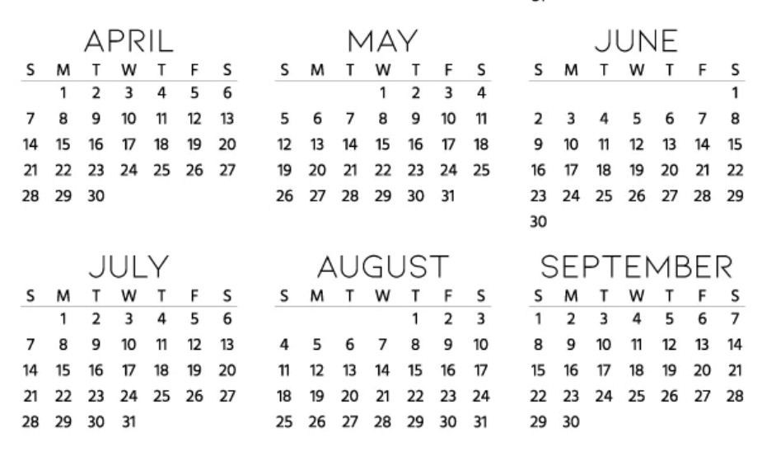
Optimizing residency application
Notes:
These are the months you have to play with. If you are between 2-3 specialties, you need to fit in rotations, or, even better, AI during these 5 months in order to have time to choose, get LORs, and get your application materials in time. This is your priority! Some specialties will accept letters from 3rd year experiences, but most want to see letters primarily from 4th year.

Slide 13
Things Programs Want to See
Will vary specialty to specialty
Discuss with your specialty advisor!
3-4 letters of recommendation
AIs vs electives
Majority clinical
May consider a 4th letter from a research mentor or other long-term contact who can speak to character (but ideally also clinical skill)
Multiple letters for one rotation?
Letters from 3rd year?
Away rotations?
SLOE?
Step 2
Notes:
“?” specialty specific – talk to your specialty advisor

Slide 14
Structuring 4th Year: April - August
Acting Internship (AI) in all specialties still under consideration
4-8 weeks of higher-intensity clinical rotations
Away rotation(s) –EM, ORTHO, PLASTICS, OPHTHO, NS, ENT, RAD ONC
(PM&R, IM)
Surgical or General Medicine AI (4 weeks)
Additional AIs
Step 2 prep/exam (4 weeks)

Slide 15
CT Campus Students
Many students will return to Vermont to complete one or more 4th year rotations
Definitely surgical subspecialties, pediatrics, EM, Neuro, Radiology, Anesthesia
Others on case-by-case basis
Discuss need to return to VT with Dr. Ellen Kulaga and specialty advisor
Notes:
Definitely surgical subspecialties, pediatrics, EM, Neuro, Radiology, Anesthesia.
IM is easiest to complete all courses in CT.
FM can be done if student doesn't choose a FM Acting Internship (not essential).
General surgery with surgery major often will return, though probably could be done all in CT.
Ob/Gyn will often return to VT for 1-2 Ob/Gyn AI's though could do General Ob/GynAI in CT.
Psych usually return for Psych AI but do have some Psych in CT.

Slide 17
Goals of Advanced Integration
Make a schedule that:
ensures clinical experiences to support specialty decision
optimizes your residency application
fulfills all graduation requirements
allows space and time for residency interviews
fills medical knowledge gaps
enables you to expand on specific interests within medicine, whether or not they have anything to do with your intended career path

Slide 18
Graduation requirements
Class of 2024 Advanced Integration Requirements for Graduation:
Acting Internship (AI) in Internal Medicine
A second AI in the student's choice of specialty
4 weeks of surgical subspecialties
Scholarly Project or Teaching Practicum
4 weeks of Emergency Medicine
Students must take USMLE Step 2CK by January 1 of the graduation year. Passing scores are required for graduation.
https://www.med.uvm.edu/mededucation/level3/preparing_for_advanced_integration

Slide 19
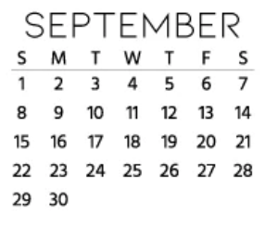
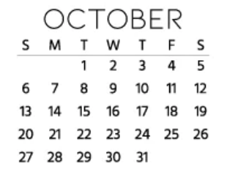

Slide 20
September - October
Graduation requirements
Electives
There will be some time to complete more rigorous rotations during this timeframe – a good time to start ticking off more intensive graduation requirements

Slide 22
Goals of Advanced Integration
Make a schedule that:
ensures clinical experiences to support specialty decision
optimizes your residency application
fulfills all graduation requirements
allows space and time for residency interviews
fills medical knowledge gaps
enables you to expand on specific interests within medicine, whether or not they have anything to do with your intended career path

Slide 23
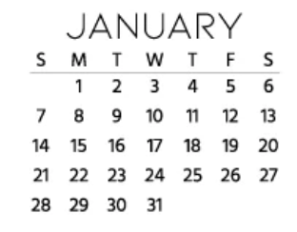
Notes:
Check Specialty Association pages to see what the timing of interviews are for individual specialties. Some span Nov - Jan. Others are concentrated

Slide 24
November – January
Same as before, but beware of need for flexibility given interview scheduling
Notes:
Check Specialty Association pages to see what the timing of interviews are for individual specialties. Some span Nov - Jan. Others are concentrated

Slide 26
Goals of Advanced Integration
Make a schedule that:
ensures clinical experiences to support specialty decision
optimizes your residency application
fulfills all graduation requirements
allows space and time for residency interviews
fills medical knowledge gaps
enables you to expand on specific interests within medicine, whether or not they have anything to do with your intended career path

Slide 28
February - March
Ensure graduation requirements are complete
Fill in knowledge gaps
Try things you want to!

Slide 30
April
Any additional graduation requirements
Transition to residency courses

Slide 32
Lottery Consideration: Competitive Rotations
Anesthesia Surgical Subspecialty
Medicine AIs – Gen Med, MICU, Cardiology
Psych AI
Peds AI
FM AI
EM Course
Wilderness Med elective (September)
Notes:
As a bit of a side note, the lottery is about getting the schedule you need, but it is also about ensuring that you get the things you WANT. The things you need may not be the most competitive things in the lottery. It would be good to ask your specialty sib about other competitive rotations you might want to select early.

Slide 33
Notes:
Everything is flexible and can be changed

Slide 34
Plug for Specialty Sibs!
Run by Student Council
You will be matched with a 4th year applying into your specialty. Your 4th year Specialty Sib you will help with the nuts and bolts of the lottery and timing of upcoming 4th year planning.
Specialty Sibs are not a substitution for career or academic advising but serve as another resource as you navigate applying to residency.

