Slide 1
Patient-Centered Teaching
Karin Gray, MD
Lewis First, MD
Essentials of Teaching and Assessment
Teaching Academy
University of Vermont
Larner College of Medicine
October 1st, 2021

Slide 2
Objectives
Discuss the importance of orientation for the learner.
Review techniques for effective and efficient clinical teaching.
Review ways to give feedback, pointing out the difference between evaluation and feedback

Slide 3
To Get Started…
Let’s come up with some “Good to Great” questions!

Slide 4
The Day One Make It or Break It Exercise

Slide 5
Usual Topics for “Day One”
Who is the student?
What do they want to get out of the class?
Are they interested in pediatrics?
What have they done thus far to prepare them for the clerkship or elective?

Slide 6
Other Things to Think About To Make Day One Even More Effective
Sit down to orient
Use student or resident name to personalize the discussion
Let the office (and if possible inpatient) staff know in advance that trainee(s) will be starting
Think about how Day One can help you!

Slide 7
How Day One Can Help You
How do you like to teach and when?
Consider the “teaching notebook” if teaching to different levels or needing to be efficient
Who else will be sharing the teaching with you?
How can you be a nominee for teacher of the year? (the one question that pays off)!
When will you give feedback?

Slide 8
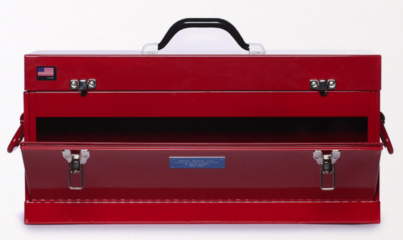
Toolbox for Clinical Teaching
You’re Both in the Hotseat

Slide 9
Toolbox for Clinical Teaching
Initial Pt Encounter
Activated demonstration
Timed history
“Activated interview”
Blank slate
Debriefing the Encounter
Full presentation vs
Pertinents
“Are you worried about…”
One Minute Preceptor
SNAPPS
Rounds
Theme of the day
Clinical question/article answer
Discharge rounds
Bedside teaching/physical findings scavenger hunt
Patient narrative

Slide 10
Toolbox for Clinical Teaching
Initial Pt Encounter
Activated demonstration
Timed history
“Activated interview”
Blank Slate
Debriefing the Encounter
Full presentation vs
Pertinents
“Are you worried about…”
One Minute Preceptor
SNAPPS
Rounds
Theme of the day
Clinical question/article answer
Discharge rounds
Bedside teaching/physical findings scavenger hunt
Patient narrative

Slide 11
“Activated Demonstration”
Best suited to…
High-intensity or fast-paced encounter
Need for speed
Prep learner with a specific task
Observational role for learner
Notes:
Arrows in the Quiver: evaluation of a workshop on ambulatory teaching. Wilkerson L, Sarkin RT
Acad Med. 1998 Oct; 73(10 Suppl):S67-9.

Slide 12
Timed History
Best suited to…
Efficiency needed (regardless of learner’s level)
Can provide for direct observation
Prep the learner
Give the learner 5 minutes to take a history
Warn families of the “take over”
Notes:
Stand out of direct line of sight of pt or introduce your role as being observational. Rapport? Illness scripts? Logical question progression?
OR come in after 5 min. In debriefing, can do in room, out of room, or if you observe, don’t even need to do
Make sure to give the learner their feedback!

Slide 13
“Activated Interview”
Best suited to…
Moderate available time
Must have at least a little prep time
New or low-medical-knowledge learners
Prep the learner with the chief complaint
AND
Discuss key questions in advance
May be either solo or observed
Notes:
Used to feel badly about “Prepping” a learner. Child with a fever and seizure-like activity: febrile sz? Simple vs complex (focality, duration, repeated); developmental trajectory, underlying illness causing the fever

Slide 14
Blank Slate
Best suited to…
Plenty of time
Strong learner
Without complex past history
Preceptor shares only chief complaint in advance
Prep/warn the family
Of course you can “eyeball” the pt
Notes:
Can send the resident first. During a “waiting period.” Need to have time to debrief this.

Slide 15
Toolbox for Clinical Teaching
Initial Pt Encounter
Activated demonstration
Timed history
“Activated interview”
Blank slate
Debriefing the Encounter
Full presentation vs
Pertinents
“Are you worried about…”
One Minute Preceptor
SNAPPS
Rounds
Theme of the day
Clinical question/article answer
Discharge rounds
Bedside teaching/physical findings scavenger hunt
Patient narrative

Slide 16
Presentation of Patient
“Full” Presentation
Adequate time
Early learner
Focus on the presentation
“Pertinent” Presentation
Just what’s relevant
Reveals learner’s thought process
Focus on the diagnosis
“What Are You Worried About?”
If presentation is brief OR if presentation was observed
Illness Scripts: Compare/contrast patient characteristics and disease presentation
“Most likely” vs “Not want to miss”
Elicit (or articulate) subconscious decision-making
Focus on diagnosis/reasoning OR next steps for management
Notes:
Options for presentation of the patient. Don’t have to have all forms of learning for every patient encounter. Can do some learning/debriefing after you finish the pt encounter

Slide 17
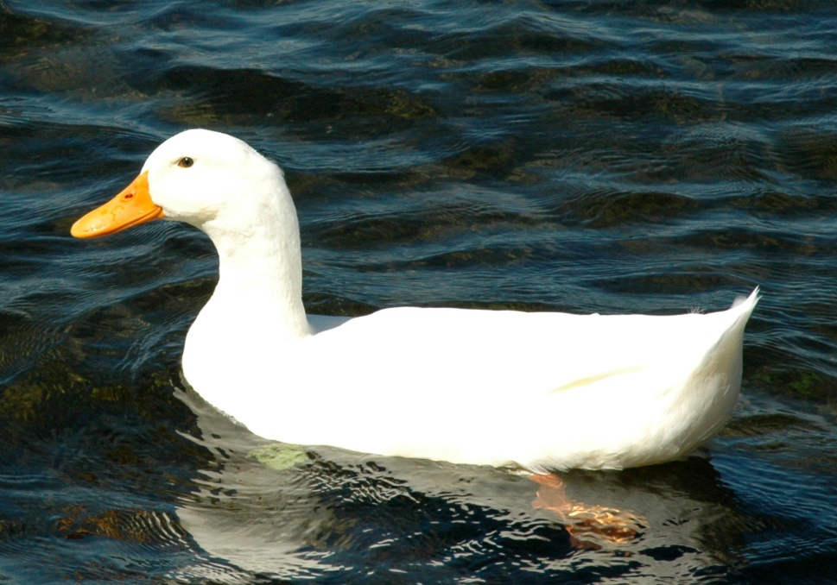
One Minute Preceptor
A five-step "microskills" model of clinical teaching
Get a commitment
Probe for supporting evidence
Teach general rules
Reinforce what was done well
Correct errors
Notes:
Neher JO, Gordon KC, Meyer B, Stevens N. J Am Board Fam Pract. 1992 Jul-Aug; 5(4):419-24.
Furney SL, Orsini AN, Orsetti KE, Stern DT, Gruppen LD, Irby DM. Teaching the one-minute preceptor. A randomized controlled trial. J Gen Intern Med. 2001;16(9):620–624. doi:10.1046/j.1525-1497.2001.016009620.x
87% of residents taught the OMP found it useful/very useful. learners of OMP residents rated teaching performance higher and were more motivated to do outside reading. However, ratings of overall teaching effectiveness were not significantly different between the 2 groups.

Slide 18
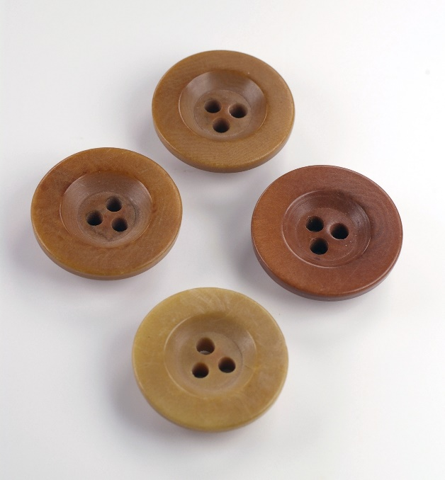
SNAPPS – Learner-centered model for Outpatient Education
Summarize Hx and PE
Narrow the differential to 2-3 most relevant
Analyze the differential (compare/contrast)
Probe the preceptor
Plan the management
Select a case-related issue for self-directed learning
Notes:
Terry and Daniel Wolpaw, Klara Papp

Slide 19
Toolbox for Clinical Teaching
Initial Pt Encounter
Activated demonstration
Timed history
“Activated interview”
Blank slate
Debriefing the Encounter
Full presentation vs
Pertinents
“Are you worried about…”
One Minute Preceptor
SNAPPS
Rounds
Theme of the day
Clinical question/article answer
Discharge rounds
Bedside teaching/physical findings scavenger hunt
Patient narrative

Slide 20
Theme of the Day
Suitable for single or multiple learners seeing multiple patients together
Brief group prep – decide on a topic
Cardiac or respiratory exams
HEADSS questions
Presenting vital signs
Notes:
Even over a longer time period, such as an inpatient month.
Compare/contrast OUT LOUD as the attending

Slide 21
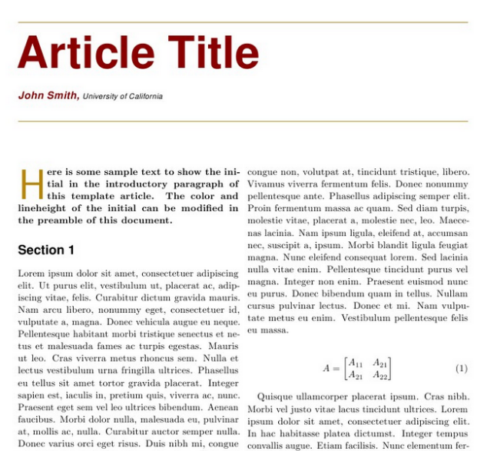
Clinical Question/Article Answer
Requires advance notification for learners, + time
Loved by residents!
Identify a clinical question
Brief (really brief) synopsis:
Is this the same pt population?
What did they do?
How does this impact our patient/answer our question?
Collate the articles (tech?)

Slide 22
Requirements for Discharge
(although, obvi, should be a component daily)
Be Specific!
May consider subheadings
Medical requirements/when are we sure pt is improving
Technology/DME/case management requirements
Education/social situation requirements
Next step: when do you think this will happen (estimate a date)
Notes:
Rectal diastat

Slide 23
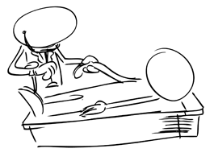
Bedside Teaching (post rounds)
Physical findings
Consent from patient/parent
Adequate time for each learner’s attempt, ideal to have a discussion and re-examination
Educated patient/parent teaching learners
Notes:
Fulfilling to families; purpose. What did you hear? What do you think you were supposed to have heard? Calibrate your exam?

Slide 24
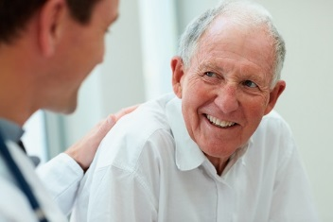
Patient Narrative (Post Rounds)
Open-ended questions, psychosocial focus
“How has this affected your daily life?”
“What is something that someone did well/did poorly early in your care?”
“What led to your diagnosis?”

Slide 25
The Feedback Game

Slide 26
Breakout Session
What fits best with your clinical setting? Your teaching style?
What one thing will you try after this session?
When and how will you implement this change?

Slide 27
Breakout Session Wrap-Up

Slide 28
Questions?

Slide 29
Thank you

