Slide 1
Trauma Informed Practice
Cate Nicholas EdD, MS, PA, FSSH
Notes:
Trauma Informed Practice (TIP) TIP aims to create safety for people by understanding the effects of trauma and its close links to health and behavior.

Slide 2
A framework of thinking and interventions that are directed by a thorough understanding of the profound neurological, biological, psychological, and social effects trauma has on an individual—recognizing that person’s constant interdependent needs for safety, connections, and ways to manage emotions/impulses.
Trauma-Informed Practice Framework
Crisis Prevention Institute

Slide 3
TIP is not about eliciting or treating trauma history. It is about creating safe spaces that limit the potential for further harm in healthcare interactions.

Slide 4
“Adopting a trauma-informed approach is not accomplished through any single technique or checklist. It requires constant attention, caring awareness, sensitivity, and possibly a cultural change at an organizational level.” (Source: CDC)

Slide 5
Trauma Informed Practice
Being trauma-informed allows you to engage with people in a way that recognizes trauma symptoms and acknowledges the role that trauma plays in their lives. Understanding vulnerabilities, culture, possible coping mechanism and triggers allows you to better care for your patients and keep yourself safe.
Triggers act as signs of possible danger and leads to a series of emotional, physiological and behavioural responses in the service of survival and safety.

Slide 6
TIP as a universal practice
We can never know which of the patients we are seeing has experienced interpersonal and/or structural trauma. People who have been traumatized may avoid seeking healthcare services because of fear of retraumatization. Following a TIP model as a universal practice helps us to avoid unknowingly retraumatizing a patient. [1]
Remember, we do not need to know the exact nature of the trauma to care for the patient.
Focusing on the reason for the visit and making plans to address other issues in the future, give us the opportunity to build trust.
Using a TIP approach to language and physical exam helps establish a safe and trusting relationship. Remember that sometimes the trauma was at the hands of the healthcare system.
Many healthcare providers and trainees have experienced trauma in their personal lives and face direct and secondary traumatization or compassion fatigue on the job.

Slide 7
Trauma Informed Practice (TIP)
The learning objectives are to:
Define trauma
List the six principles of TIP
Apply TIP to patient care and or educational practices.

Slide 8
Building trust and creating a safe and supportive session
Please share a strength or positive quality you appreciate about your self
What word or short phrase reflects the positive atmosphere we want to foster during the workshop

Slide 9
TIP
Understand trauma
Safety and Predictability
Trustworthiness and Transparency
Collaboration and Mutuality
Empowerment and Choice
Cultural Humility and Equity

Slide 10
Understand
trauma
Notes:
Trauma is an emotional response that results from experiencing a distressing event- which can harm a person’s sense of safety, sense of self and the ability to regulate emotions and navigate relationships.

Slide 11
Understanding Trauma
Trauma arises from repeated adverse events.
True or False??
Notes:
Trauma can rise from a single or repeated adverse event that overwhelms a person’s ability to cope.
Trauma is an event, a series of events or set of circumstances experienced as threatening or harmful and has lasting adverse effect.
When it is repeated and extreme, occurs over a long time or is perpetrated in childhood by caregivers it is called complex trauma.
Acute trauma results from exposure to a single overwhelming event.
Examples: Rape, death of a loved one, natural disaster.
Characteristics: Detailed memories, omens, hyper-vigilance, exaggerated startle response, misperceptions or overreactions.
Chronic trauma results from extended exposure to traumatizing situations.
Examples: Prolonged exposure to violence or bullying, profound neglect, series of home removals. Characteristics: Denial and psychological numbing, dissociation, rage, social withdrawal, sense of foreshortened future.
Complex trauma results from a single traumatic event that is devastating enough to have long-lasting effects. Examples: Mass casualty school shooting, car accident with fatalities involved, refugee dislocation. Characteristics: Perpetual mourning or depression, chronic pain, concentration problems, sleep disturbances, irritability

Slide 12
Understanding Trauma
Trauma can happen to:
anybody (minors, elders, vulnerable adults, intimate partners) by
anyone ( a loved one, a caregiver, a healthcare professional or a stranger)
anywhere (in the home, at work, at a party, a health care facility or on the street)
Can be emotional, psychological, sexual, and or physical.
Can be due to neglect/abandonment or financial abuse.
Can be due to
Violence in the home
Violence in the workplace/public spaces
Human trafficking
Torture
War
Refugee trauma
Separation and loss
Consider intersectionality where 2 or more of these collide

Slide 13
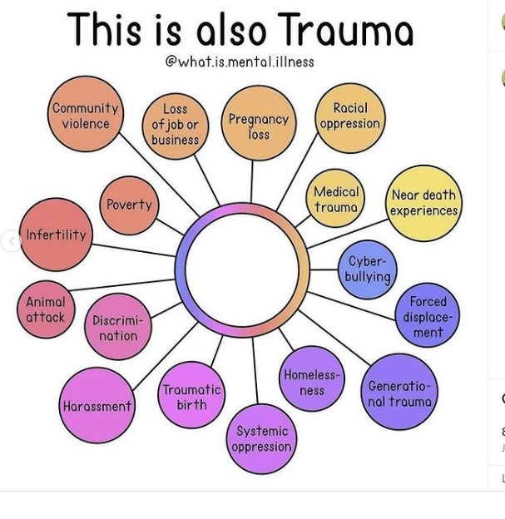
Understanding Trauma

Slide 14
Traumatization occurs when internal and external resources are inadequate for coping

Slide 15
Understanding Trauma
Everyone’s experience of a traumatic event is the same.
True or False??
Notes:
Complex facets of a person’s identity—gender, sexuality, race, ethnicity, and potential disabilities, among others—can uniquely lead to or exacerbate traumatic life experiences.

Slide 16
Social structures (economic, political, legal, religious and cultural) that result in racism, homo/transphobia sexism, ageism, sizeism, or ableism stop individuals, groups and societies
from reaching their full potential. [2]
These social structures determine who falls ill and who has access to care.
Represents a violation of patient’s autonomy as
systematic factors impinge on patients’ ability
to make their own decisions.
Structural violence results in systemic trauma.

Slide 17
Trauma
Trauma cannot be passed on genetically
True or False??
Notes:
Trauma can be passed on from one generation to the next, potentially through epigenetics—the study of how your experiences, including your behaviors and environment, can alter how DNA is read or expressed. Intergenerational transmission of trauma effects- exp. like stress, famine or war can influence the which genes are activated or deactivated- does not change DNA but rather how your body reads and responds to the DNA.

Slide 18
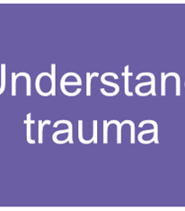
Understanding trauma/violence impact on peoples’ lives and behaviors:
Handle disclosures by affirming and validating them while expressing concern for their safety and wellbeing.
Shifting from “What is wrong with you?” to “What has happened to you?” leads to more compassionate, strength-based response to trauma.
Be mindful of red flags.

Slide 19
Red Flag Indicators
Notes:
Clinical presentation and oral history do not match
Multiple cancelled visits/no shows
Unattended medical needs
Missing glasses, hearing aids etc.
Accompanied by a person who exerts control over the visit
Unexplained injuries, bruises, cuts or sores
Signs of restraints
Poor hygiene
Dehydration or unusual weight loss
Over or under medicated
New depression, confusion or withdrawal
Unplanned pregnancies
Repeated instances of sexually transmitted infections

Slide 20
Safety & Predictability

Slide 21
The physical setting provided is safe and the interpersonal interactions promote psychological safe space for patients and providers
Need to re-establish compassionate and dependable relationships.
Establish rapport through words and actions.
Increases sense of predictability- no surprises

Slide 22
Trustworthiness & Transparency
Notes:
Trauma-informed care emphasizes open and transparent communication. Trust is built when individuals feel informed about their care, understand processes, and are involved in decision-making
Trustworthiness is demonstrated through consistent and reliable actions. This includes consistently applying trauma-informed principles, following through on commitments, and providing reliable support over time.
Communicating clearly and honestly fosters trust.
Trust is built when professionals demonstrate competence in trauma-informed care. This includes having the knowledge and skills to understand the impact of trauma, recognizing potential triggers, and applying appropriate interventions.

Slide 23
Empowerment & Choice
Notes:
A focus on recognizing, empowering, and building upon the strengths and experiences of trauma-impacted individuals. Strength based approach
Foster opportunities for choice, collaboration and connection:
Actively listen and privilege the patient’s voice
Provide meaningful choice.
Use person centered, strength-based thinking and language. Focused on what they can do not what they cannot do.
Meet t
Trustworthy care involves empowering trauma survivors to actively participate in their care. Collaborating with individuals, seeking their input, and acknowledging their strengths contribute to a sense of trust and partnership. Meeting the person where they are. Allow the person to have control.

Slide 24
Strength Based Approach
People who have experienced trauma have strengths that often go unrecognized within the current health care system.
A strength-based approach shifts the conversation from “What is wrong?” to “What is right?” Helps the patient identify where they can find strength to help themselves through a tough situation.
An understanding of the patient’s strengths can be incorporated into any care plan that is developed.
Asking a patient about what is right about them might be the first time anyone has focused on their strengths and may improve their self perception. [6]

Slide 25
Strength Based Approach
Sample of questions that can be asked:
Individual’s strengths:
What is the individual good at? What do they enjoy doing?
What did they used to enjoy doing but can no longer do?
What would they like to be better at?
What do they think they can do better or more of?
What do they think they can do to improve themselves and their wellbeing?
What do they think will help, if not to make things better, then at least to prevent things from getting worse?

Slide 26
Strength Based Approach
Sample of questions that can be asked:
Individual’s support network (friends, family, neighbors, professionals, etc.), their strengths, abilities, knowledge, etc.
Who is there for them or is cheering for them when something good happens. Remember we all define family in different ways. Could be a co worker, a teacher or another person from the homeless shelter.
Are there any other people helping the individual? Any other professionals?
Is there anything that could facilitate this network to increase, either in quantity or quality? Do they want it to increase?
What has been working until now, and how have things changed?

Slide 27
Strength Based Approach
Sample of questions that can be asked:
Needs, challenges, risks, etc. (focusing on strengths does not mean ignoring these, but maximizing and using the strengths to overcome them)
What is preventing the individual from doing what they would like to do or seeing who they would like to see?
What do they think they can do to change this?
Who do they think can help to change it?
Important to acknowledge their progress and accomplishments: “Great that you have been smoking less” or “have started to exercise once a week.”
All too often we gets into an “all or nothing” approach to behavior change. Little steps are just an important.

Slide 28
Collaboration & Mutuality
Notes:
Shared decision making and sharing of power.
The relationship should be collaborative
Patient as an active planner and participant
The patient's need to be respected, informed, connected
Patients need to know that they are important to someone. That there is someone who cares and will listen carefully.
Let patient have predictability and control over their healing
Understand patient capacity for self-healing
Understand the importance of maintaining boundaries and confidentiality.

Slide 29
Interprofessional/multidisciplinary approach to case management

Slide 30
Multi-disciplinary Case Management
Patient
Trauma Surgery
Emergency Medicine
Psychiatry
OB GYN
Pediatrics
Gerontology
Addiction medicine
The needs of patients can be very complex and vary from one patient to another.
Because no single provider can respond to the broad range of needs, effective case management relies on an multi-disciplinary approach.

Slide 31
Cross Sector Care Coordination
Care Coordination
Health Care
Social Services
Short term safe shelter
Long term housing needs
Immigration services
Legal services
Law enforcement
Beyond healthcare provision, other services may need to be coordinated. Such as
Social services- including financial resources and daily living needs.
Immediate safe shelter and stable long term housing.
Risk assessment and safety planning.

Slide 32
Cultural humility and equity
Notes:
The organization tries to move past cultural stereotypes and biases; utilizing policies, protocols, and processes that respond to racial, ethnic,
and cultural needs.

Slide 33
Cultural Humility and Equity
Lifelong learning and critical self-reflection
Recognize and change power imbalances
Institutional accountability
It is a daily practice for people to deal with hierarchical relationships, changing organizational policy and building relationships based on trust. It encourages people to realize their own power, privilege and prejudices, and be willing to accept that acquired education and credentials alone are insufficient to address social inequality accountability

Slide 34
Cultural Humility and Equity
If practices, procedures, and policies are not just, they are not trauma-informed.
Racism, sexism, homophobia, ableism and other forms of societal oppression can be trauma-inducing and push communities of people out of systems of care.
When we are open to reckoning with the trauma and adversity caused by historical and present-day structural oppressions and hold ourselves accountable to counteracting these forces as individuals and institutions, we can work together to mitigate these harms and to foster equity and belonging for all of us.

Slide 35
TIP
Understand trauma
Safety and Predictability
Trustworthiness and Transparency
Collaboration and Mutuality
Empowerment and Choice
Cultural Humility and Equity

Slide 36
Implementing a trauma informed approach

Slide 37
Stages of a patient visit
Pre-visit
History
Physical exam
Post visit

Slide 38
Pre-visit preparation
Find the time to review the patient’s chart for:
red flags or
any trauma experience so the patient will not need to repeat the trauma history and to
identify any resources that might be helpful during the visit.
Make sure you have everything you need in the exam room so you avoid needing to go out and get supplies, or call for someone to come into room.
Do not have staff interrupt unless an emergency.
Prep as much as possible so you can be the most effective and
the exam time is not protracted.

Slide 39
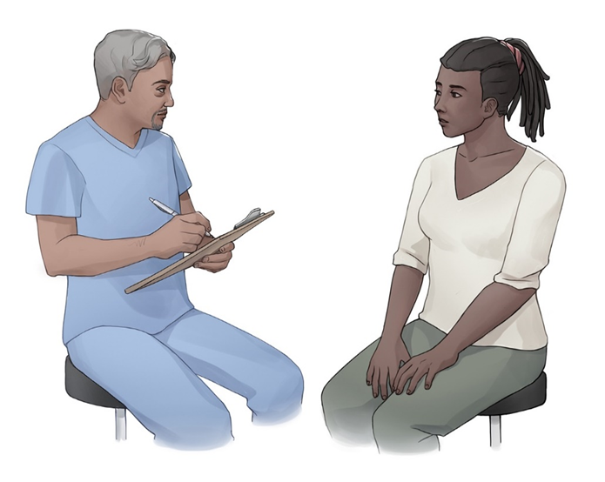
Communication Skills [5]
Meet the patient prior to them changing into a gown.
Knock and wait to be invited in.
Introduce yourself, your pronouns and your role.
Confirm the patient’s name, how they want to be addressed and the pronouns they use.
Sit at eye level with the patient if possible.
Maintain appropriate eye contact and open body posture. Be aware of what your resting face looks like (grumpy or angry) and adjust to be warm and welcoming. 80% of communication is non-verbal.
If a language interpreter is needed, determine if patient has a gender or cultural preference (letting them know it may not be possible).

Slide 40
Communications skills
Observe if they are they showing signs of stress- tensing muscles, fidgeting, rapid breathing, trembling, or seem distracted. Check in with them before proceeding. “You seem anxious, is there something I should know or do?”
If you are a teaching facility, ask the patient if they agree to have a student or resident as part of the visit. Respect their choice.
If patient is accompanied by another, encourage but do not insist that person wait in the waiting room. If you need to separate them, find a reason to have the patient be alone- going to x-ray etc.
If patient is accompanied by children, ask them if the children could be cared for by staff.
Be sure patient understands confidentiality and its limits.
Let the patient know you will be taking notes during the encounter.

Slide 41
History
Medical Interview to include the patient’s point of view
The explanatory model includes the patient’s beliefs about their illness, the personal and social meaning they attach to their disorder, expectations about what will happen to them and what you will do, and their own goals.
Understanding the patient’s explanatory model helps you provide patient-centered care.
Kleinman, A., Eisenberg, L., & Good, B. (1978). Culture, illness, and care: clinical lessons from anthropologic and cross-cultural research. Annals of internal medicine, 88(2), 251-258.

Slide 42
History
Start the interview with the following We all have a way of understanding health and illness- I am going to ask you some questions to help me understand how you see things.
Confirm the chief concern and other issues the patient may want to address. Ask if they have another way or name when referring to this problem
Agree to a shared agenda for this visit and note issues that may need to be followed up with another visit.
You can use the following general statement to screen for trauma “Many times stressful life events can affect a person’s health and well being. Are there any stressful life events that would be helpful for me to know?”

Slide 43
History
Obtain Symptom Story- tell me about what has been happening?
Patient Attribution What do you think caused your problem
Patient Fears/Concerns
What do you fear most about your illness?
What are the chief problems that your symptoms/illness has caused you?
Attempted treatment- What have you done to try to treat this? What kind of treatment do you think you want or should receive? What is the most important results you hope to see from treatment?

Slide 44
History
If you need to ask questions about safety, substance use and or you are gathering an inclusive sexual history, explain the rationale. Let them know these are questions you ask of all your patients to normalize the process.
Let the patient know what comes next, in terms of any physical exam, labs/imaging or procedures.
Ask patient if there are any physical exams that make them anxious and if there is anything you can do to help. Listen to what they say and agree to do it.

Slide 45
Trauma informed language- Some of the language we commonly use during a physical exam can be problematic especially if the patient has experienced trauma. Some small adjustments can make the exam feel safer. [5]

Slide 46
say this…..
not that…..
“I am going to examine or inspect …”
“Please swallow.”
“Sit on the table.”
“Put this drape on your lap.”
“Please move your shirt up so I can examine your abdomen.”
“Please bend your elbows.”
“Push forward (strength exam).”
“I want to look at, feel or touch….”
“Swallow for me.”
“Hop onto the bed.”
“Put this sheet on your lap.”
“Pull your shirt up for me.”
“Put up your arms like you are going to fight.”
“Push me away.”

Slide 47
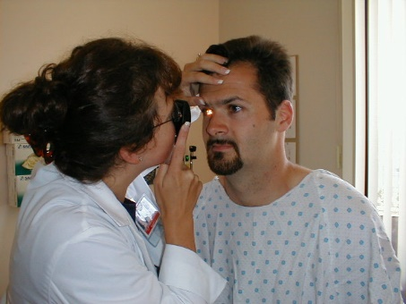
The Physical Exam [11]
Allow the patient to change in private. If there is a shared bathroom, let them know they may hear the lock click.
Ask them if they want a to have a support person in the room. If it is one of staff, check on gender preference.
Let them know how to wear the gown and where to put their clothes. If too vulnerable to change, see if you can work around their clothes. If not ask them the best way to proceed. Sometimes you can do most of the exam in their street clothes and only have them change when necessary.
Tell them where to sit, on exam table or chair. Make sure they have no mobility issues if they need to get onto table.
Knock and wait to be invited in before to you return to room.
Give patient an overview of what exams you will be doing and why. Tell them how long it might take. Ask them if there is any language, they would like you to use when referring to their body parts.

Slide 48
The Physical Exam
Let the patient know that they can ask for a pause in the exam or they can ask you to stop. It is important that you listen to them and don’t try to finish the exam by rushing or telling them you are almost done.
During the exam, ask patient to shift clothing or gown to allow for the exam as opposed to you moving them. If they cannot, ask permission
Tell patient what you are going to do before you do it, how it might feel and provide cueing, (“You will feel the stethoscope on your back, it might feel cold, I going to listen to the [not your] lungs in several different places.”)
Avoid keeping the BP cuff inflated for longer than you need it- can feel like a restraint.
Avoid the patient keeping their mouth open for longer than you need it. Can bring back trauma.

Slide 49
The Physical Exam
Stay where the patient can see you-perform all exams from the front or the side. When you need to move to the back, let them know you will be moving and why.
If doing a speculum exam, ask the patient if they would like you to raise the head of the exam table so you can see each other, offer them a mirror if they want and offer speculum self-insertion. Ask the patient to show you any genital lesion to reduce the time trying to find it yourself.
Perform a skin exam looking for burns, cuts, homemade tattoos, sores or signs of branding.
If you think the patient is getting anxious, slow down and ask what you can do. Suggest that some people find a deep breath in and out may help them to feel less anxious. If the patient asks you to stop, listen to them.

Slide 50
The Physical Exam
Only touch the patient as needed.
Be aware of where your body is in relationship to theirs during the exam.
Don’t lean against them when doing the exam.
Do not drape your arm over legs during pelvic exam
Don’t touch their knee or shoulder as a way of showing you care unless you have established that the patient is okay with that level of touch.
Let them know when exam is coming to an end. Try to be an efficient as possible.
Ask them to get dressed before discussing next steps.
Step out of room.

Slide 51
Post-visit
When you re-enter, knock and wait to be invited in.
Sit at eye level.
Share findings and next steps.
Let patient know if exam was normal or if you have heard or felt something. (“I hear some wheezing which makes me think you might have asthma which is a condition that can make breathing more difficult.” or “Your blood pressure is 110/68 which is normal.”)
Ask for questions in an open ended way “What questions do you have for me?” instead of “Do you have any questions?
Answer any questions. Check for understanding.
Avoid jargon.

Slide 52
Post-visit
Provide written after care and follow up plan in case patient experienced dissociation or they were so focused on getting through visit, they were distracted.
Set up follow up visit if needed.
Describe any lab, imaging or procedures and what they may experience.
If trauma is known and patient agrees, alert referrals regarding trauma history.
Let them know visit coming to an end.
Be sure they know what to do next.
If you have identified this patient is experiencing violence and is open to assistance, refer to your institutions policies and procedures for what steps to take next.
NOTE: Avoid standing between the patient and the room exit.

Slide 53
Risk Assessment and Safety Planning

Slide 54
Risk Assessment and Safety Planning
Once a patient has disclosed, they are experiencing or have experienced violence, you need to assess the patient’s risk for personal harm and help the patient plan for immediate, intermediate and long-term safety.
It is important to explore if there are any indicators of escalating risk:
An increase in the frequency or severity of threats
New or increasingly violent behavior
New of increasing threats of homicide or suicide
Access to and prior threats with firearms or other lethal weapons.
If safety is an immediate concern, security or law enforcement should be contacted with the patient’s consent and in keeping with your organizations policies and procedures and any state mandated requirements for reporting.

Slide 55
Risk Assessment and Safety Planning
Be familiar with the general principles of safety planning, including determining:
Support, documents or resources the patient may need if they decide to remain in the current situation or if they want to leave it
Steps that can be planned head of time in anticipation of the patient’s needs should they attempt to leave the situation in the future.

Slide 56
Summary
We have provided you with an overview and details of how to provide trauma/violence informed care as a universal practice.
If this concept is new to you, it may take time to incorporate into your practice.
Take your time and use this resource as guide that you can consult as needed.
You will find that you will be more satisfied with clinical care as will the patients.

Slide 57
Remember
Trauma can be a defining life event with a complex course
Goals of services should be safety, stability, and empowerment
People need to be respected, informed, connected
Work should be collaborative with survivors, family and friends of the survivor, and other human services agencies

Slide 58
Thank you.

Slide 59
References
Elisseou S, Puranam S, Nandi M. A Novel, Trauma-Informed Physical Examination Curriculum for First-Year Medical Students. MedEdPORTAL. 2019;15:10799. https://doi.org/10.15766/mep_2374-8265.10799
Farmer PE, Nizeye B, Stulac S, Keshavjee S (2006) Structural violence and clinical medicine. PLoS Med 3(10): e449. DOI: 10.1371/journal.pmed.0030449
Wathen CN, Schmitt B, MacGregor JC. Measuring trauma-(and violence-) informed care: A scoping Review. Trauma, Violence, & Abuse. 2021 Jul 8:15248380211029399.
https://equiphealthcare.ca/resources/equity-essentials/trauma-and-violence/ (Retrieved 12/27/2022)
Chokshi B, Walsh K, Dooley D, Falusi O, Deyton L, Beers L. Teaching Trauma-Informed Care: A Symposium for Medical Students. MedEdPORTAL. 2020;16:11061. https://doi.org/10.15766/mep_2374-8265.11061
https://www.crisisprevention.com/CPI/media/Media/download/PDF_TICRG.pdf?_

Slide 60
References
https://www.scie.org.uk/strengths-based-approaches/guidance (retrieved on 12/27/2022)
Sandoval MB, Palumbo MV, Hart V. Electronic health record’s effects on the outpatient office visit and clinical education. BMJ Health & Care Informatics. 2016 Oct 1;23(4).
Berishaj K, Boyland CM, Reinink K, Lynch V. Forensic nurse hospitalist: the comprehensive role of the forensic nurse in a hospital setting. Journal of Emergency Nursing. 2020 May 1;46(3):286-93.
Wolf LA, Perhats C, Delao A. Educational needs of US emergency nurses related to forensic nursing processes. Journal of trauma nursing. 2022 Jan 1;29(1):12-20.
Campbell R, Patterson D, Lichty LF. The effectiveness of sexual assault nurse examiner (SANE) programs: a review of psychological, medical, legal, and community outcomes. Trauma, Violence, & Abuse. 2005 Oct;6(4):313-29.
Providing Trauma Informed Care ttps://www.aafp.org/pubs/afp/issues/2017/0515/p655.html (retrieved on 12/27/2022)
Trauma-Informed Care Implementation Resource Center https://www.traumainformedcare.chcs.org/

Slide 61
References
Trauma Informed Care Competencies for Medical Students https://tic4meded.org/tic-ume-competencies
Berman S, Brown T, Mizelle C, Diep T, Gerber MR, Jelley M, Potter LA, Rush P, Sciolla A, Stillerman A, Trennepohl C. Roadmap for trauma-informed medical education: introducing an essential competency set. Academic Medicine. 2023 Aug 1;98(8):882-8.

